Slide 1
Mobile Gaming: The “Freemium” Model
& the Law
SCOTT ASHBOURNE & CONOR KENNELY

Slide 2

Market Overview & The Business of Mobile Gaming
Models of Mobile Gaming
The Cost of Mobile Gaming
Privacy Considerations
Intellectual Property Considerations

Slide 3
Market Overview & The Business of Mobile Gaming
Models of Mobile Gaming
The Cost of Mobile Gaming
Privacy Considerations
Intellectual Property Considerations

Slide 4


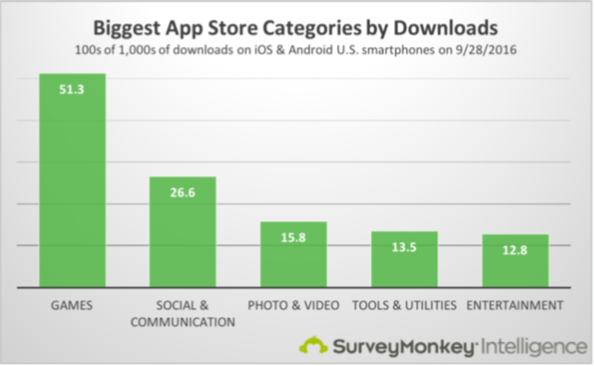
Sonders 2016
11/14/18
4

Slide 5
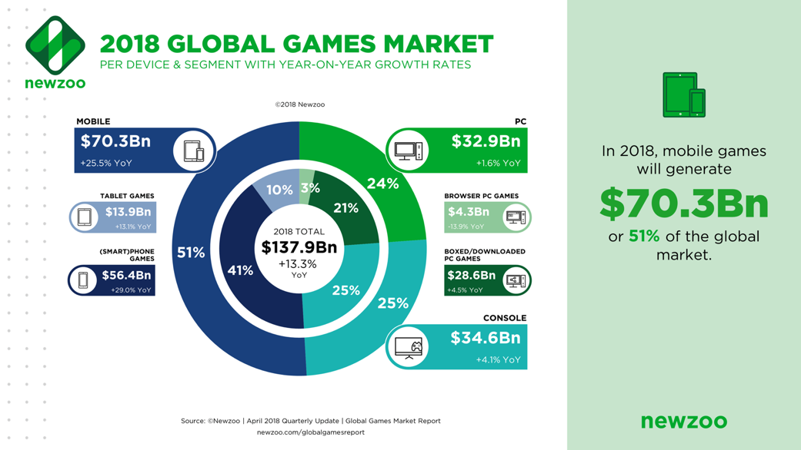

Slide 6
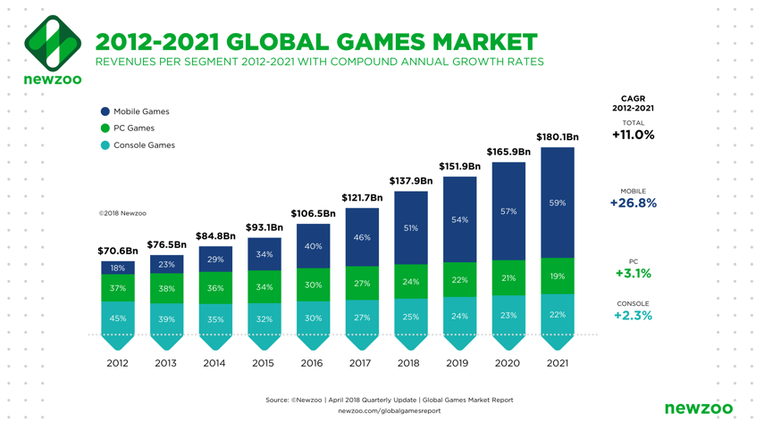

Slide 7
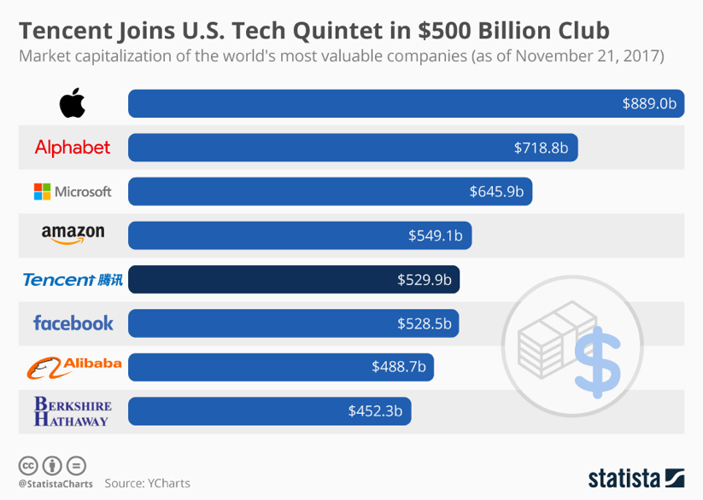

Slide 8
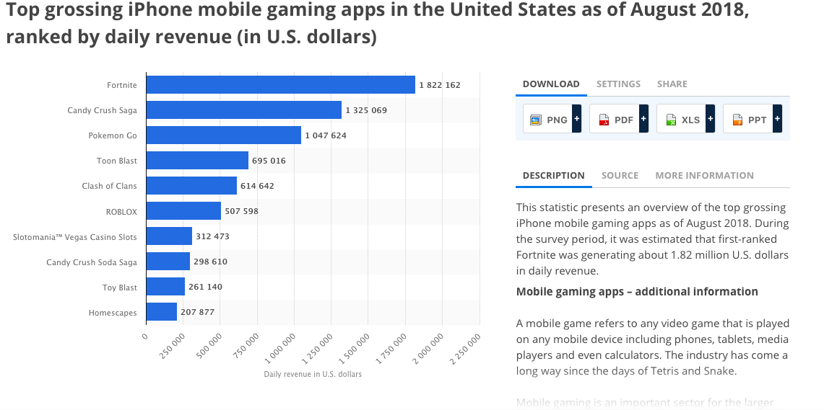

Slide 9
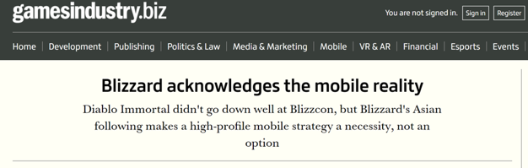


Slide 10
Market Overview & The Business of Mobile Gaming
Models of Mobile Gaming
The Cost of Mobile Gaming
Privacy Considerations
Intellectual Property Considerations

Slide 11
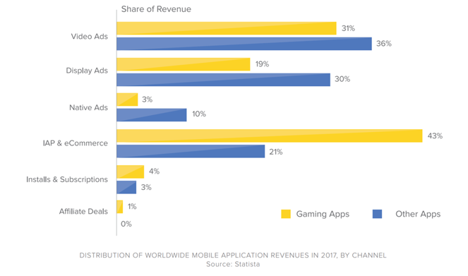
Models of revenue
Up-Front App Purchase
Subscription Based
“Freemium”

Slide 12
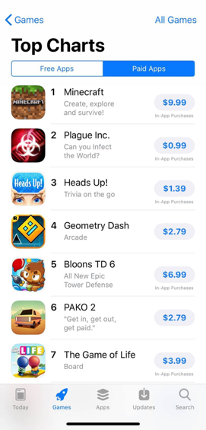
Up-front app purchase model
Generally ranges from $0.99 to $15
More popular for productivity-type apps
Still includes in-app purchases

Slide 13
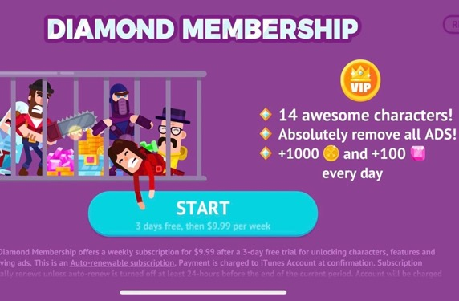
Subscription Model
In 2016, Apple opened up subscription option for all apps on the App Store, including games​
Still relatively uncommon in games, but some apps have begun to use it as an alternative to microtransactions​
  Supercell’s Boom Beach recently started offering two different subscriptions: “Endless Reserves” which removes the time constraints related to training troops for $9.99/mo and “Extra Builder” which allows a player to build two buildings at the same time for $2.99/mo

Slide 14
“Freemium” model

Slide 15
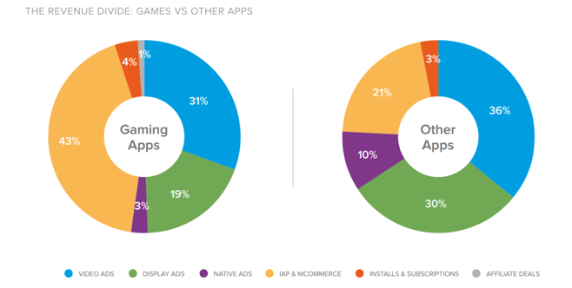
“Freemium” Model

Slide 16
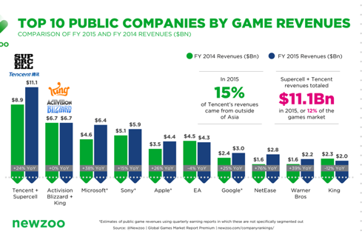
Who are the developers?
Anyone can develop and publish a mobile game
Developers range in size from global giants like Tencent, King, and Supercell to small teams or solo indie developers

Slide 17

Who are the developers?
Even solo developers can create hits
Flappy Bird, created by Vietnamese developer Dong Nguyen, was the most downloaded app in the free category of the iOS App Store as of January 2014
  At its popularity-peak, the game earned $50,000 US per day from in-app advertisements
  Mr. Nguyen claims that the game took him "2 to 3 days at best" to create

Slide 18
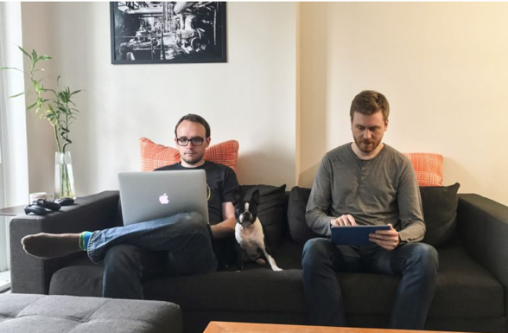
APPLE'S 2017 GAME OF THE YEAR IN 12 COUNTRIES: SPLITTER CRITTERS
“We work wherever we want, but primarily home, coffee shops, and the Vancouver Public Library – anywhere that has power and internet, basically,” says Ringrose. “I’ve got a second bedroom and den that have been converted into a small office space where most of the magic happens. I’ve got a 2015 MacBook Pro to do all the heavy lifting, and a drawer full of old phones that I use as test devices. It’s simple, but that’s all you really need. Jason’s home office is a few blocks away, too, so it’s pretty convenient if we ever need to work in the same physical space.”

Slide 19
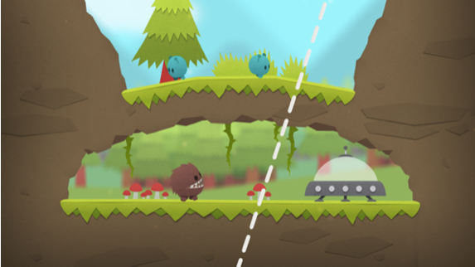
SPLITTER CRITTERS
“Splitter Critters started off in a game jam in April 2016,” says Ringrose, referencing a type of event that sees small groups of creators building games in just a few days, often over a weekend. “Our theme was ‘shapeshift.’ We interpreted that literally and made a game about shifting the shape of the world to get critters back to their home. We only had 72 hours to concept, design, and develop a playable game, so there was no time to second guess our decisions or overthink things. These constraints were a great catalyst for creativity, so what we came up with was very unique and unlike any other game we’d played before.”

Slide 20
Market Overview & The Business of Mobile Gaming
Models of Mobile Gaming
The Cost of Mobile Gaming
Privacy Considerations
Intellectual Property Considerations

Slide 21
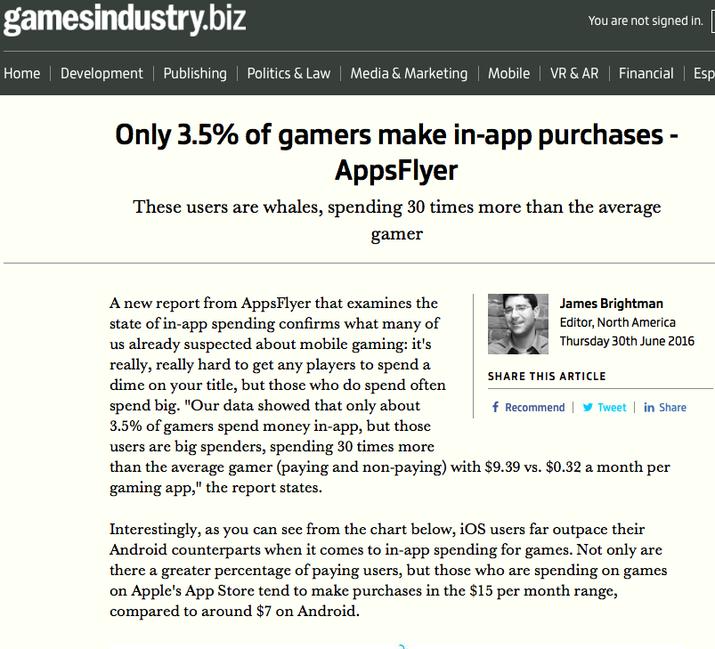
In-app purchases
How Lucrative are in app purchases?

Slide 22
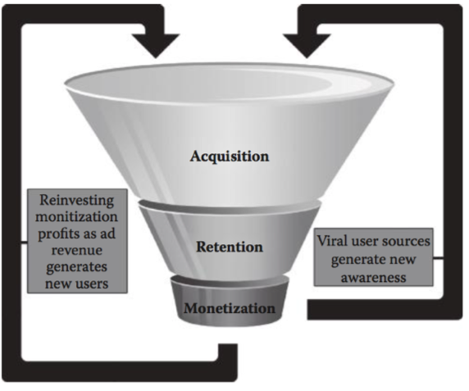
Why Does it Work?
700,000 Apps available on the App Store
35 billion Downloads
Apple takes 30% of all sales, and still has paid out $6.5 Billion in Royalties
Average of $9,286 per app
However, apps are like books; There are a few top sellers and thousands you haven't heard of

Slide 23
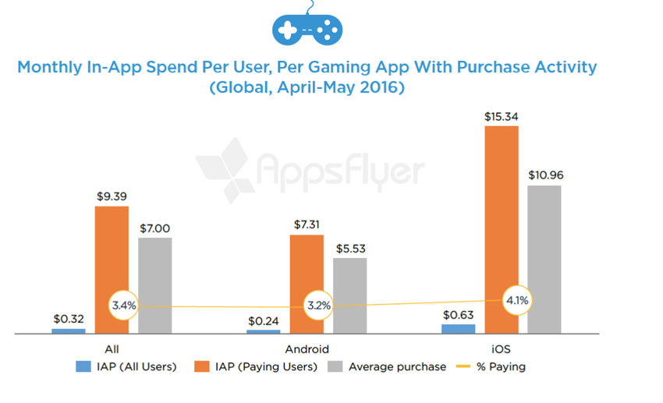
Who spends more money on games?
11/14/18
23

Slide 24
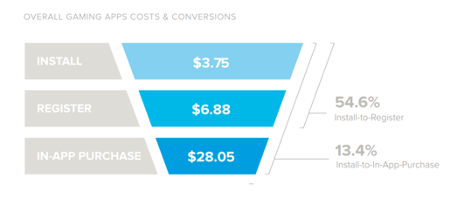
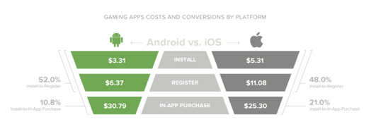
Costs at each level

Slide 25
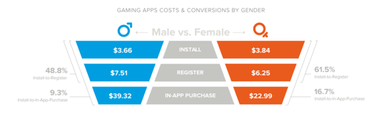
Costs at each level

Slide 26
Market Overview & The Business of Mobile Gaming
Models of Mobile Gaming
The Cost of Mobile Gaming
Privacy Considerations
Intellectual Property Considerations

Slide 27
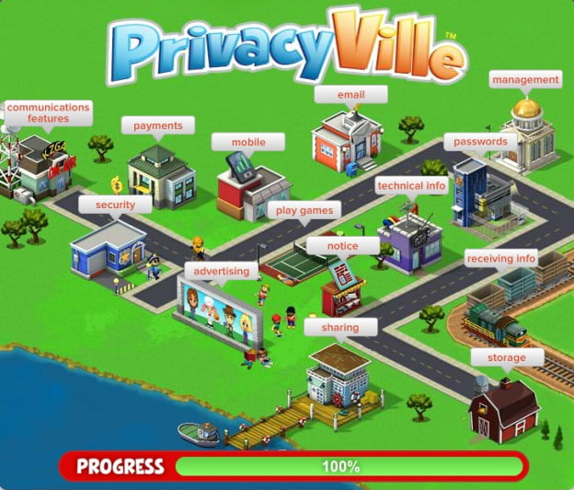
Welcome to

Slide 28


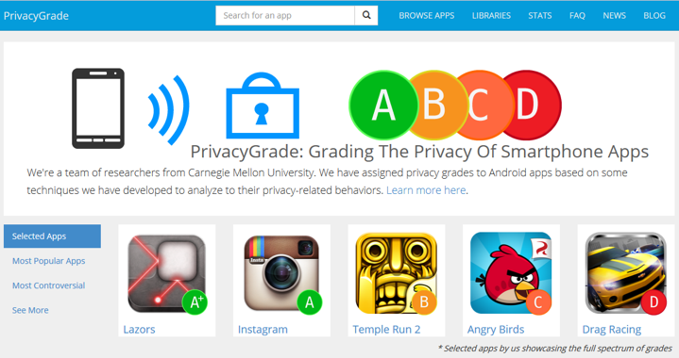
Privacy grade
Team of researchers from Carnegie Mellon University assigned privacy grades to Android Apps
Grades based on a measurement of the gap between people’s expectations of an app’s behaviour and the app’s actual behaviour
What apps do you expect to score lowest?

Slide 30
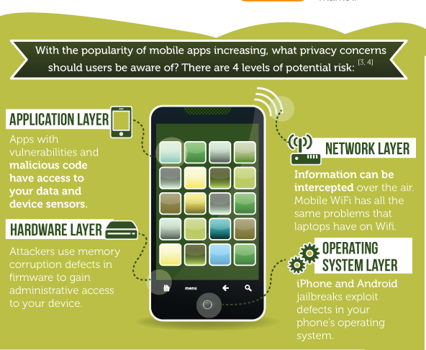

Slide 31
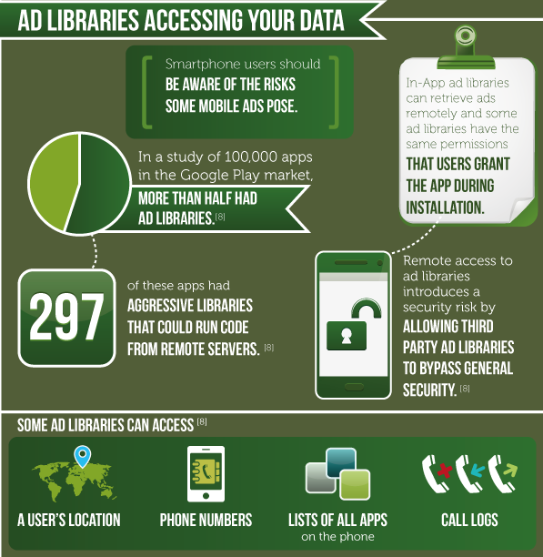

Slide 32
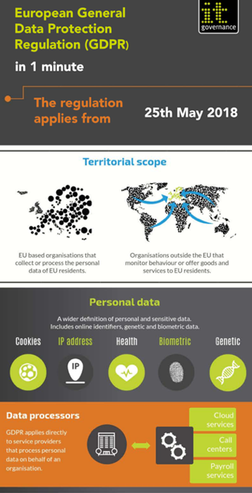
Major Privacy law modernization – gdpr
EU introduced the General Data Protection Regulation (GDPR) in May 2018
Considered the world’s strongest data protection rules, and intended to harmonize Europe’s data privacy laws

Slide 33
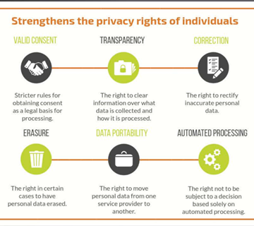
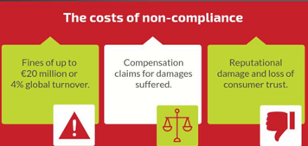

Slide 34
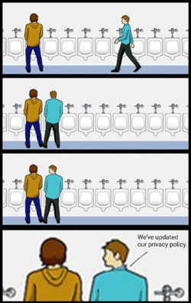
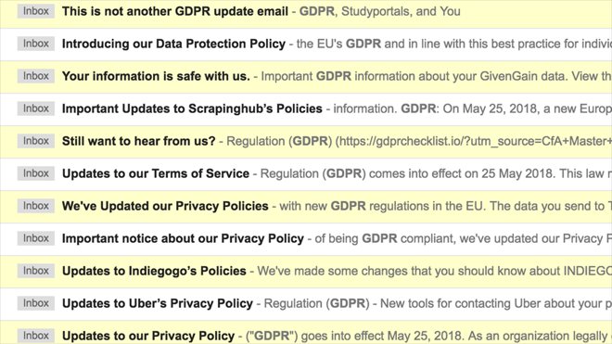

Slide 35

GDPR - game dev’s puzzling requirements
For most media outlets, GDPR compliance is relatively straightforward
  Remove all tracking and ad scripting unless consent is given
  After GDPR, USA Today’s EU site content load went from over 5MB to 0.5MB
For game developers, GDPR compliance is more murky
  Tracking and advertising deeply embedded in both the coding and financing of mobile gaming

Slide 36
GDPR - game dev’s puzzling requirements
GDPR Article 25
  Requires publishers to build proper handling of user privacy into everything they create going forward
  Often referred to as “Privacy by Desgin”
  This means that on top of retro-fits, all new products must have built-in proper privacy controls
These requirements have already proven too much for some developers, who have chosen simply to shutter old titles

Slide 37
Components of compliance
No form requirement for GDPR compliance
Different companies have adopted varied approaches

Slide 38
Components of compliance - consent
Recommendation checklist from the Information Commissioner’s Office UK
☐ We have checked that consent is the most appropriate lawful basis for processing.
☐ We have made the request for consent prominent and separate from our terms and conditions.
☐ We ask people to positively opt in.
☐ We don’t use pre-ticked boxes or any other type of default consent.
☐ We use clear, plain language that is easy to understand.
☐ We specify why we want the data and what we’re going to do with it.
☐ We give separate distinct (‘granular’) options to consent separately to different purposes and types of processing.
☐ We name our organisation and any third party controllers who will be relying on the consent.
☐ We tell individuals they can withdraw their consent.
☐ We ensure that individuals can refuse to consent without detriment.
☐ We avoid making consent a precondition of a service.
☐ If we offer online services directly to children, we only seek consent if we have age-verification measures (and parental-consent measures for younger children) in place.

Slide 39
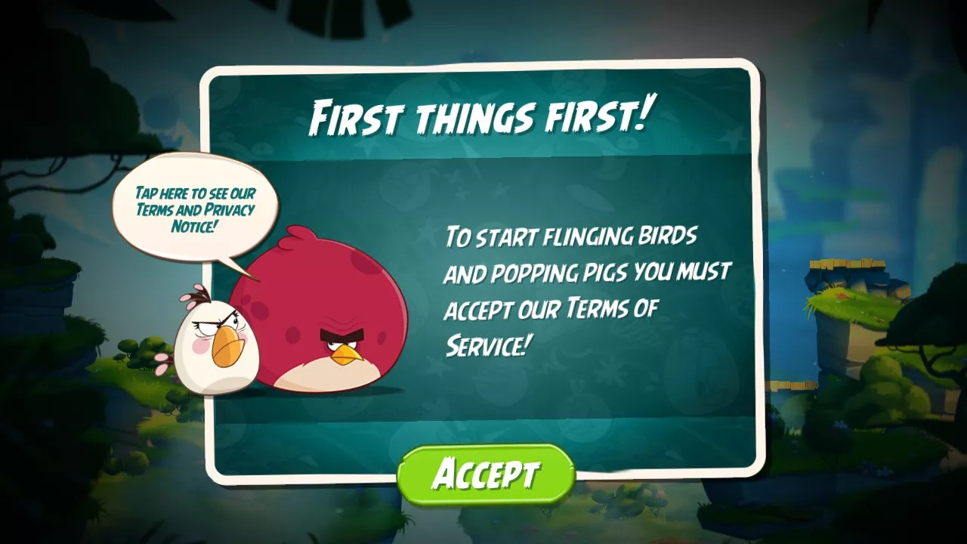
Components of compliance - consent
Hard gates: you must agree to the ToS and Privacy Policy in order to access the games functionality

Slide 40


Slide 41
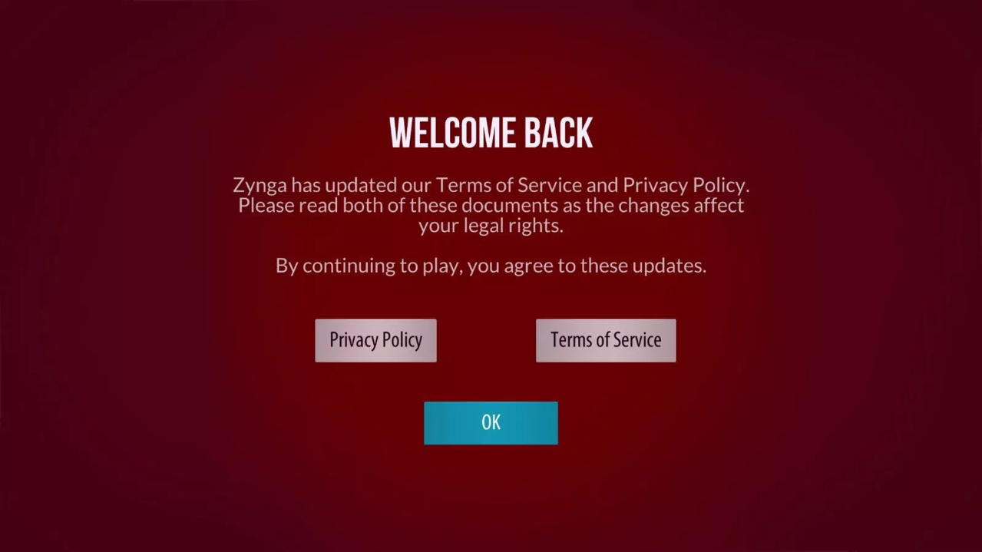

Slide 42
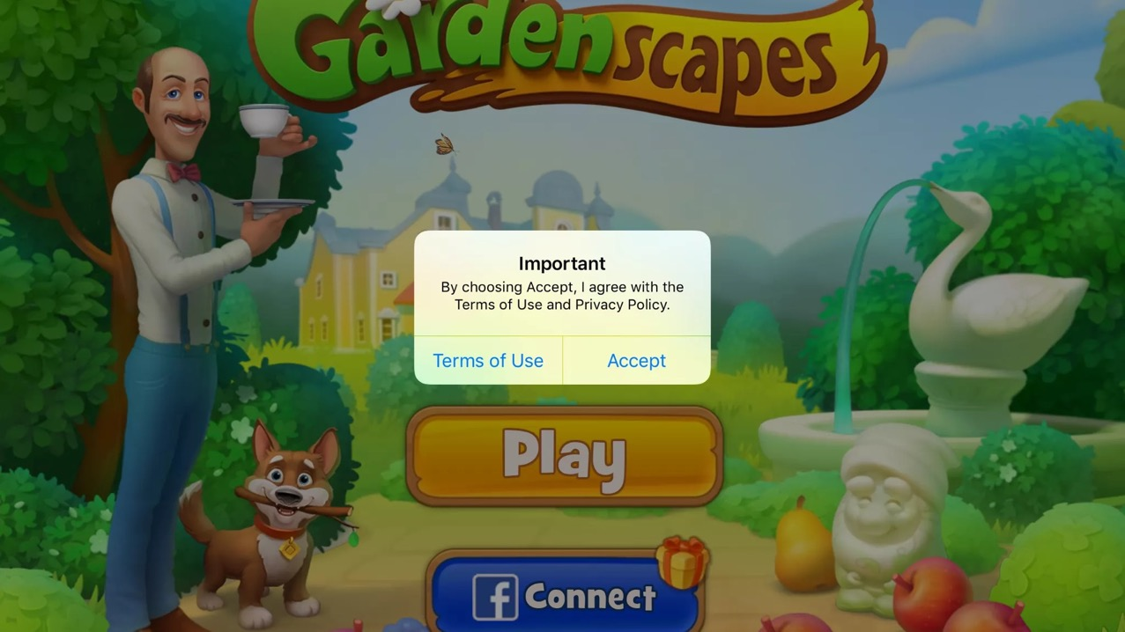

Slide 43
Components of compliance - consent
Recommendation checklist from the Information Commissioner’s Office UK
☐ We have checked that consent is the most appropriate lawful basis for processing.
☐ We have made the request for consent prominent and separate from our terms and conditions.
☐ We ask people to positively opt in.
☐ We don’t use pre-ticked boxes or any other type of default consent.
☐ We use clear, plain language that is easy to understand.
☐ We specify why we want the data and what we’re going to do with it.
☐ We give separate distinct (‘granular’) options to consent separately to different purposes and types of processing.
☐ We name our organisation and any third party controllers who will be relying on the consent.
☐ We tell individuals they can withdraw their consent.
☐ We ensure that individuals can refuse to consent without detriment.
☐ We avoid making consent a precondition of a service.
☐ If we offer online services directly to children, we only seek consent if we have age-verification measures (and parental-consent measures for younger children) in place.

Slide 44
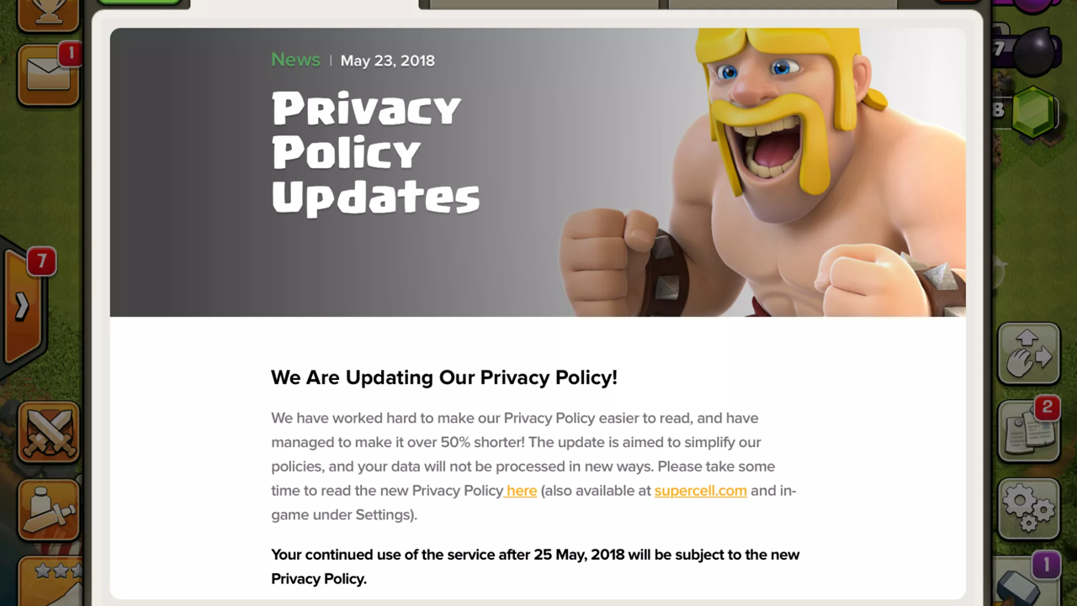
Components of compliance - consent
Other developers are providing notice of updates to their privacy policy

Slide 45


Slide 46
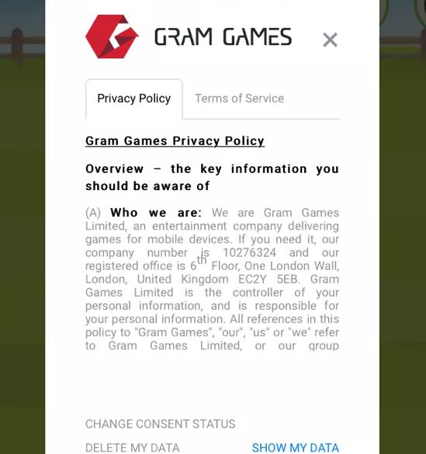
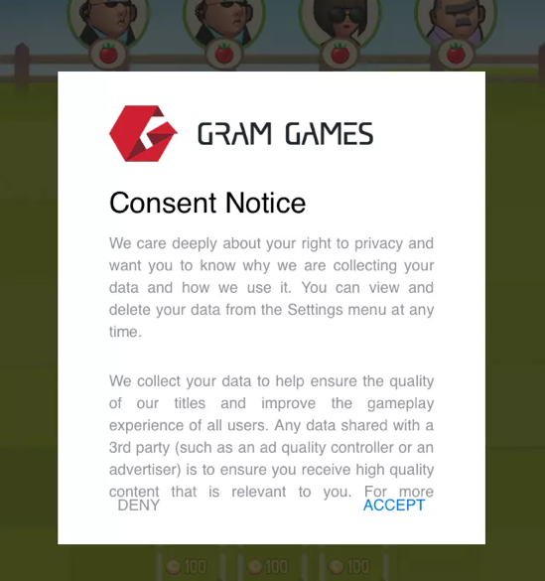

Slide 47
Components of compliance - consent
Recommendation checklist from the Information Commissioner’s Office UK
☐ We have checked that consent is the most appropriate lawful basis for processing.
☐ We have made the request for consent prominent and separate from our terms and conditions.
☐ We ask people to positively opt in.
☐ We don’t use pre-ticked boxes or any other type of default consent.
☐ We use clear, plain language that is easy to understand.
☐ We specify why we want the data and what we’re going to do with it.
☐ We give separate distinct (‘granular’) options to consent separately to different purposes and types of processing.
☐ We name our organisation and any third party controllers who will be relying on the consent.
☐ We tell individuals they can withdraw their consent.
☐ We ensure that individuals can refuse to consent without detriment.
☐ We avoid making consent a precondition of a service.
☐ If we offer online services directly to children, we only seek consent if we have age-verification measures (and parental-consent measures for younger children) in place.

Slide 48
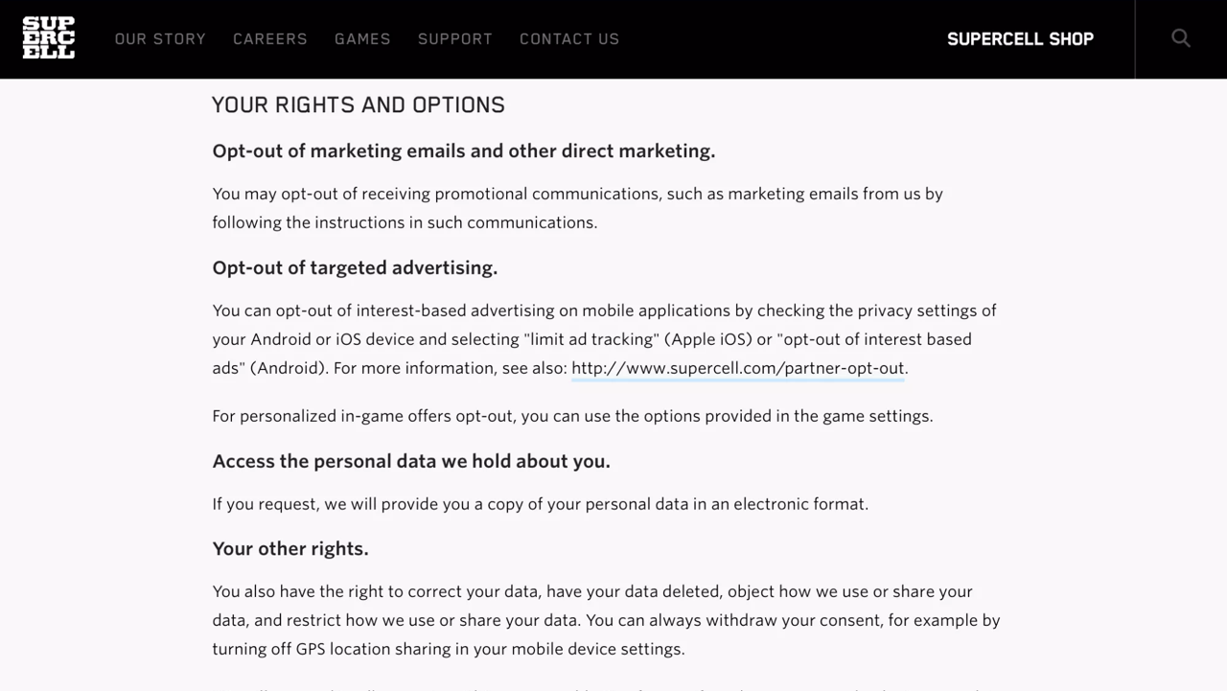
Components of compliance – other rights
No consensus on best strategies for compliance yet

Slide 49


Slide 51
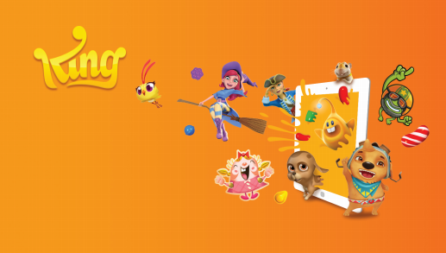
Sample Privacy Policy
https://king.com/privacyPolicy

Slide 52
GDPR-K
Recital 38: Special protection of children's personal data
  ¹Children merit specific protection with regard to their personal data, as they may be less aware of the risks, consequences and safeguards concerned and their rights in relation to the processing of personal data.
  ²Such specific protection should, in particular, apply to the use of personal data of children for the purposes of marketing or creating personality or user profiles and the collection of personal data with regard to children when using services offered directly to a child.
  ³The consent of the holder of parental responsibility should not be necessary in the context of preventive or counselling services offered directly to a child.

Slide 53

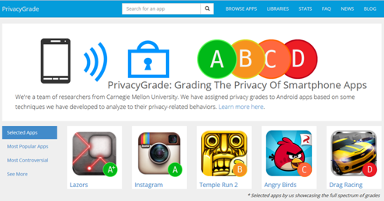

Slide 54
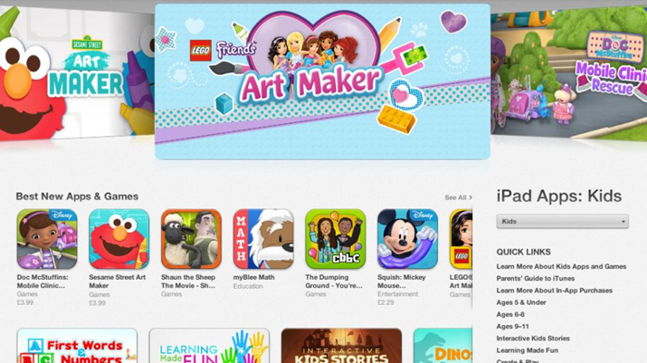
Freemium for kids
In ad-supported freemium models, the player’s data is the commodity. So what legal concerns arise when that player is a child?

Slide 55
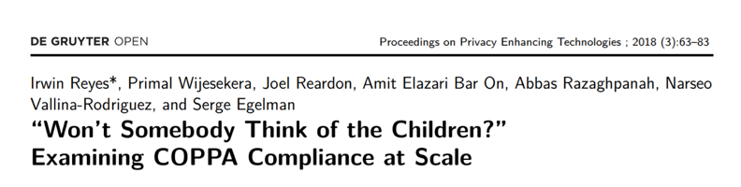
Children’s Online Privacy Protection Act (COPPA) is a US federal statute which regulates how mobile apps, games and websites are allowed to collect and process personal information from children under the age of 13
  Prohibits certain data collection practices, while others are permissible with parental consent
This 2018 study from the International Computer Science Institute analyzed 5,855 of the most popular free children's apps on the Android App Store for compliance with COPPA
  Submission onto the Designed for Families program of the App Store includes an agreement to abide by COPPA

Slide 56

  They found that the majority were not in compliance with COPPA
    28% accessed sensitive data protected by Android permissions
    73% transmitted sensitive data over the Internet
  COPPA requires any geolocation information to have verifiable parental consent
    706 apps included location permissions, and 235 were observed actually accessing GPS coordinates
    In each of these, “The Monkey” was able to access this geolocation functionality, implying that verifiable parental consent is not being obtained

Slide 57

On the note of Parental Consent
Acceptable methods include having the parent:
sign a consent form and send it back to you via fax, mail, or electronic scan;
use a credit card, debit card, or other online payment system that provides notification of each separate transaction to the account holder;
call a toll-free number staffed by trained personnel;
connect to trained personnel via a video conference;
provide a copy of a form of government issued ID that you check against a database, as long as you delete the identification from your records when you finish the verification process;
answer a series of knowledge-based challenge questions that would be difficult for someone other than the parent to answer; or
verify a picture of a driver's license of other photo ID submitted by the parent and then comparing that photo to a second photo submitted by the parent, using facial recognition technology.

Slide 58


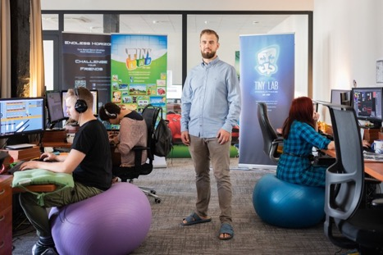
In the study, developer TinyLab singled out as particularly egregious
  81 of 82 apps shared GPS coordinates with advertisers
  Advertisers such as MoPub use this data for behavioral advertising, which is explicitly prohibited under COPPA
Fun Kid Racing (10 - 50M installs)
Disney’s “Where’s My Water? Free” (100 - 500M installs)

Slide 59
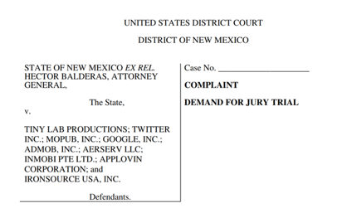
Filed September 2018
1. This action is brought to protect children in the State of New Mexico from Defendants’ surreptitious acquisition of their personal information for the purposes of profiling and targeting them for commercial exploitation.
2. Defendants design, develop, and/or market mobile gaming applications (“apps”) expressly for children. When children play Tiny Lab’s gaming apps on their mobile devices, their geolocation, demographic characteristics, online activity, and other personal data, are inescapably—and without verifiable parental consent—exfiltrated to third parties and their marketing networks in order to target the children with advertisements based on their own personal information. This conduct endangers the children of New Mexico, undermines the ability of their parents to protect children and their privacy, and violates state and federal law.

Slide 60
3. Defendants are app developer Tiny Lab and advertising companies that Tiny Lab works with in its child-directed apps: Twitter, MoPub, Inc., Google, Inc [...] The apps at issue here are—in substance, style, and marketing—clearly and indisputably designed for children. Their names alone reflect their appeal to children, including toddlers: Fun Kid Racing, Candy Land Racing, Baby Toilet Race: Cleanup Fun, and GummyBear and Friends Speed Racing.
4. Alarmingly, Tiny Lab’s CEO states that it is precisely because the company’s apps are directed at children that it engages in tracking and user profiling. In an interview, he laments the difficulty of monetizing children, stating “there is a low buying power of our players who are mainly under 13 years old. It’s hard to convince them to spend their money on additional game items or levels as most of them have to ask their parents for the purchase.” Accordingly, the company relies on in-app advertising fueled by surreptitious data collection.

Slide 61
5. […] Defendants have embedded coding in the apps that allows them to exfiltrate children’s data as they play. These bits of coding are called software development kits (or “SDKs”)… Once embedded, the SDKs allow the app to communicate directly with the advertising companies (the SDK Defendants), sending data and advertisements back and forth. The SDK sends the child’s data back to the SDK Defendants, where it is analyzed, stored, and used to build increasingly-detailed profiles of child users. It is also shared with and sold to myriad third-parties so that each can continue to build their own profiles. All of this activity serves one primary purpose: to learn more about the child in order to send her highly-targeted advertisements.

Slide 62
7. […] This conduct is condoned by Defendant Google, which fraudulently facilitates and furthers Tiny Lab’s marketing of its apps as being safe and appropriate for children in Google’s app marketplace (the Google Play Store)… Google’s bad acts are compounded because it represents to parents and guardians that Tiny Lab’s apps are compliant with COPPA—despite express knowledge that this is not true—and safe for children. Indeed, Google itself is one of the SDK Defendants whose embedded coding tracks and profiles children.
8. […] Forensic testing reveals that the SDK Defendants’ software embedded in Tiny Lab’s gaming apps collect highly-sensitive personal data, including a child’s precise location within +/- 5 meters, constantly updated.

Slide 63
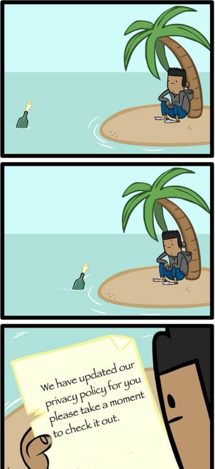
To wrap up...
Most of the law in this area is in its infancy
Doesn't hurt to read your Privacy Policies
Remember: if it's free, you are the commodity

Slide 64
Market Overview & The Business of Mobile Gaming
Models of Mobile Gaming
The Cost of Mobile Gaming
Privacy Considerations
Intellectual Property Considerations

Slide 65
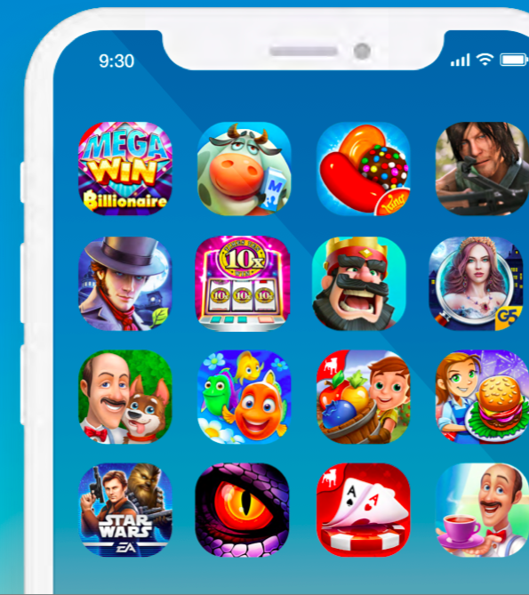
Intellectual Property Rights in Mobile Games

Slide 66
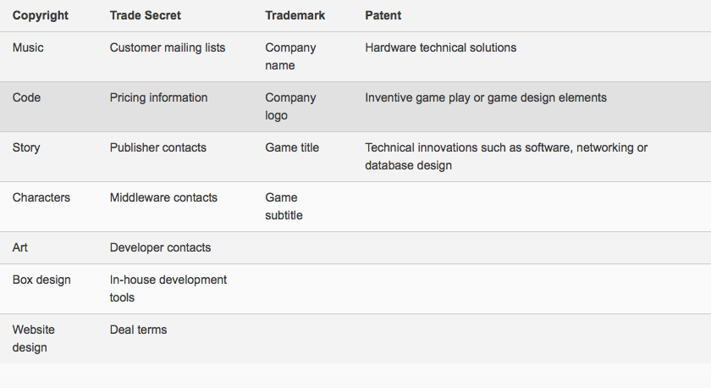
Types of IP
Intellectual property (“IP”) relates to intangible assets, including inventions, brands, new technologies, source code and artistic works. More specifically, IP pertains to patents, trade-marks, copyright and industrial design. IP also extends to trade secrets and confidential information; however, these latter two categories are not governed by a specific statute, unlike the other kinds of IP in Canada.

Slide 67
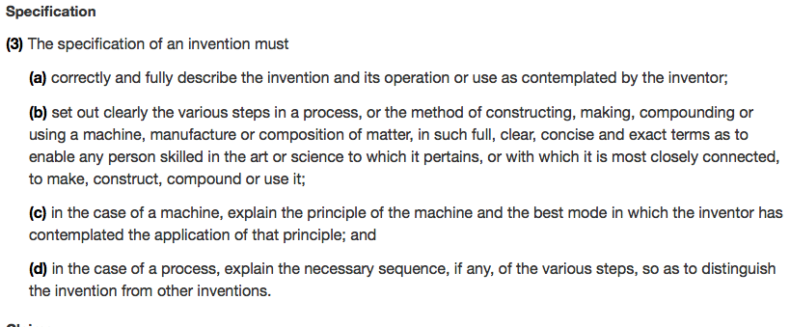
Patents
Patent Act (R.S.C., 1985, c. P-4)
Limited Time Protection for an Invention
Entitles the patent owner to the exclusive right to make, use and sell his or her invention in exchange for full and clear disclosure on how to work the invention.
An invention means any new and useful art, process, machine, manufacture or composition of matter, or any new and useful improvement in any art, process, machine, manufacture or composition of matter.
Unlawful making, using and selling of an invention can result in a finding of patent infringement and relief including damages and injunctions

Slide 68
Are Mobile Video Games subject to patent law?
Maybe...
In order to get a patent in Canada, the "invention" at issue needs to be under patentable subject matter, and must meet the following criteria: utility, novelty, and non-obviousness
Patent law generally excludes computer programs
Due to the complex requirements for the grant of patents, the costs for obtaining and enforcing a patent may be costly

Slide 69
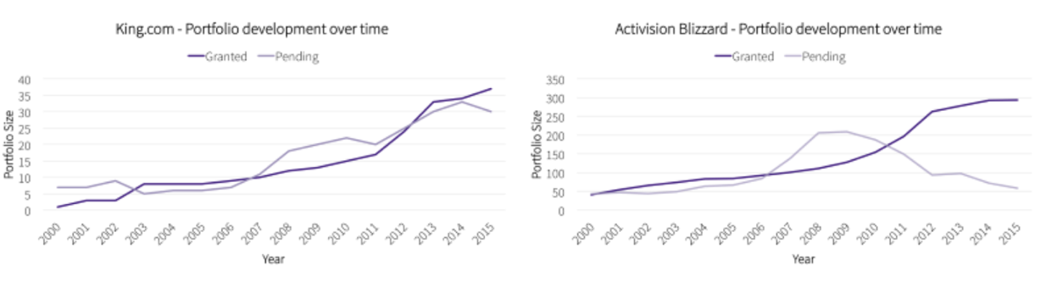
To be Clear... large mobile game companies heavily pursue patents

Slide 70

Copyright
Copyright relates to new original artistic, literary, dramatic or musical works.
It provides for the exclusive legal right to produce, reproduce, publish or perform an original literary, artistic, dramatic or musical work.
Copyright automatically subsists in the work created. Copyright may also be registered, which provides further support for the presumption of validity.
In many countries, computer programs, whether in source or object code, are protected under copyright. The major advantage of copyright protection lies in its simplicity. Copyright protection does not depend on any formalities such as registration or the deposit of copies in the 151 countries party to the Berne Convention for the Protection of Literary and Artistic Works. This means that international copyright protection is automatic - it begins as soon as a work is created.

Slide 71
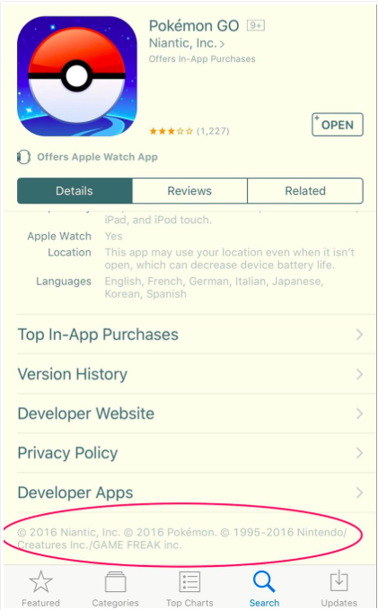
Copyright Act (R.S.C., 1985, c. C-42)
There is no established legal classification for video games under Canadian copyright law. In this regard, the Canadian Copyright Act protects―every original literary, dramatic, musical and artistic work
Aspects of a particular video game may largely be protected as a computer program, given that a video game is in essence akin to software
Under the case law of the Supreme Court of Canada, an original work under the Copyright Act is one that originates from an author and is not copied from another work. Authorship results from the exercise of skill and judgment. Such skill and judgment must not be so trivial that they could be characterized as a purely mechanical exercise.

Slide 72

Trade-Marks
Trade-marks Act, RSC 1985, c T-13, s 2.
A trade-mark is unique and identifies the source of the goods and services with which it is associated. It may consist of a combination of letters, words, sounds or designs that distinguishes one company’s goods or services from those of others in the marketplace.
By registering a trade-mark, you protect your mark from misuse by others. A registered trade-mark entitles the trade-mark owner to exclusive right to use that trade-mark in association with the identified goods and services throughout Canada for 15 years.
Trade-mark rights may also arise through use of a trade-mark at common law. Although certain IP protection exists for non-registered trade-marks, registration provides additional benefits to the owner including additional remedies in the event of trade-mark infringement and passing off.

Slide 73
Industrial Design
TRADE SECRETS AND CONFIDENTIAL INFORMATION
Industrial design relates to the features of a product that appeal to the eye. This includes things like the pattern on a clothing garment, the shape of a computer console, the contour of a bottle. Distinctive and attractive features may give a product marketplace advantages and as such can be an important part of your IP assets
Industrial Design Act, RSC 1985, c I-9, s 2.
Trade secret typically refers to things like formulae, processes and patterns and more generally to valuable technical information that is kept confidential. Confidential information typically refers to valuable information that is not public and is kept confidential and may apply to things like price lists, client lists and other customer information.

Slide 74

WHAT IS SOURCE CODE, AND IS IT PROTECTED?
Since mobile apps are software applications running on a mobile device, each is designed with a unique source code that allows it to run on a desired platform. Source code is a set of instructions for computers and mobile devices written in a human-readable computer language that facilitates the actions of the computer or mobile device. Source code meets the standard for copyright protection because it is an original work of authorship designed by the app developer fixed in a tangible medium.

Slide 75
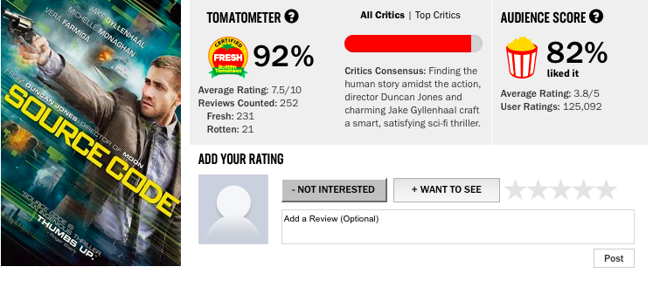

Slide 76
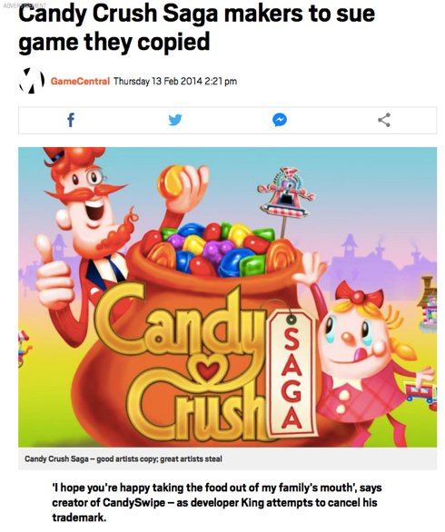

Litigating Copyright Infringement & Trade-Mark Claims

Slide 77
Copyright Infringement: Yes or No?
Cinar Corporation v Robinson, 2013 SCC 73
Copyright infringement occurs when a copyrighted work, or any substantial part of a copyrighted work, has been reproduced without the consent of the owner of the copyright. In considering what constitutes a "substantial part" of a work, the Supreme Court noted that it is a "flexible notion", which is "a matter of fact and degree". In fact, the Copyright Act protects authors against both literal and non-literal copying, so long as the copied material forms a substantial part of the infringed work. However, the Supreme Court again cautioned about the need to strike an appropriate balance between giving appropriate protection to the skill and judgement of authors in their expression of ideas, and leaving ideas and elements in the public domain free to all to draw upon.

Slide 78

Opposing View
Navitaire Inc v Easyjet Airline Co. and BulletProof Technologies Inc. [2004] EWHC 1725 (Ch) (30 July 2004)
“Take the example of a chef who invents a new pudding. After a lot of work he gets a satisfactory result, and thereafter his puddings are always made using his written recipe, undoubtedly a literary work. Along comes a competitor who likes the pudding and resolves to make it himself. Ultimately, after much culinary labour, he succeeds in emulating the earlier result, and he records his recipe. Is the later recipe an infringement of the earlier, as the end result, the plot and purpose of both (the pudding) is the same? I believe the answer is no.”

Slide 79
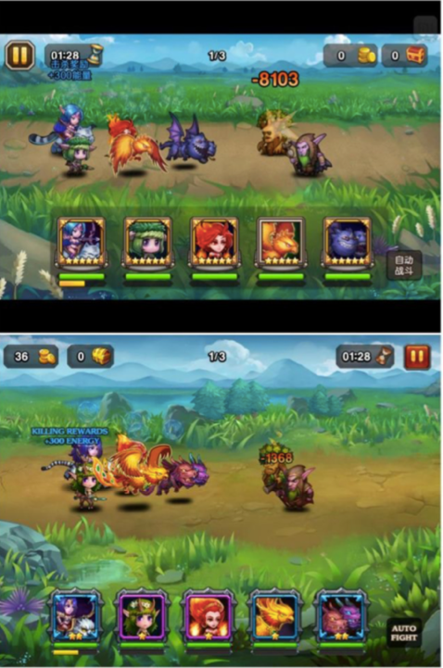
So What do you think?
Blizzard Entertainment, Inc. v. Lilith Games Co. (US)

Slide 80
No Infringement: scènes à faire doctrine
An intellectual property term used in reference to copyright to exclude from copyright and prevent alleged holders of copyright from attempting to assert exclusive ownership of elements of a work that are standard, stock or common either in general or in relation to a particular topic.

Slide 81

Yes or no?
TETRIS HOLDING, LLC AND THE TETRIS COMPANY, LLC V XIO INTERACTIVE, INC. (US 2012)

Slide 82
Copyright infringed!
In the suit, Xio admitted to downloading Tetris and conducting extensive research to determine which parts of the game could be legally copied.
In the suit, Xio argued that what they copied were the rules of the game, which they argued were not an “original expression” and, thus, not subject to copyright infringement claims. The court examined each of Xio’s defenses, rejected the defenses, and granted Tetris Holding’s motion for summary judgment.
This copying was so clear that both the merger and scènes à faire defenses were quickly dismantled.

Slide 83

Spry Fox LLC v. LOLApps, Inc.

Slide 84
Copyright likely Infringed... Maybe?
This case started with a business relationship that broke down
The two companies were developing an app together, but LOL APPS dropped out and created an app of their own that was substantially similar to the one the two companies were working on
In a motion to dismiss, the court rejected many of the similarities as uncopyrightable, but cited:
  "the application of uncontroversial copyright principles to the ever-evolving field of video games"
The companies settled for an undisclosed amount

Slide 85

Kung fu v glu
Kung Fu proposed a game to the Kardashians
Glu developed a substantially similar game
Glu settled with Kung Fu for a substantial amount of money

Slide 86

Flappy Bird & Nintendo
Recall that Flappy Bird was created in a few days by a solo developer
At its peak, it had $50,000 a day in ad revenue
There was speculation that the game was taken down due to a legal challenge by Nintendo

Slide 87


Slide 88

Final Example
Glu Mobile's Deer Hunter 2014 (Left)
Hothead Games' Kill Shot (Right)
“Kill Shot is effectively a complete ripoff of our game Deer Hunter 2014,” said Chris Akhavan, the president of publishing at San Francisco-based Glu Mobile, in an interview with GamesBeat. “The only difference is that in Kill Shot, you are shooting humans. In our game, you are shooting deer and other animals.”
The companies settled for an undisclosed amount, plus continued royalties

Slide 89
Takeaway
The law related to copyright in mobile games has yet to be fully developed, especially in Canada
While it appears that Copyright law generally supports the protection of mobile games in Canada, it has yet to be heavily litigated
The courts in the United States tend to put a strong focus on the originality of the work, while deterring frivolous litigation for games that, while similar, have distinct differences

Slide 90

Final Thought

Slide 91


Slide 92
Should copyright infringement, privacy violations, and reverse coding be covered by insurers?
5 main principles of insurance:
1. Compensation of loss
2. Indemnity limited to the loss
3. Fortuity: The idea that insurance protects against uncertain events
4. Utmost good faith of both the insurer and the insured
5. Consumer Protection: Bargaining Protection between the insured and insurer
BROWN, “PRIVATE INSURANCE AND PUBLIC POLICY”

Slide 93
Application to the Mobile Video Game Context
Insuring against copyright infringement, trademark theft, and privacy violations violate the principle of fortuity, as the party seeking compensation is breaking the law
Most insurance contracts have an exception excluding coverage for illegal acts, but then why is a major insurance broker offering this type of insurance?
Similarities to gambling?

Slide 94


