Slide 1
The Future of Video Games
Made by: Camilla, Klara, Lara and Mette-Marie

Slide 2
Gaming Technologies
Notes:
So, I’m going to talk about the predictions for the future gaming technologies, i.e. how we are going to play video games in the future. Before we dig into it, I want us to start off by making a small poll to see how we in this class play games today (there can be multiple answers).
The poll regarding game genres is very simplified and just takes some of the biggest and most common-known genres.

Slide 3
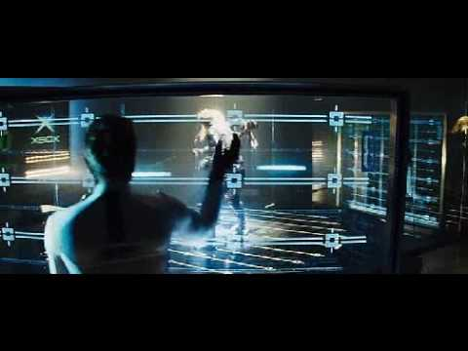
Movie Predictions: The Island (2005)

Slide 4
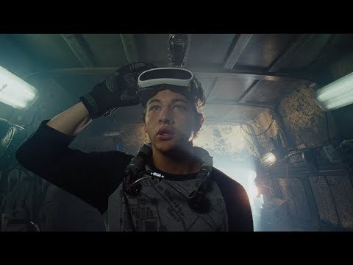
Movie Predictions: Ready Player One (2018)

Slide 5
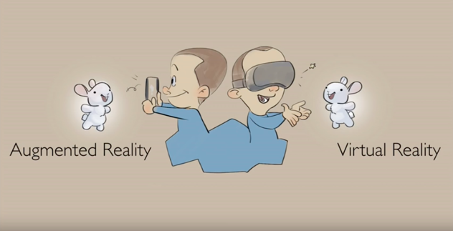
The Big Trends: VR & AR

Slide 6
Market Predictions - 2017-2023
Global augmented reality and virtual reality market is expected to reach $94.4 billion by 2023.
VR is expected to grow at a CAGR of around 26%.
However, during the forecast period, the market for AR devices is expected to grow faster, witnessing a CAGR of 73.8%.
So growth - but even Zuckerberg says 5-10 years for it to reach the “goal”

Slide 7
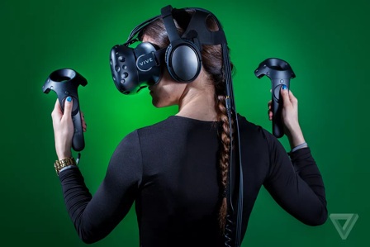
VR - Virtual Reality
Creates a simulated reality/environment
Isolates you from the real world
At the moment it use of VR headset and controllers
Examples: Beat Saber, The Climb, Ready Player One: OASIS beta, Pavlo VR (CS:GO VR)

Slide 8
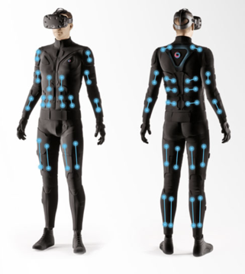
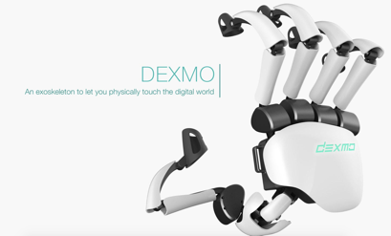
VR - Technology Development
Haptic controllers (ex.: DEXMO)
Haptic suits (ex.: Teslasuit)

Slide 9
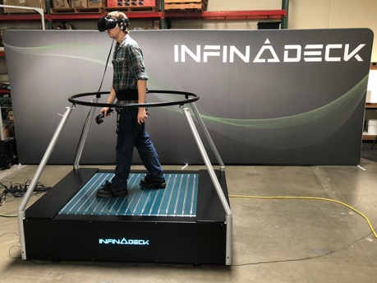
VR Development
VR Treadmills (ex.: Infinadeck)
Going from just turning and moving with a controller to actually move around ourselves with all this technology

Slide 10
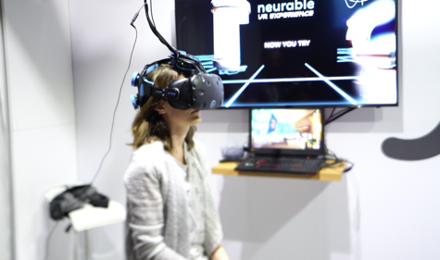
VR Future Gaming
For now: Still quite the work to do
Ready Player One
The competitiveness of esport - CS:VR?
Taking it further: BCI?

Slide 11
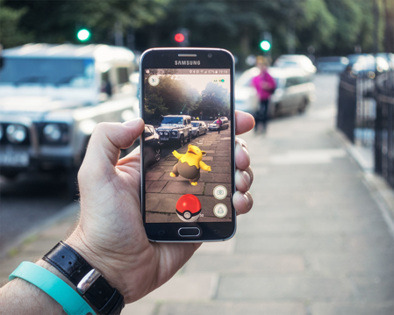
AR - Augmented Reality
Uses existing natural environment
Overlays virtual information
Typically used via phones
AR Glasses (example: Microsoft HoloLens)
Examples: Pokémon GO, Snapchat overlays

Slide 12
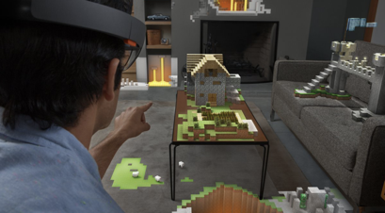
AR In The Future
The multiplayer part will most likely grow
Cooperative games
You will be able to see your friends’ avatar or alike on your own screen
Glasses instead of looking through your phone

Slide 13
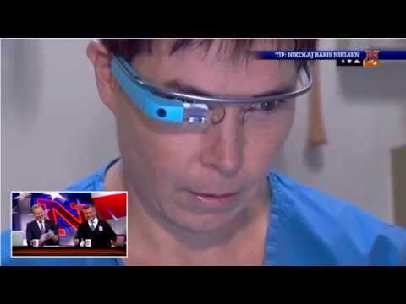
A fun example of Google Glasses

Slide 14
How New Gaming Technology Can Affect The Movie Industry

Slide 15
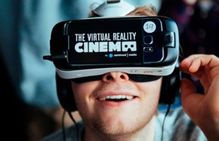
The Future Of Cinema?
The cinema experience is believed to change in the coming years
Earlier this year the IMAX chain opened its first VR cinema
Leading film festivals now have sections dedicated to VR movies
But is the audience ready for VR feature films?

Slide 16
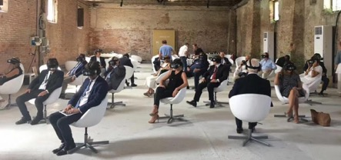
The Future Of Cinema?
Still hurdles to overcome
Equipment is expensive
Difficult to shoot
Is it even storytelling? I it even a movie?
VR consumption is fundamentally different from that of movies

Slide 17
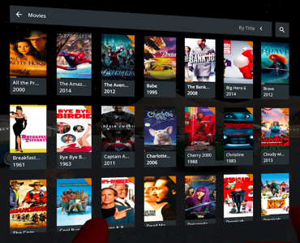
Content Is King
VR needs to reimagine the content
Not suitable for every movie
Needs to offer something new

Slide 18
Adding A Social Touch To Cinema
Flesh and Sand by director Alejandro González Iñárritu
VR movie
Allowing individuals to experience a fragment of a refugee’s journey
Awarded the first Special Achievement Academy Award in over 20 years

Slide 19
Adding a Social Touch to Cinema
Will maybe not replace original cinema but become a new branch
Where is the line between video games and cinema?

Slide 20
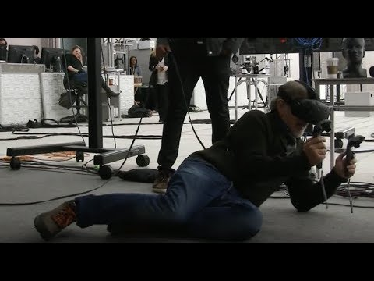
Can also affect the way movies are made

Slide 21
Artificial Intelligence in the Future

Slide 22
AI is a simulation of human intelligence processes by machines. These processes include learning, reasoning and self-correction.

Slide 23
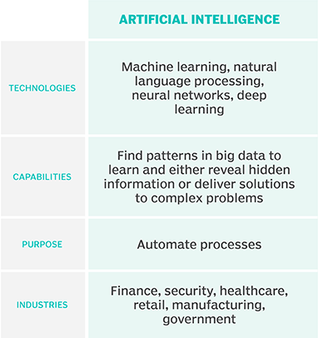
How does it work?

Slide 24
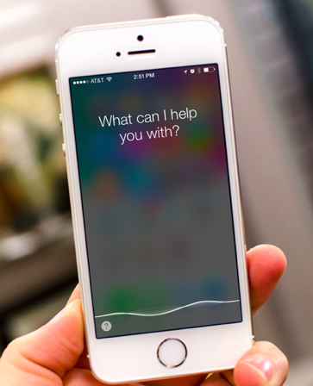
Examples of AI
Robot Pixie (Danish law firm)
Siri (Apple)
Spotify
Netflix
Video games

Slide 25
AI in Future Video Games
Better visuals
More realistic games
Real world vs. virtual world
Personalized games

Slide 26
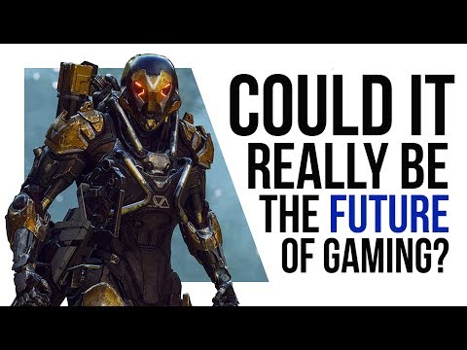

Slide 27
Concerns?

Slide 28
Brexit and the Future of the UK Games Industry

Slide 29
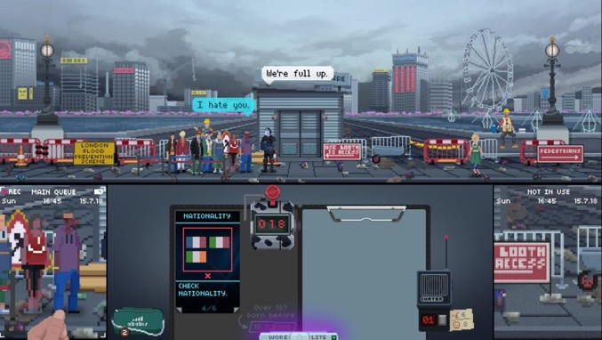

Slide 30
https://www.bbc.com/news/av/uk-politics-44971523/hard-brexit-soft-brexit-no-deal-what-does-brexit-mean

Slide 33
Uncertainty and Bureaucracy
Expenses and Access Difficulties
Relocation to the EU
Loss of Access to EU Talent
Loss of Consumer Rights
Cultural Diminishment

Slide 34
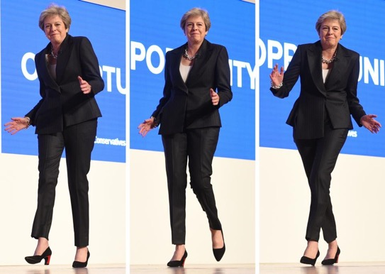
Reciprocal
Arrangements
Funding Initiatives
Free Trade Area

Slide 36
Conclusion

