Slide 1
Video Game Culture and Negative Behaviours

Slide 2
Harassment and Misogyny in Gaming
INTRODUCTION:
Prevalence of Harassment in Gaming
Focus on misogynistic harassment
Gamergate incident
Overview
FBI Investigation and Lawsuits
Canadian cyberbullying and harassment legislation

Slide 3
Harassment in Gaming: A Pervasive Problem
- 74% of study participants harassed while using online gaming platforms.
- 65% of these participants ‘severely harassed’ - repeated and consistent threats of physical violence, cyberstalking, etc
- 29% were ‘doxed’ – had their personal details leaked online by a stranger
- 40% of women harassed because of their gender alone

Slide 4
The Gamergate Incident
August 2014:
- ex-boyfriend of video game developer, Zoe Quinn, writes a blog post detailing the demise of their relationship, and accuses her of sleeping with multiple journalists with the intent of improving reviews of her games. Relentless online harassment of Quinn begins.
- Anita Sarkeesian creates a new episode of her Tropes v Women in Video Games series that corresponds with the attacks on Quinn. Harassment targeting Sarkeesian escalates to unprecedented levels and lasts well into 2015.
October 2014:
- bomb threat made towards lecture Sarkeesian was scheduled to give at Utah State University.
- Brianna Wu comments on Gamergate, and herself becomes subjected to harassment online. As of May 2019, she and her husband still live under aliases.

Slide 5
FBI Investigation
“He admitted that he was the one making the [redacted]. He told me that he has probably called her at least 40 to 50 times with threats. He sometimes just harasses her and tries to get on her nerves. He explained that he gets online in a chat group and she usually gets upset with them for what they are talking about. They recognize that she is upset and then they try to harass her to make her even more upset. The chat group asked [redacted] to call her and threaten her according to [redacted]. [Redacted] told me that he never made any bomb.”
FBI investigation wraps up in September 2015, citing a lack of leads.

Slide 6
Quinn’s Lawsuit
- Quinn faced constant harassment not only about the contents of her ex-boyfriend’s blog and the relationships he speculated about, but also over the lawsuit she tried to pursue against him.
- Dropped the lawsuit against him in 2016, citing harassment as her primary reason for doing so.
“Trying to get the law to protect me has only continually put me in harm’s way.”

Slide 7
Online Harassment and Cyberbullying Laws in Canada
Canadian Human Rights Act:
13. (1) It is a discriminatory practice for a person or a group of persons acting in concert to communicate telephonically or to cause to be so communicated, repeatedly, in whole or in part by means of the facilities of a telecommunication undertaking within the legislative authority of Parliament, any matter that is likely to expose a person or persons to hatred or contempt by reason of the fact that that person or those persons
are identifiable on the basis of a prohibited ground of discrimination
Repealed in 2013 over concerns about the limitations it placed on section 2(b) Charter rights

Slide 8
Online Harassment and Cyberbullying Laws in Canada
Criminal Code:
Criminal Harassment
264:
(1) No person shall, without lawful authority and knowing that another person is harassed or recklessly as to whether the other person is harassed, engage in conduct referred to in subsection (2) that causes that other person reasonably, in all the circumstances, to fear for their safety or the safety of anyone known to them.
(2) The conduct mentioned in subsection (1) consists of
(a) repeatedly following from place to place the other person or anyone known to them;
(b) repeatedly communicating with, either directly or indirectly, the other person or anyone known to them;
(c) besetting or watching the dwelling-house, or place where the other person, or anyone known to them, resides, works, carries on business or happens to be; or
(d) engaging in threatening conduct directed at the other person or any member of their family
Harassing Communications
372:
(1) Everyone commits an offence who, with intent to injure or alarm a person, conveys information that they know is false, or causes such information to be conveyed by letter or any means of telecommunication.
(2) Everyone commits an offence who, with intent to alarm or annoy a person, makes an indecent communication to that person or to any other person by a means of telecommunication.

Slide 9
Sources
News Articles:
https://www.adl.org/news/press-releases/two-thirds-of-us-online-gamers-have-experienced-severe-harassment-new-adl-study
https://kotaku.com/74-of-adults-have-been-harassed-while-gaming-online-s-1836678162
https://www.economist.com/open-future/2019/05/03/the-vile-experiences-of-women-in-tech
https://www.theverge.com/2014/10/6/6901013/whats-happening-in-gamergate
https://www.theverge.com/2017/1/27/14412594/fbi-gamergate-harassment-threat-investigation-records-release
https://www.theguardian.com/technology/2014/oct/17/brianna-wu-gamergate-human-cost
https://www.newsweek.com/fbi-has-file-gamergate-293441
https://www.theguardian.com/technology/2014/oct/15/anita-sarkeesian-feminist-games-critic-cancels-talk
https://www.destructoid.com/new-game-invites-players-to-beat-up-anita-sarkeesian-230831.phtml
https://www.vox.com/2014/9/6/6111065/gamergate-explained-everybody-fighting
https://www.theguardian.com/technology/2014/oct/15/anita-sarkeesian-feminist-games-critic-cancels-talk
https://www.newsweek.com/fbi-has-file-gamergate-293441

Slide 10
Sources
FBI Report:
https://vault.fbi.gov/gamergate/Gamergate%20Part%2001%20of%2001/view
Books
Crash Override: How Gamergate (Nearly) Destroyed My Life, and How We Can Win the Fight Against Online Hate. New York City, NY: PublicAffairs.
Cases:
R. v. Noddle, 2016 BCCA 164
R. v Labrentz, 2010 ABPC 11

Slide 11
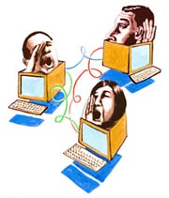
Governance of Crime in Virtual Communities
Notes:
I am going to talk about virtual communities and how behaviors by avatars that simulate sexual crimes are governed. I will describe some examples of virtual sexual crimes committed on various platfomrs and how those platforms have handled complaints of violations but First I am going to show a short video to give you an idea of what ”virtual rape” is.
https://www.youtube.com/watch?v=neTTQLbmhcA

Slide 12
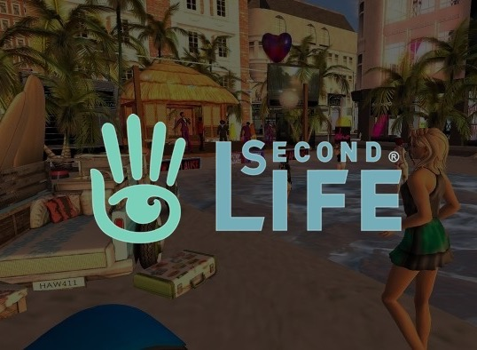
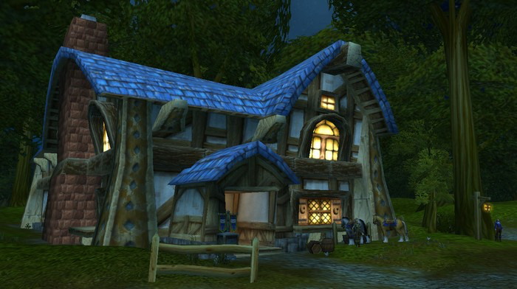
Previous Disputes
Notes:
Now that you have an idea of what it is, I will talk about a few examples/
”Virtual Rape” seems to have been talked about for quite sometime. One of the first mentions being by author Julian Dibble who described a “cyberrape” in a multiplayer computer community/chat room called LambdaMoo where the user known as Mr. Bungle leveraged a subprogram that allowed him to make sexual actions that were falsely attributed to other characters in the virtual community that he described as sexual violations of the avatars.
However, more recently, there have been other cases where video game users have been able to modify code to enable their avatars to simulate sexual activities in both consensual encounters as well as in an effort to ”rape” other characters.
One example of this is in Grand Theft Auto as we saw in the video clip. Palyers were modifying the game’s code to latch onto other characcters and simulate sex. Many users were doing this and then posting videos on youtube
Interestingly with GTA, it is noted that the game does not recognize the action as a crime and doesn’t result in penalties to the user. So clearly in this case, the game administrators have not taken any action.

Slide 13
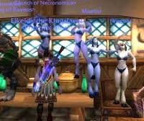
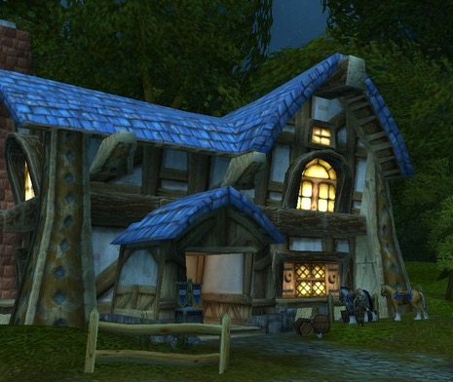
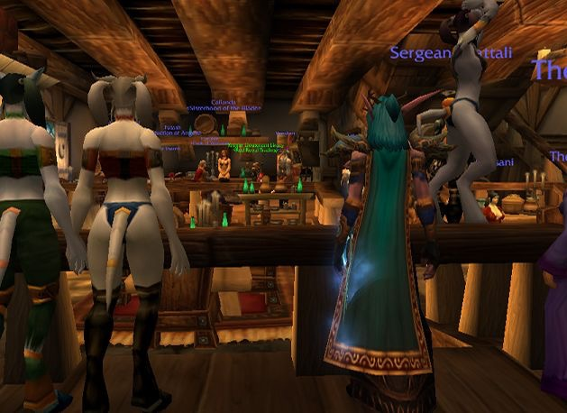
Tavern of Goldshire
Notes:
A second example is the World of Warcraft Tavern of Goldshire. Predatory behaviors on this platform has been described as a mix between Virtual Simulation of Rape and Real Live Messaging on the game where other users request phone numbers and photographs.
The Tavern of Goldshire has been described as a location on a specific ”role playing server” where sexual advances are made through the chat function and as simulated by user’s avatars. However, it was described as more about animation where players would simulate sex through different dances, battles, or spell animations.
One user described being approached by other users and after declining the ”invitation to have sex” characters responded by surrounding her and harassing her further. The user logged off he game and deleted her character.
In response to complaints on the Blizzard Support forum, Blizzard reported that customer service would actively patrol Goldshire Inn on the Moon Guard server on a regular basis and take action for gamers violating the Harassment policy but would limit this to public messages and unsolicited actions.
In this case the developers stepped in and said they would monitor the location for users violating the terms of services but it is unclear whether there was any enforcement.

Slide 14
What is Second Life?
Notes:
Second Life is an important virtual community to talk about because despite not technically being a ”game” I believe it is the platform that has seen a lot of intersection between virtual and offline worlds.
So basically, It is an online virtual world owned by Linden Lab. Although similar to multiplayer online role-playing games (Like World of Warcraft), Second Life is not a game because there is no set objective for its players.
Virtual users create avatars of themselves and can interact with places, objects and other avatars. They can engage in group activities and trade virtual property an services with one another.
2 Fundamental Aspects of Second Life = (1) All content is user generated (2) You can purchase the virtual currency of the game (The Linden Dollar) for real world currency.
Residents are able to create virtual objects and other content and users retain all the rights to their content allowing them to distribute and sell their creations via the marketplace and actually profit.

Slide 15
SECOND LIFE TERMS OF SERVICE
6.1 You will not post or transmit prohibited Content, including any Content that is illegal, harassing or violates any person's rights.
(iii) Stalk, harass, or engage in any sexual, suggestive, lewd, lascivious, or otherwise inappropriate conduct with minors on the Service;
(v) Post, display, or transmit Content that is obscene, hateful, involves terrorism, or is racially, ethnically or otherwise objectionable; or
(vi) Post, display or transmit any Content or conduct or host any activity that is sexually explicit, or intensely violent.
Notes:
The User of Second Life has to Agree to the Terms and Conditions of the Game to be eligible to play. The provision most important for the topic of todays discussion is 6.1(3)(5) and (6).
It is clear that sexual and violent conduct and harassment is not allowed on Second Life but like the other games, there have been reported virtual rapes on second life and there is also a community of users who consensually engage in sexual activities through their avatars including a known “BDSM” community

Slide 16
Second Life and Virtual Rape
Notes:
So this is a headline from a Belgian newspaper that reads Brussels Police were investigating a virtual rape on second life.
From what I have gathered online, similar to the previously mentioned games, there are modifications that users can make to their second life characters in order to be able to “rape” other characters but normally these modifications still require consent from other players.
There are some objects that give users control over another's avatar through code modifications but they are supposed to require an object obtain permission before animating an avatar. This implies theencounters areconsensual, but it isn’t difficult to imagine someone new to virtual worlds or unfamiliar with the objects consent without knowing what is going on.
So again the question is raised on how these encounters should be handled – Should administratos just let it be like in GTA or should they “patrol” the site likein WOW or does it desreve more durastic offline measures?

Slide 17
Moving in the Direction of Real World Protection in Virtual Communities
Intellectual Property Rights
Evans v Linden Research:
Recognized that land purchases in Second Life were equivalent to real property purchases meaning Second Life could not unilaterally reclaim land from its users. Second Life users enjoy copyright protection for virtual land and items they purchase or create.
Notes:
So im not sure what the best answer is and whether there should be accountability by the creators and administators of the game, whetehr tehre should be regulations enacted that all games must follow or whether these simulated sexual advances could ever be policed offline but it is clear that virtual communities are moving towards offline protection in other asepcts of virtual communities.
1 example of this is IP protection granted by second life. In Evans v Linden Research it was recognized that because all content is user generated, the property and land held was equivalent to real property and users enjoy copyright protection for what they purchase or create.

Slide 18
2. Virtual Theft
HabboHotel Investigation:
in 2007, a Dutch teenager was arrested for allegedly stealing virtual furniture worth thousands of euros.
Finnish police again investigated up to 400 cases of theft of virtual furniture and other items in 2010 through phishing attacks.
Notes:
Another example is HabboHotel in which theft of virtual furniture was investigated and prosecuted offline. I think we can make sense of this when considering users are spending real money on virtual objects.

Slide 19
3. XBOX LIVE and Criminal
Charges
Notes:
Another example of the intersection is through Xbox Live and criminal charges being laid for statements made through the Live Chat function on the gaming platform.
In one case, a 13 year old using the “party chat” feature claimed he was going to “shoot up” his middle school resulting in other players calling the police. The student was charged with a false report concerning the use of a firearm in deadly manner.
In another case, another 13 year old faced felony hate crime, harassment, and disorderly conduct charges and a misdemeanor obstruction charge also using the XBOX Live feature with the police being notified.
I think we can all make pretty good sense of this as well because the necessary elements of the crime were all there. The only difference in these cases is xbox live being the medium for how the crime was committed.

Slide 20
Factors to Consider in Whether Virtual Crime Deserve Offline Punishment
Is the Avatar an extension of one’s self?
Type of Virtual Community
Does gaming activity mirror offline motivations
In Sexual Assault specifically, it lacks an element of the crime – physical touch
Notes:
In considering the question of whether virtual crime will ever reach the point of offline punishment and enforcement, I identified a couple of factors that I thought may sway someone one way or the other.
The first consideration is whether an avatar is an extension of one’s self. If so, it could be the case that the violation of a virtual sexual assault is so traumatic and profound that an offline punishment may seem appropriate.
The type of virtual community also may have in an impact. In some articles I read, engaging in sexual content appeared to require consent from both parties, or something extra like the role play expansion in WoW, therefore in some virtual communities sexual behaviors seem to be less predatory.
The third consideration is whether predatory bheaviors by one’s avatar in the virtual community reflect any motivations or desires to engage in predatory behavior offline. It could be the case that policing virtual communities could serve as red flags or evidence offline.
Lastly, at least by the criminal code standards in Canada, sexual assault requires the physical touch – so this may bar virtual crime from ever reaching the level of offline prosecution at least by the current state of the law.
So yeah, If no one has any questions or thoughts ill pass it on.

Slide 21
Racialized Video Game Culture

Slide 22
Overview
Gaming Industry Demographics
In-Game Content and Stereotypes
Player Harassment

Slide 23
*
**
**
*Adapted from International Game Developers Association’s Developer Satisfaction Survey
**Adapted from PEW Research Center’s Gaming and Gamers Report

Slide 24
Taken from New Media and Society’s “The virtual census: representations of gender, race and age in video games”

Slide 25
Overtly Racist Video Games: Border Patrol

Slide 26
Watch Dogs
Subtle Racial Stereotypes

Slide 27
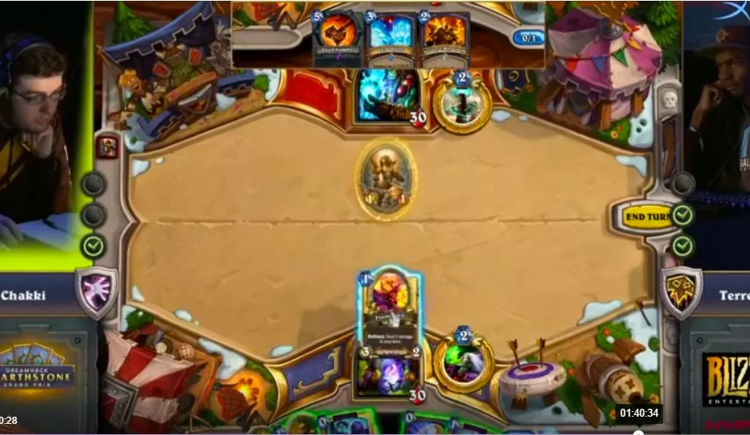
Player Harassment: Terence Miller
Miller, an African-American Hearthstone gamer, made it to the finals of DreamHack, a live-streamed competition in Austin Texas.
During the live stream he was subjected to so much racism in the comments section that the moderators couldn’t keep up.

Slide 28
Blizzard’s Response
As it currently stands, Twitch leaves almost all moderation to the people running the channels. They offer tools that can help censor certain words or even give users “time-outs”.
Although seemingly useful, these measures can easily be circumvented.
Following the Miller incident, Blizzard’s president stated the following:
“we're investigating a pilot program that Twitch has in the works to streamline moderation and combat ban evasion. We're also updating our esports tournament partner policies with a stronger system of checks, balances, and repercussions to provide a better chat experience around our content.”

Slide 29
Xbox’s Approach
When asked for a comment on Xbox live becoming a “racist and toxic environment for players of color” their response referenced their code of conduct and encouraged users to report abuse.
This is essentially a self-policing model in which the players are responsible for policing and reporting one another.
Question: Should Xbox and other gaming systems take a more involved role in the policing of their users?

Slide 30
The Future?
Xbox has announced that they will begin testing text-based filters with voice filters to follow.
This system will use four tiers of filter sensitivity: friendly, medium, mature, and unfiltered.

Slide 31
The Debate
The debate of violence in video games has been ongoing since the 1980s
Previously associated with;
Anti social behaviours
Diminished vision
Limited attention span
Brought back into the light
Increased gun violence
Increased graphic realism
Notes:
One group of researchers provides evidence suggesting that video game violence increases players’ levels of aggression and related constructs.
Another group suggests that violent video games exhibit a null effect on aggression and may even lead to positive effects
Recently, comments made by President Trump following a series of shootings have brought the debate back into light
Trump alluded to the increase in graphic realism as a major factor contributing to gun violence

Slide 32
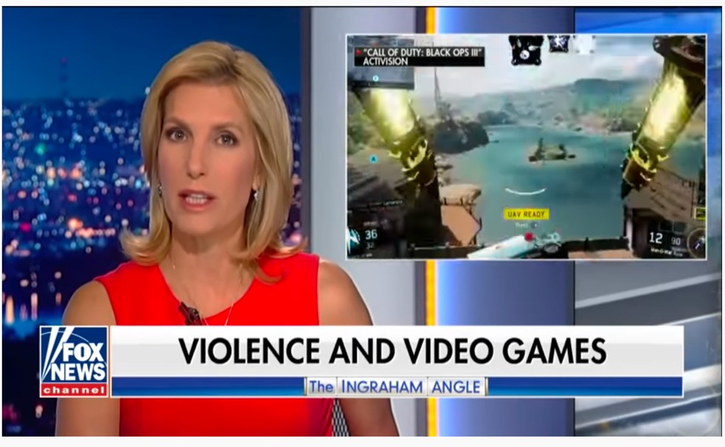

Slide 33
Priming: Fact or Fiction?
Suggestions that immersing one’s self in violent video games predisposes people to violent behavior
Is the brain wired to be primed in such a way?
Does not help you physically learn novel skills
helps build an understanding of how to approach them
Improvements are likely as a result of strengthened neural pathways
Notes:
Dr David Zendle, from the University’s Department of Computer Science, proposed that “If players are ‘primed’ through immersing themselves in the concepts of the game, they should be able to categorise the objects associated with this game more quickly in the real world once the game had concluded.”
This was not found to be the case-- Participants who played a car-themed game were no quicker at categorising vehicle images, and indeed in some cases their reaction time was significantly slower.
This suggests that these games exercise brain functions and strengthen neural connections improving the function

Slide 34
Answers
Conflicting evidence:
Longitudinal intervention study
Case law (USA)
APA Resolution on Violence in Video Games and Interactive Media adopted in 2005
Notes:
LIS- first to investigate the effects of long-term violent video gameplay using a large battery of tests spanning questionnaires, behavioural measures of aggression, sexist attitudes, empathy and interpersonal competencies, impulsivity-related constructs (such as sensation seeking, boredom proneness, risk taking, delay discounting), mental health (depressivity, anxiety) as well as executive control functions, before and after 2 months of gameplay.
The present results thus provide strong evidence against the frequently debated negative effects of playing violent video games in adults and will therefore help to communicate a more realistic scientific perspective on the effects of violent video gaming.
In Brown v. Entertainment Merchants Association Justice Scalia held that the Psychological studies purporting to show a connection between exposure to violent video games and harmful effects on children do not prove that such exposure causes minors to act aggressively. Any demonstrated effects are both small and indistinguishable from effects produced by other media.
APA- scientific research has demonstrated an association between violent video game use and both increases in aggressive behavior, aggressive affect, aggressive cognitions and decreases in prosocial behavior, empathy, and moral engagement;

Slide 35
Considerations
Experience level
More experienced gamers had fewer aggressive tendencies after🡪 focusing more on skill of their actions than the violence
Moral justification
Neutral reactions regardless of whether violence was justified
Graphic realism
No evidence of any correlation between realism and violent behaviour
Moral disengagement
Mechanism implemented to prevent moral engagement
Notes:
Experienced gamers were find to focus more on the skill of their actions than the violence, whereas the less experienced gamers more were prone to frustration
cues implemented in contemporary violent video games effectively help players to disengage from moral concern, which the evidence suggests is successful

Slide 36
Why?
Confirmation bias
Politics
Scapegoats
What do you think: what effects our opinions on psychological phenomenon?
Notes:
Confirmation bias is a phenomenon in which people tend to search for information that confirms there existing beleifs
This underlies most sociological research
Politics seems to be a confounding factor of the different perspectives on this debate
The use of video games as a scapegoat not only does this detract from what could be a valuable social tool but it ensures that the really problems are not be addressed
Naomi Clark, an independent game developer and co-chair of New York University’s Game Center program, agreed. “I find it more plausible that America’s long-standing culture of gun violence has affected video games, as a form of culture, than the other way around,”

Slide 37
Toxicity & Anti-Social Gaming

Slide 38
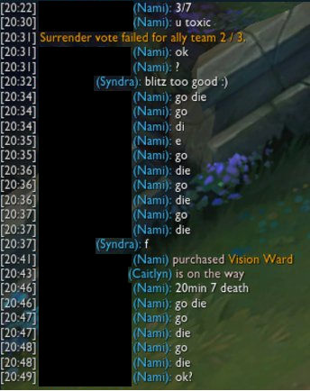
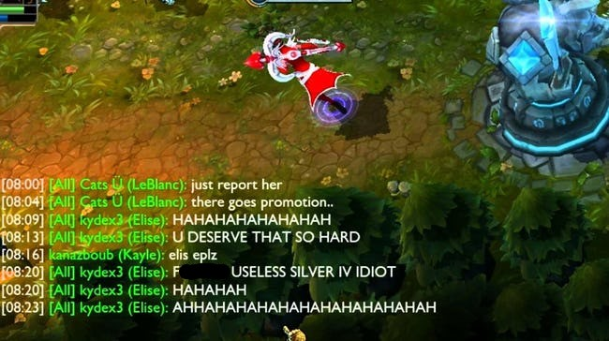
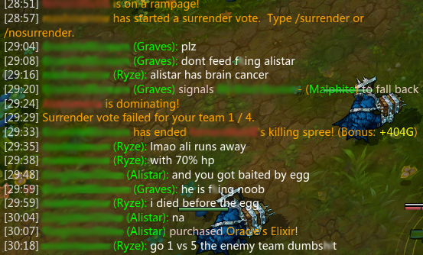
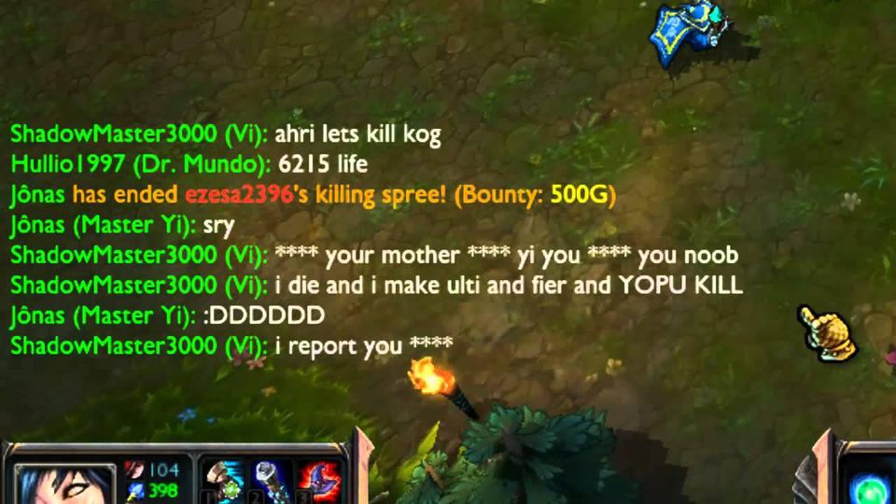
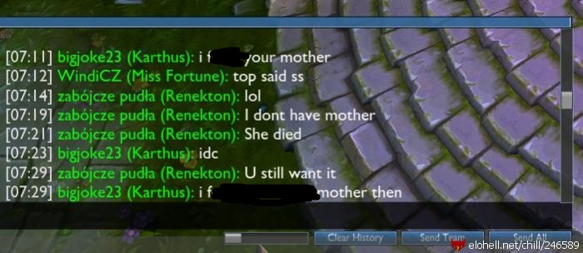
SETTING THE STAGE
IMAGINE YOU ARE STARTING A GAME OF LEAGUE OF LEGENDS
EVERYTHING IS GOING WELL, UNTIL…

Slide 39
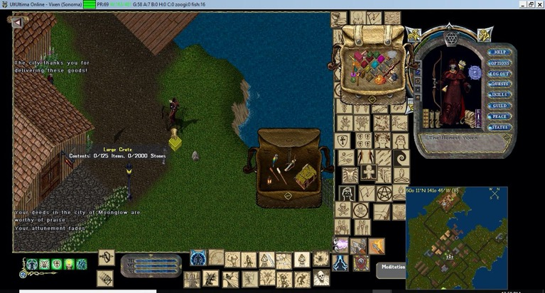
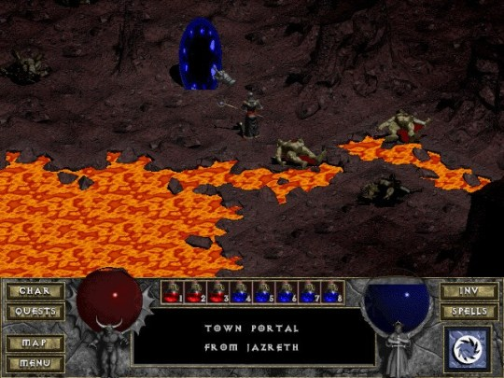
HISTORY OF ONLINE GAMING
BAD BEHAVIOUR IN GAMING HAS A LONG HISTORY
AS ONLINE GAMES DEVELOPED, SO DID OPPORTUNITIES FOR NEGATIVE PLAYER INTERACTIONS.
DURING THE 90’S MMO GAMES WERE PUBLISHED WHICH PROVIDED PVP OPTIONS, WITH REAL-TIME STRATEGY GAMES (RTS) AND ONLINE FIRST-PERSON SHOOTERS (FPS) APPEARING.
PLAYER KILLING (PK’ING), EARLY HACKING/ACCOUNT HACKING AND OTHER FORMS OF GRIEFING STARTED TO HAVE A LARGER ROLE IN ONLINE GAMING.

Slide 40
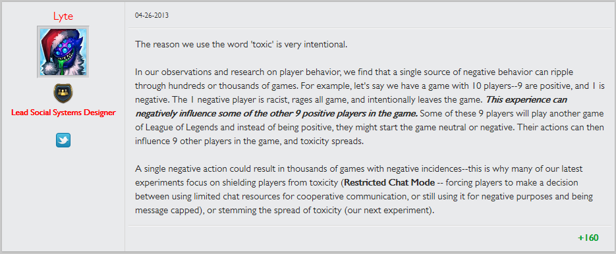
WHAT IS TOXICITY?
DIFFICULT TO PINPOINT THE ORIGIN OF WHEN IT STARTED TO BE USED TO DESCRIBE GAMER BEHAVIOUR
“TOXIC” MIGHT HAVE FIRST BEEN COINED BY LYTE, THE FORMER LEAD SOCIAL SYSTEMS DESIGNER AT RIOT GAMES, WORKING ON LEAGUE OF LEGENDS:

Slide 41
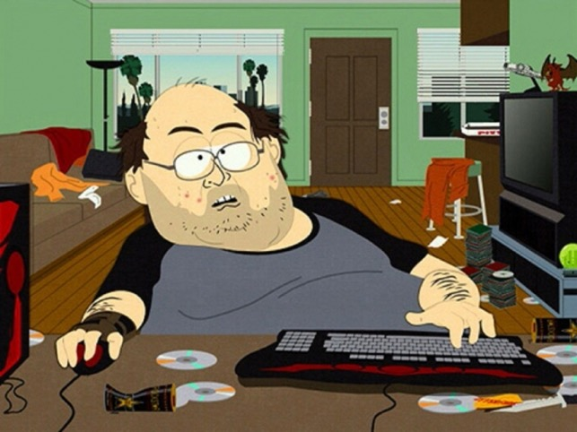
WHY IS THERE TOXICITY?
DIFFERENT EXPLANATIONS:
THE MERITOCRACY THEORY
PREJUDICE
THE JERK THEORY
- MAYBE THERE ARE JUST JERKS IN GAMES BECAUSE THE WORLD IS FULL OF JERKS.

Slide 42
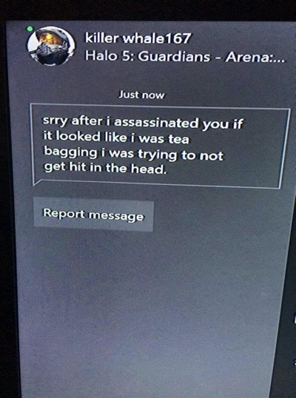
THE MERITOCRACY THEORY
THEORY DEVELOPED BY CHRISTOPHER PAUL IN HIS BOOK “THE TOXIC MERITOCRACY OF VIDEO GAMES”
PART OF THE REASON FOR TOXICITY COMES FROM HOW GAMES ARE DESIGNED.
THE NOTION OF ‘REAL GAMERS’ IS PART OF THIS.
LEAGUE OF LEGENDS AS A CASE STUDY

Slide 43
PREJUDICE
KATE MILNER WRITES THAT SEXISM IN GAMING IS PREVALENT BECAUSE OF HOW GENDERING WORKED TO DESIGNATE TECHNOLOGY AS A ‘MALE’ SPACE.
ACCORDING TO ANITA SARKEESIAN, THIS LEFT THE SPACE PREDOMINANTLY CONTROLLED BY MEN FOR MEN, EXCLUDING ANYONE WHO WASN’T A STRAIGHT MAN OR BOY.
WHEN WOMEN SHOW UP IN ONLINE SPACES, IT IS PERCEIVED AS A THREAT.
THE “FIGHTING GAME COMMUNITY” EXAMPLE
RACE AND SEXUALITY ARE ALSO FREQUENTLY SUBJECTS OF HARASSMENT

Slide 44
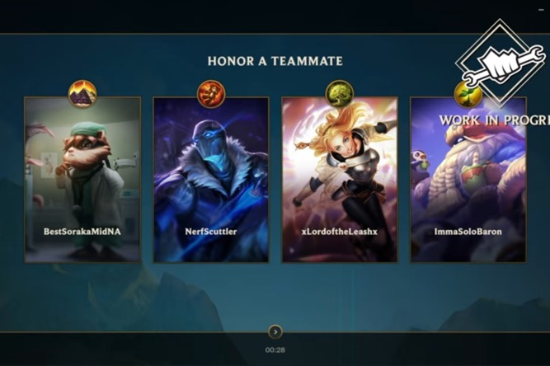
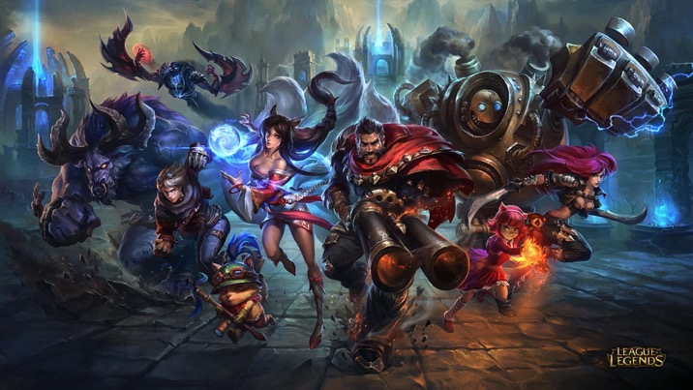
COMBATING TOXICITY
A LOOK AT HOW RIOT GAMES DEALS WITH LEAGUE OF LEGENDS TOXICITY:
THERE’S A REPORTING SYSTEM FOR TOXIC PLAYER BEHAVIOUR.
RIOT ASSEMBLED A TEAM TO LOOK AT TOXIC MESSAGES WHICH WERE REPORTED.
FOUND THAT: ONLY ABOUT 1% OF PLAYERS ARE CONSISTENTLY TOXIC WERE RESPONSIBLE FOR PRODUCING ABOUT 5% OF THE OVERALL TOXICITY REPORTED.
THE EARLY SYSTEM WASN’T VERY EFFECTIVE.

Slide 45
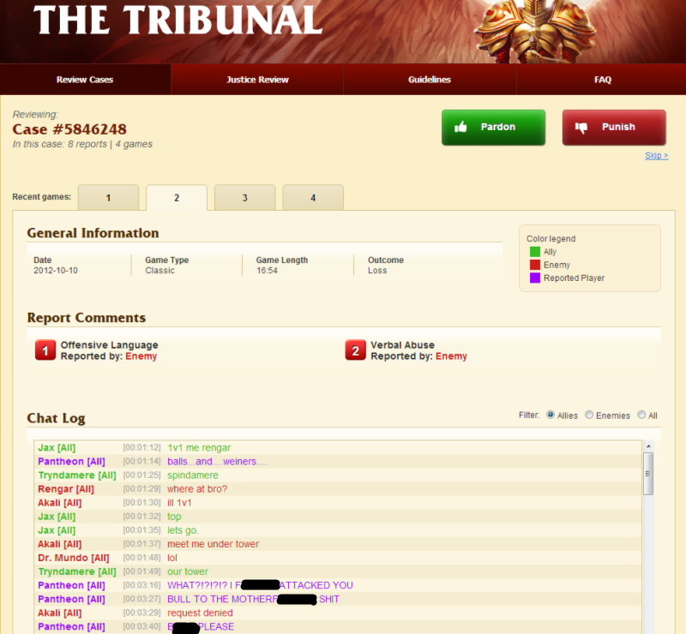
LEAGUE’S TRIBUNAL SYSTEM
HOW IT WORKS:
PLAYERS VOLUNTEERED TO REVIEW REPORTED PLAYERS CHAT LOGS.
WHEN BANNED, PLAYERS ARE GIVEN A ‘REFORM CARD’, WITH FEEDBACK, AND TRIBUNAL MEMBERS’ FEEDBACK.
THE REFORM RATE OF BANNED PLAYERS WENT UP TO 70%
IT WAS TOO SLOW…
WHEN AUTOMATED, REFORM RATE WENT UP TO 92%

Slide 46
POSSIBLE SOLUTIONS
POLICING PLAYER BEHAVIOUR WILL NOT FIX THE PROBLEM.
NEED A MULTIFACETED APPROACH:
- GAME DEVELOPERS NEED TO ADDRESS GAME DESIGN
- ONLINE PLATFORMS/MESSAGE BOARDS NEED TO FOSTER CRITICAL ATTITUDES TOWARDS STATUS QUO TOXIC NORMS (LIKE SEXISM)
- PEOPLE IN POSITIONS TO MAKE DECISIONS NEED TO BE MORE WILLING TO SPEAK OUT AGAINST PREJUDICIAL BEHAVIOUR.

Slide 47
HOW CAN THE LAW HELP?
WHEN CAN THE LAW STEP IN TO PROTECT PEOPLE?
WHEN TOXIC BEHAVIOUR VEERS TOWARDS CRIMINAL ACTIONS WHICH THREATEN YOUR SAFETY. GET LAW ENFORCEMENT INVOLVED. - THE CASE R. V. A. (B.L.), 2015 BCPC AS AN EXAMPLE.
IF THE HARASSING BEHAVIOUR IS SUSTAINED, CONSIDER PURSUING A CIVIL ACTION (EX. DEFAMATION) IF IT IS PARTICULARLY BAD.

Slide 48
ARE VIDEO GAMES DESENSITIZING US?

Slide 49
DEATH RACE AND “EXTREME VIOLENCE”

Slide 50
VIDEO GAMES “CAUSE PROBLEMS”
A waste of time that creates unproductivity;
They create difficulty distinguishing reality from fantasy;
They lead to more harmful attitudes and sexual violence towards women;
They cause lower empathy and decreased kindness;
Simulated violence leads to real-life violent and aggressive behaviour;
Desensitize players to real-life social issues;

Slide 51
VIDEO GAMES ARE AT FAULT

Slide 52
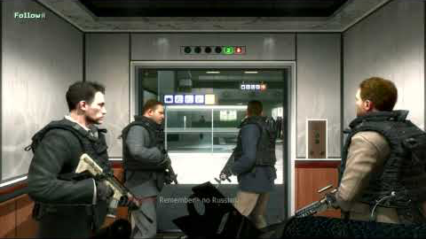
ARE WE DESENSITIZED TO VIOLENCE?
Call of Duty: Modern Warfare II
DOOM
Gears of War 5

Slide 53
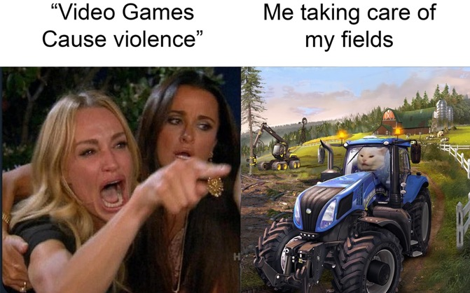
DIFFERENT PERSPECTIVE: IT’S NOT THE CONTENT, IT’S THE CULTURE
Naomi Clark - Game Designer, Teacher, and Scholar at NYU Game Center:
Even though it’s silly to say that ’games cause violence’, it’s also just as silly to say that games have nothing to do with a culture that has a violence problem.
Katherine Cross - Sociologist, Gaming and Social Critic at University of Washington:
“At this moment, there is urgent need to shine a light on video game culture, the fan spaces that have been infiltrated by white supremacists looking to recruit that minority of gamers who rage against ‘political correctness’
“We treat video games as unreal, as unserious play, and that creates a shadow over gaming forums and fan communities that has allowed toxicity to take root. It’s also allowed neo-Nazis to operate mostly unseen. That is what needs to change.”

Slide 54
DEALING WITH THE PROBLEM?
World of Warcraft / League of Legends
Reporting of negative players and manual review
Rainbow 6: Siege
Tier-based suspension system for use of “slurs”
Dota 2
Bans up to 19 years for low conduct scores
Counter Strike: Global Offensive
Immersive chat-reading Artificial Intelligence

Slide 55
QUESTIONS?

