Slide 1

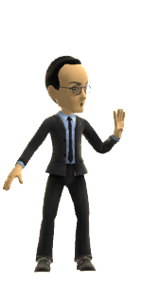
Collaborative Class: Games, Politics &
Our Branded Lives
Class 9B
PowerPoint Draft 1
Video Game Law - Fall 2020
UBC Law @ Allard Hall
Jon Festinger Q.C.
Centre for Digital Media
Allard Law of Law, UBC
QMUL School of Law (CCLS)
http://videogamelaw.allard.ubc.ca/
Twitter: @jonfestinger
jon_festinger@thecdm.ca

Slide 2
Are video games the future of politics?

Slide 3
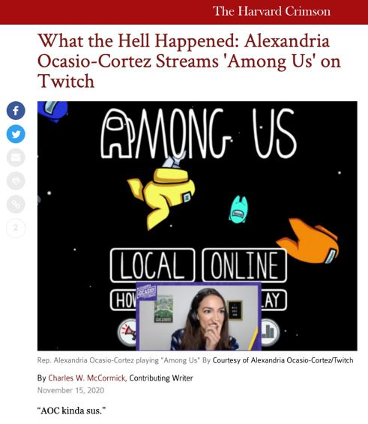

Slide 4
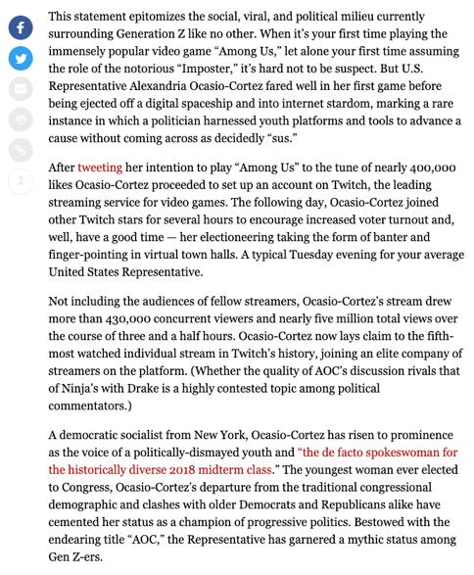

Slide 5
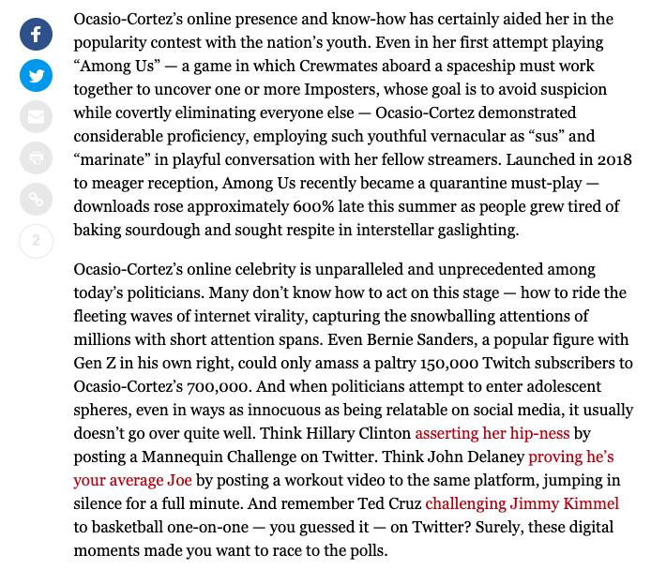

Slide 6
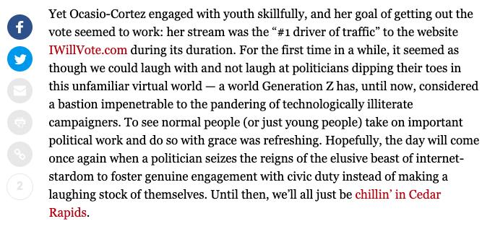

Slide 7
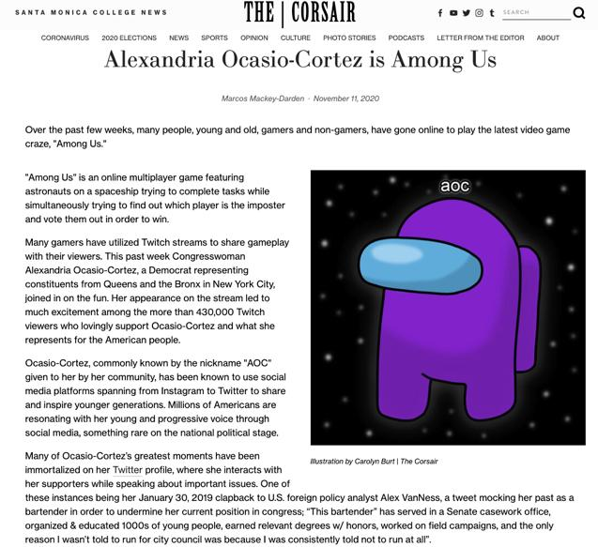

Slide 8
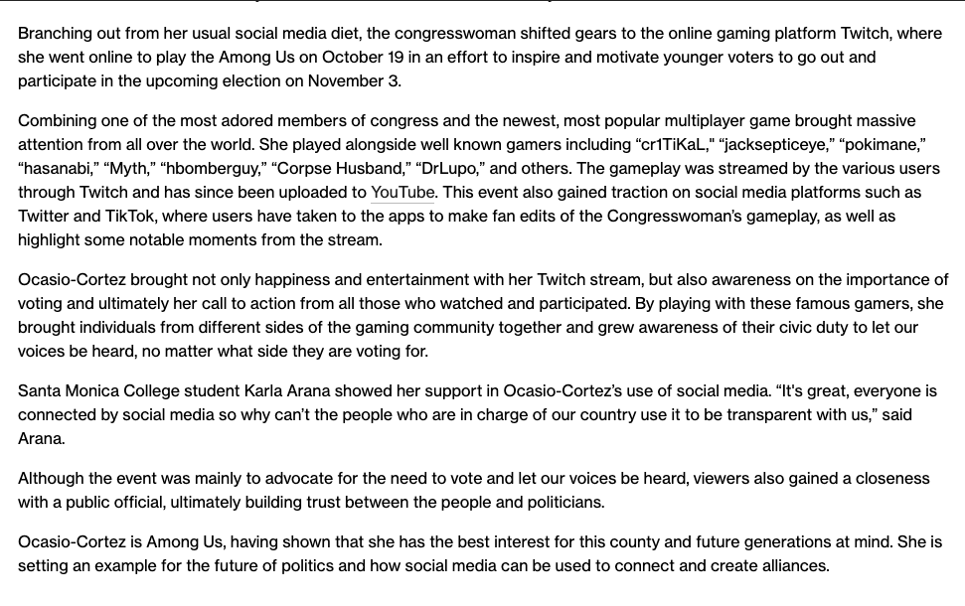

Slide 9
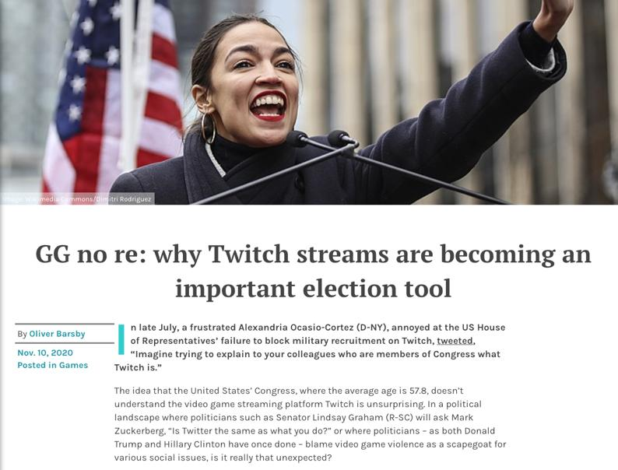

Slide 10
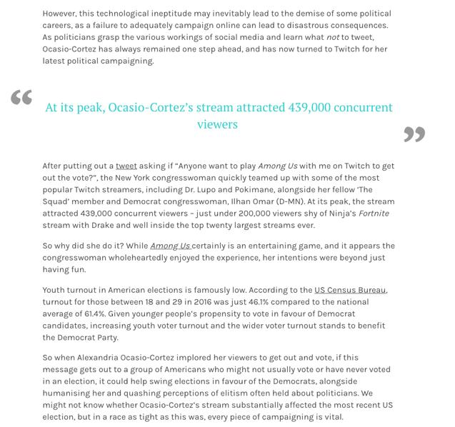

Slide 11
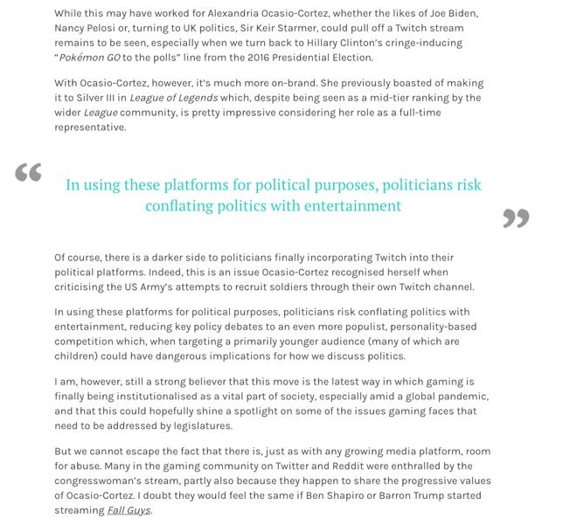

Slide 12
Lindsay graham plays other games?

Slide 13
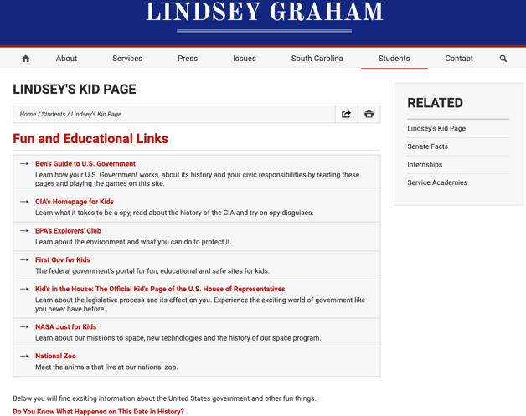
Contrast to…

Slide 14
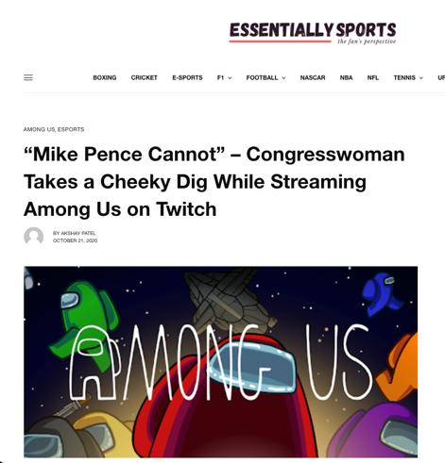
And…

Slide 15
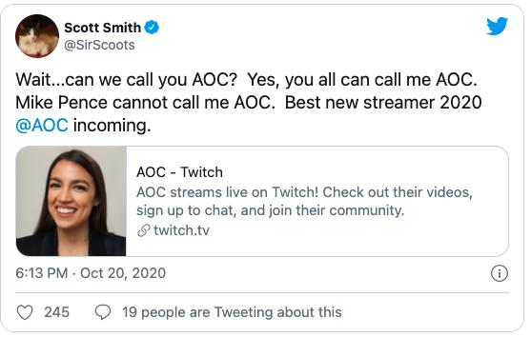

Slide 16
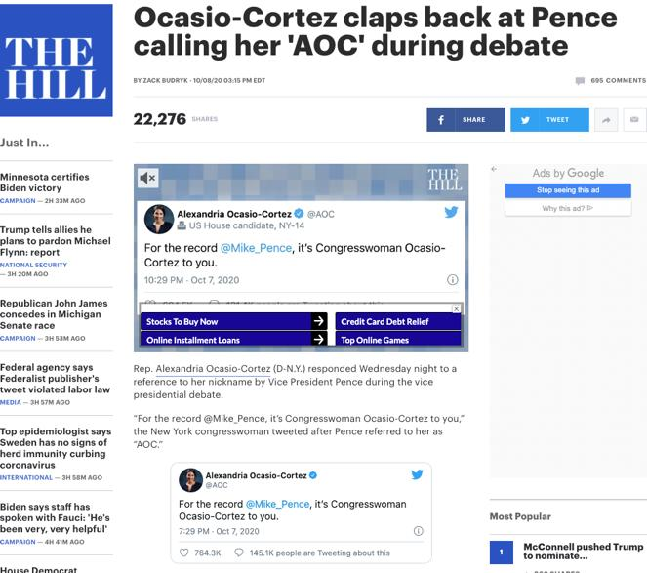

Slide 17
AOC Branding a Demographic
VTV Branding a Demographic

Slide 18


Slide 19


Slide 20


Slide 21
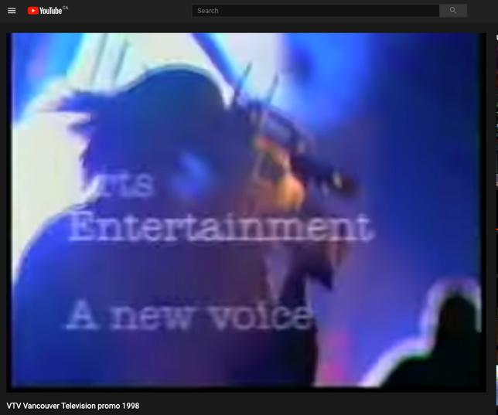
https://youtu.be/6MzM-gZC1r0

Slide 22
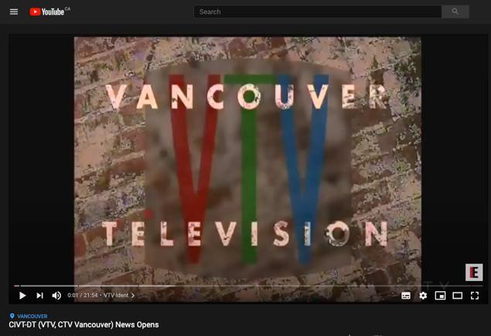
Demographic shift @5:00 & beyond
https://youtu.be/6GLm5c0HAk4

Slide 23
Branding Politics (AOC)
Branding Sports
Branding Sports & Politics

Slide 24

Blurred Lines

Slide 25

Jordan – Great @ basketball

Slide 26
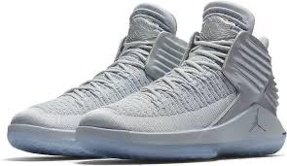
Jordan – Great @ shoes

Slide 27

Jordan – Great @ acting (?!)

Slide 28
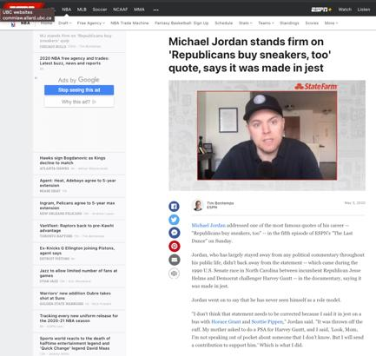
Jordan – Bad @ politics

Slide 29

Lebron – Great @ acting (?!)

Slide 30
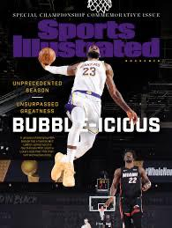
Lebron – Great @ basketball

Slide 31
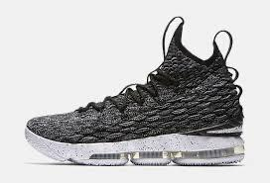
Lebron – Good @ shoes

Slide 32
Lebron – Great @ acting (??)

Slide 33
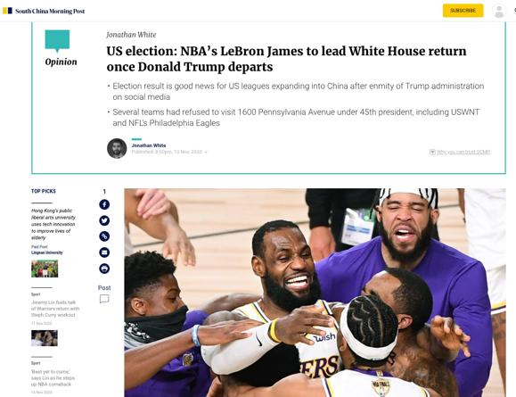
Lebron – Great @ politics

Slide 34
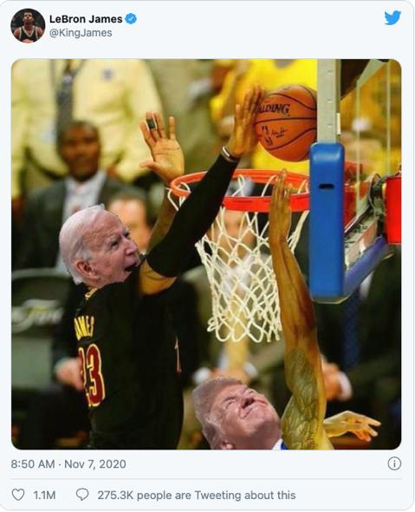

Slide 35
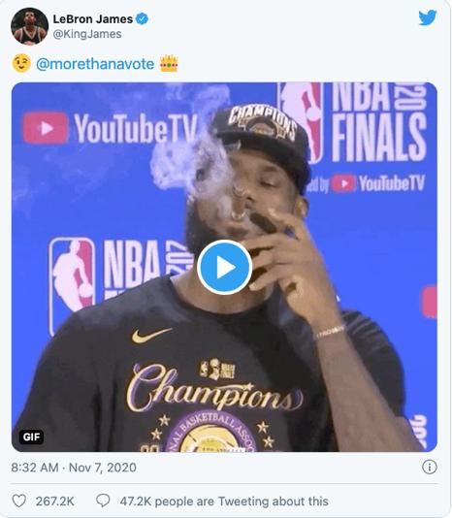

Slide 36
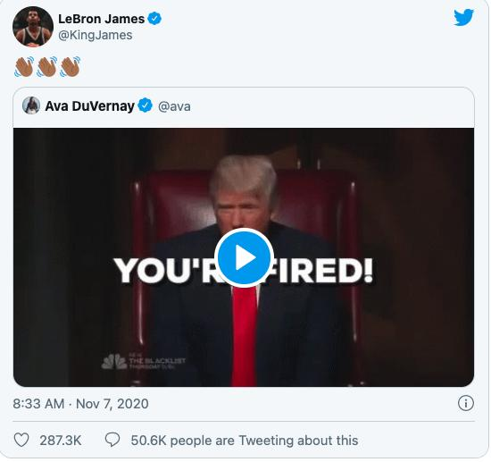

Slide 37
Politics are commercial.

Slide 38
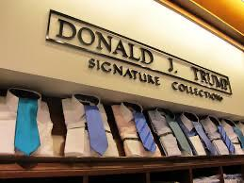
US Politics as battle of the brands

Slide 39
Implications?

Slide 40
Implications for video-games?

Slide 41


Slide 42

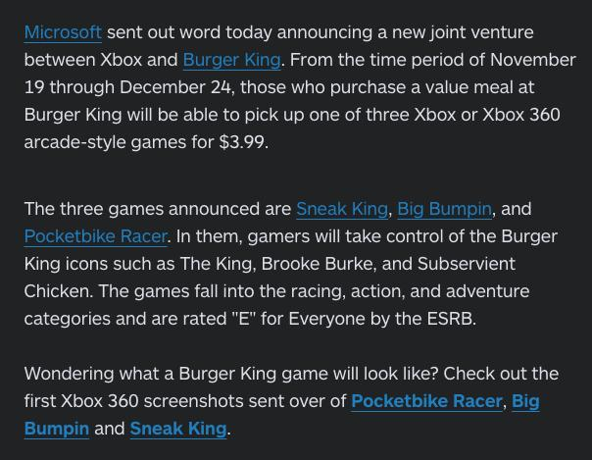

Slide 43
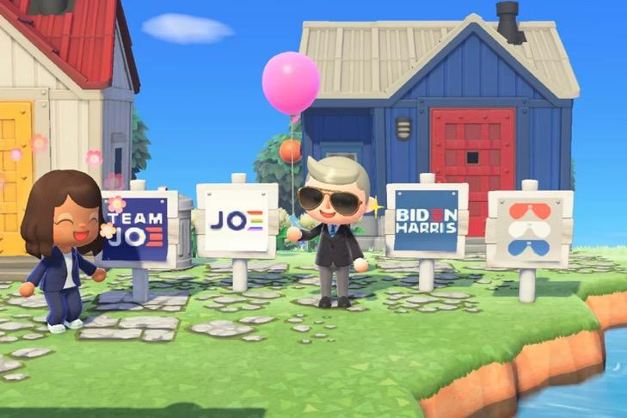

Slide 44
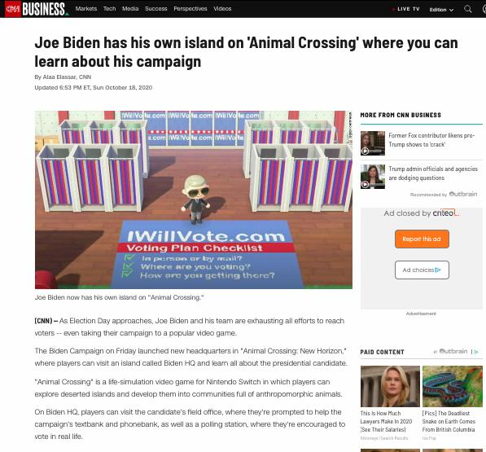

Slide 45
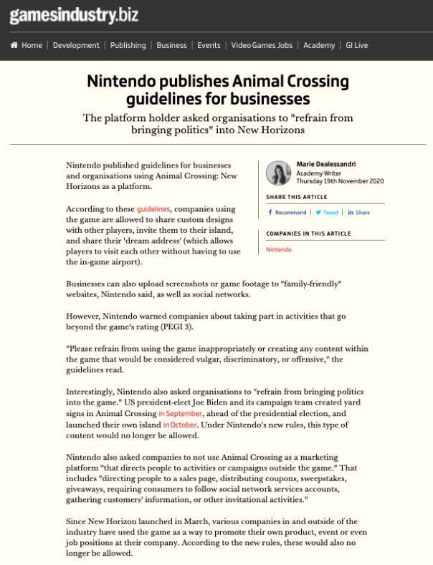

Slide 46
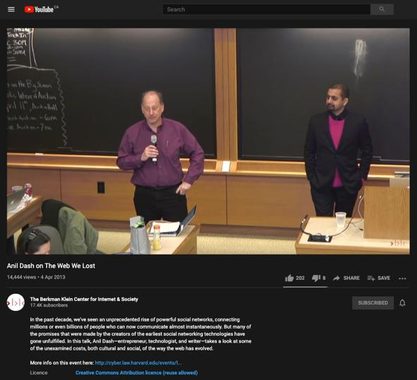
https://youtu.be/9KKMnoTTHJk

Slide 47



Slide 48


Slide 49
Can voters become addicted to preferences reinforced through digital mechanics?

Slide 50
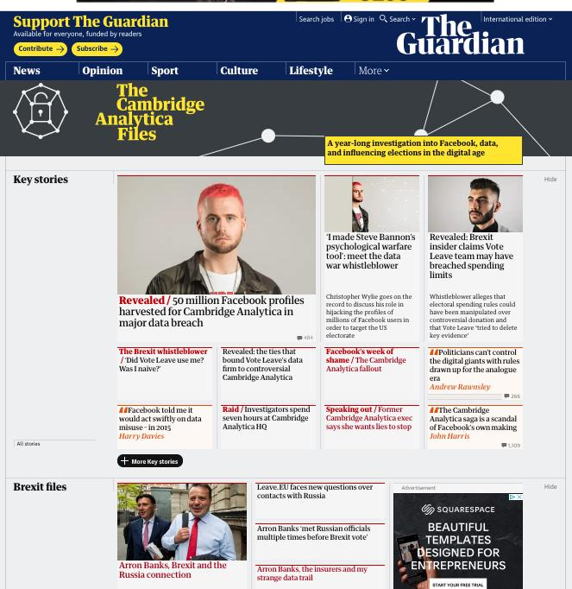

Slide 51
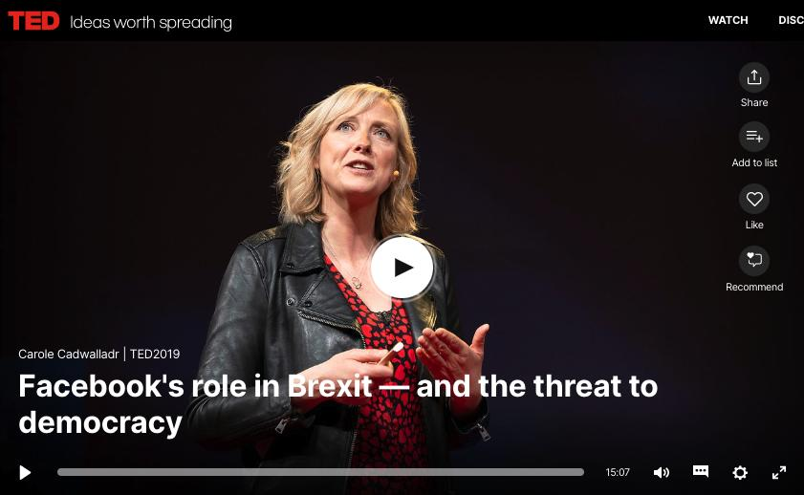
https://www.ted.com/talks/carole_cadwalladr_facebook_s_role_in_brexit_and_the_threat_to_democracy

Slide 52


Slide 53
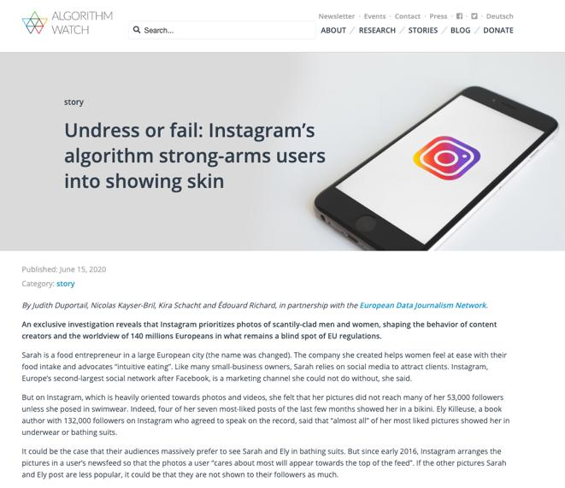

Slide 54
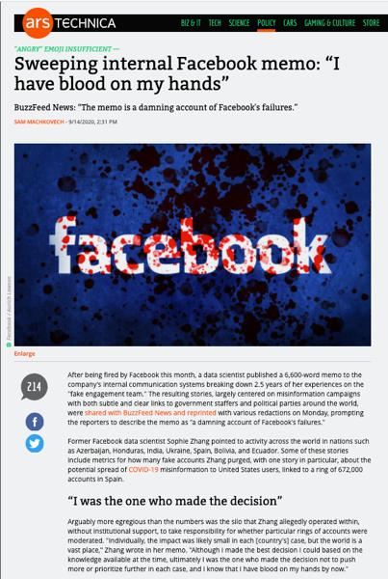

Slide 55
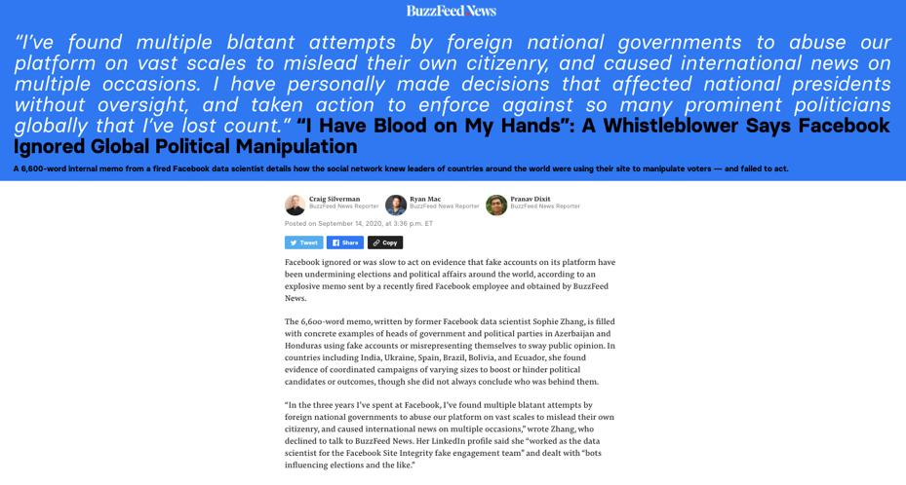


Slide 56
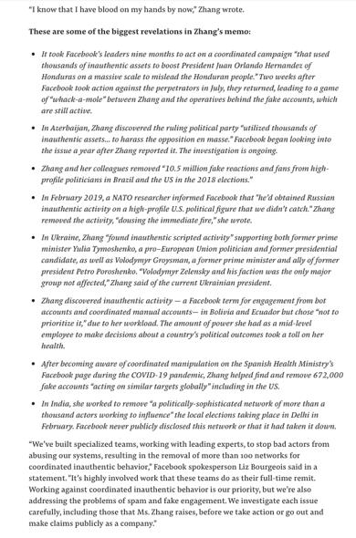

Slide 57
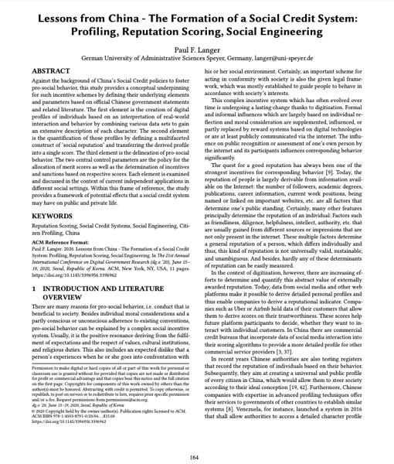

Slide 58
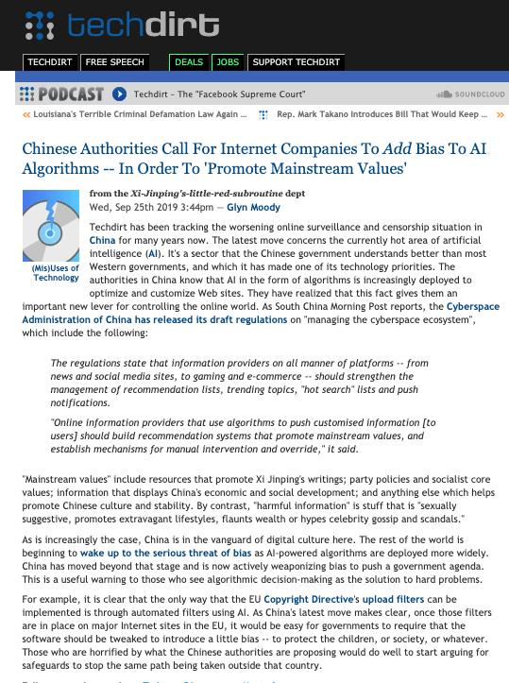

Slide 59
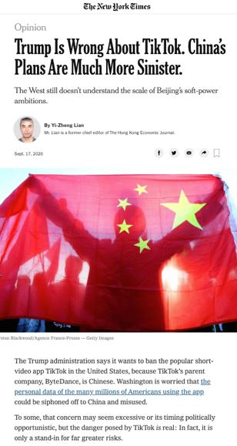

Slide 60

Can Politics be Loot-Boxed?

Slide 61
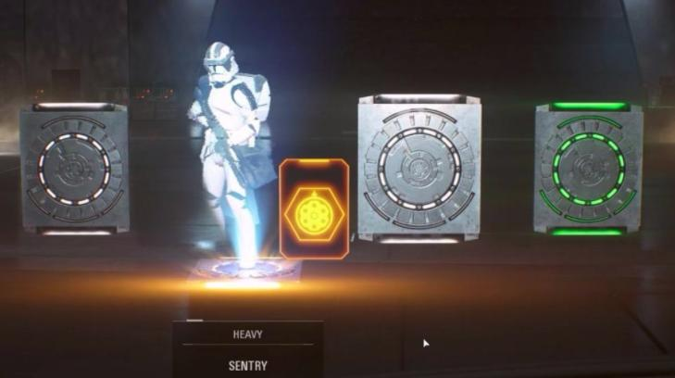

Slide 62
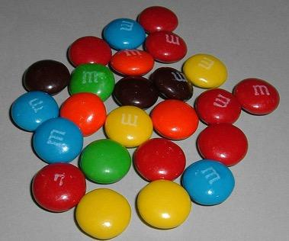

A MATTER OF PERSPECTIVE

Slide 63


Slide 64
In learning you will teach
And in teaching you will learn
Phil Collins' Son of Man (1999)

Slide 65

Always include a cat picture

Slide 66
Our Academic Partners

