Slide 1


Connecting Ourselves: Gamer Vulnerability in Virtual Realities Part 1
Talk 5
Part B “Connecting”
Video Game Law - Fall 2021
UBC Law @ Allard Hall
Jon Festinger Q.C.
Centre for Digital Media
Allard Law of Law, UBC
QMUL School of Law (CCLS)
http://videogamelaw.allard.ubc.ca/
Twitter: @jonfestinger
jon_festinger@thecdm.ca

Slide 2

Happy FarCry6 Release Week

Slide 3
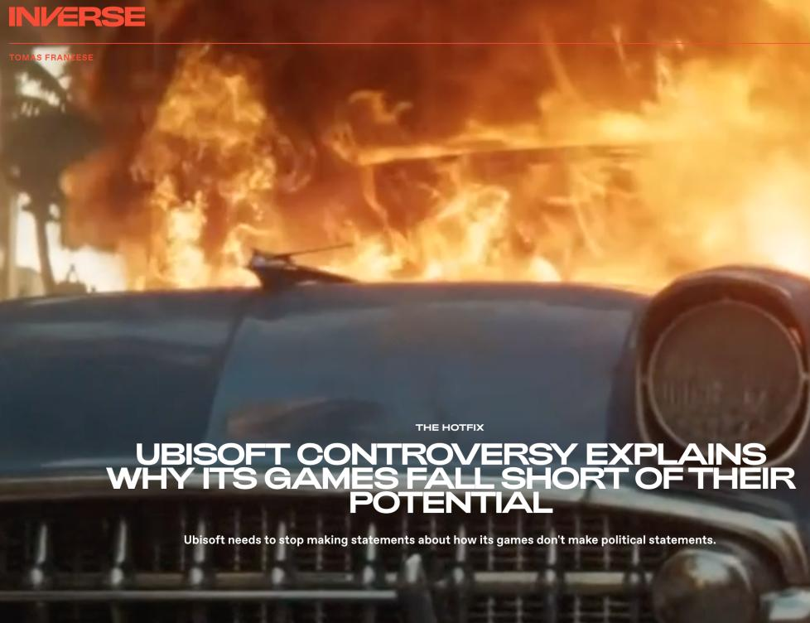

Slide 4
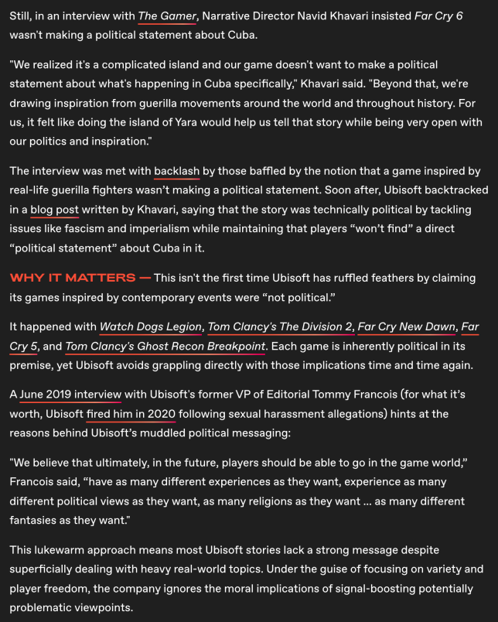

Slide 5
Is all art political?

Slide 6
Stuff

Slide 7
Thank you
For your Bio’s

Slide 8
http://videogame.law.ubc.ca

Slide 9
Anyone not have an invite? If not please let me know at the break.

Slide 10

Website issues…

Slide 11


On website…

Slide 12
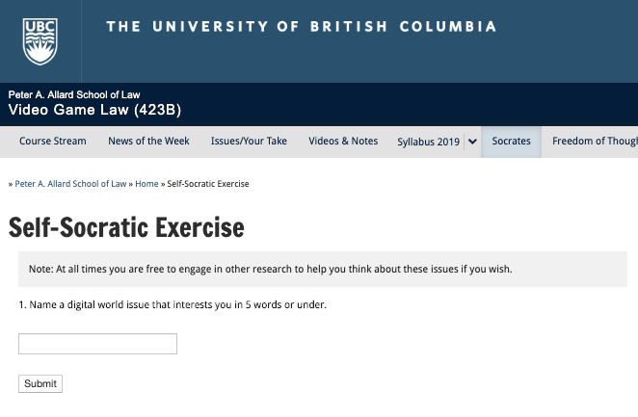

Slide 13
Did you try?
Reactions?
Thoughts?

Slide 14
Evaluation
A. Participation = 25% includes any or all of:
class, website, forum contributions;
following “Self-Socratic” protocols – email me results
B. Presentation = 25%. This will be based on a presentation. Please also post to the course website (or otherwise distribute to the class) about 5 days before your presentation one article or video you would like us to review in advance. Presentation can be synchronous or asynchronous. Open to most any form you might be interested in.
C. Term Paper/Major Project (18 to 20 pages or equivalent – 5000 words – any font) = 50%.

Slide 15
Paper Confessional
(or what I learned one winter holiday)
Legal/normative reasoning/argument including footnote/bibliography support & Contribution/Move forward → 60%
Presentation including layout, headings, grammar, language/writing skills, “tightness” → 25%
Topic/Originality/Degree of Difficultly → 15%
THIS IS NOT A RUBRIC. IT IS A SELF ASSESSMENT.

Slide 16
Will read: drafts…outlines…synopsis……abstracts…etc.
As late as I can…
Due last day of exams by 4:00 PM.
Send in papers by email. Make sure you get acknowledgment of receipt.

Slide 17
Presentation Groups?

Slide 18
Presentations
3 - 4 (ideally) if a group
Marked individually or as a group? Yes.
Sign-up by emailing me
Any topic – not constrained by what I’m talking about that week
Consult with me (even informally) re the topic you want to take on
Post one thing you want us to read or watch

Slide 19
Grades (primarily)
Paper → Quality
Participation → Effort

Slide 20

Pause

Slide 21
News of
the Week

Slide 22
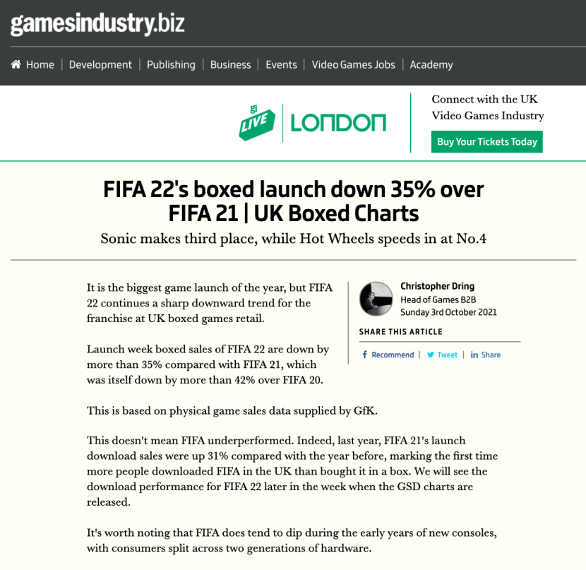

Slide 23
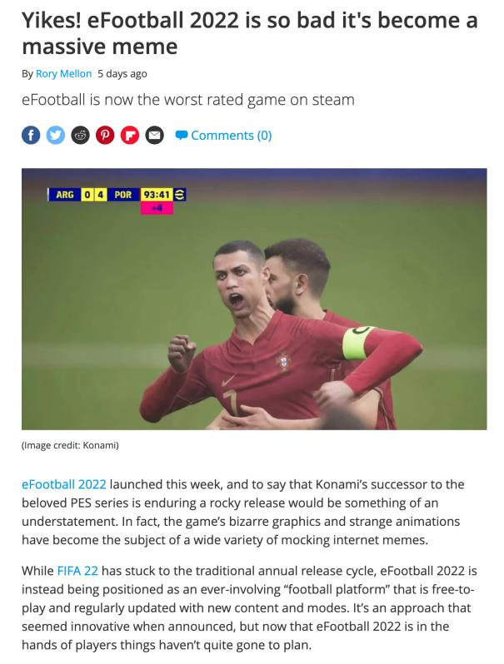

Slide 24
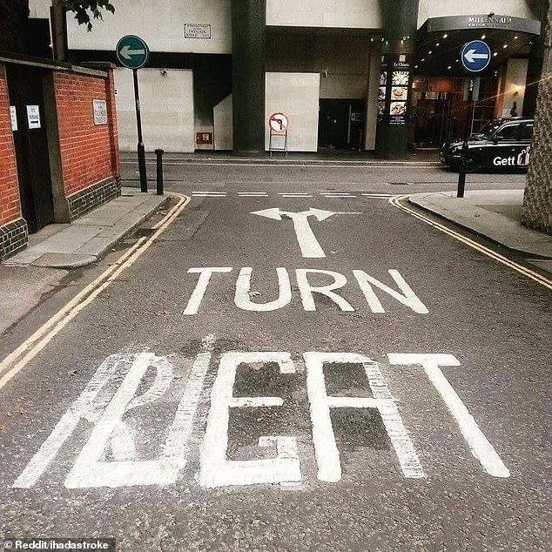
Game to Platform: Directional change?

Slide 25
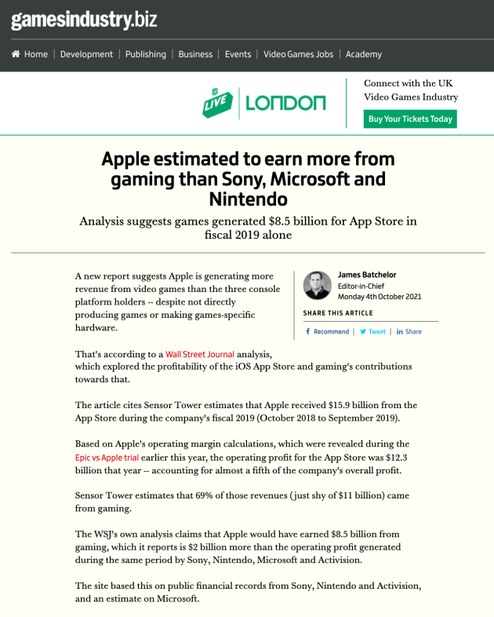

Slide 26
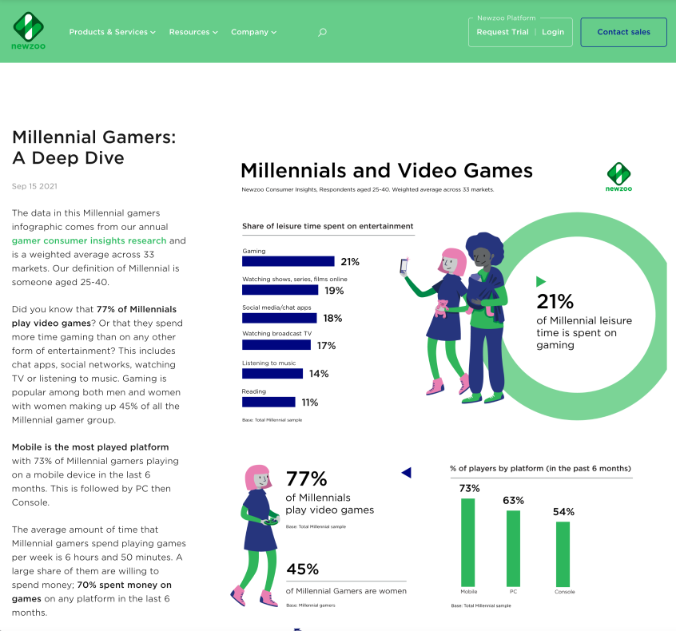


Slide 27
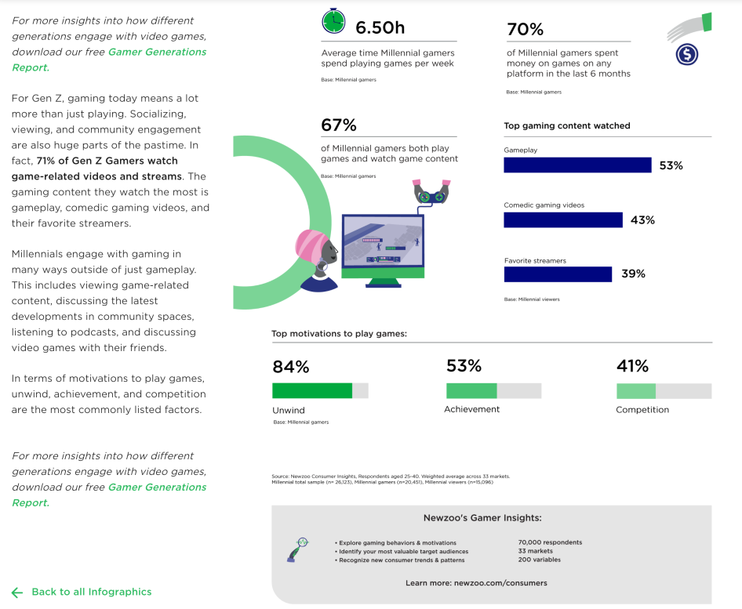

Slide 28
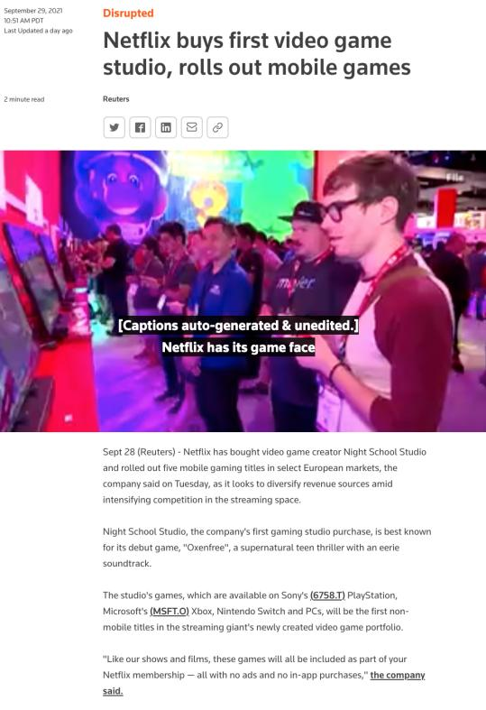

Slide 29
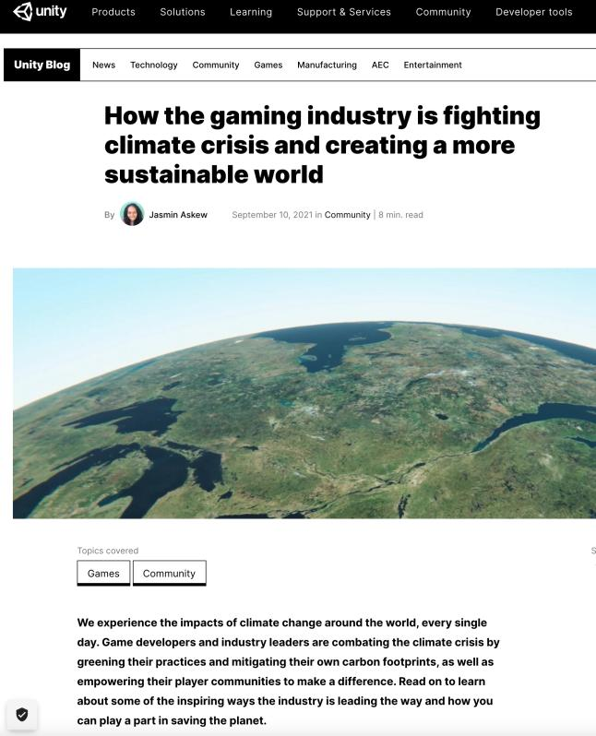

Slide 30
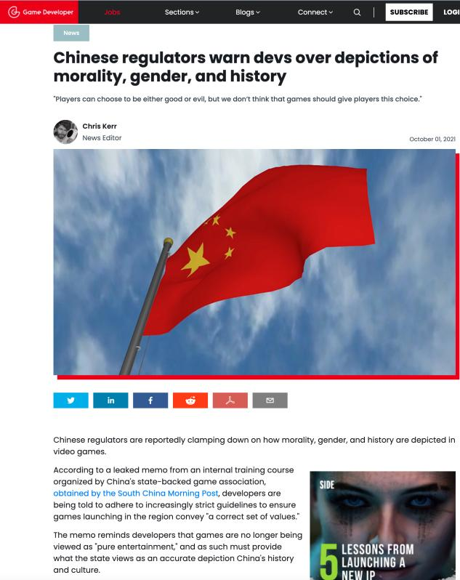

Slide 31
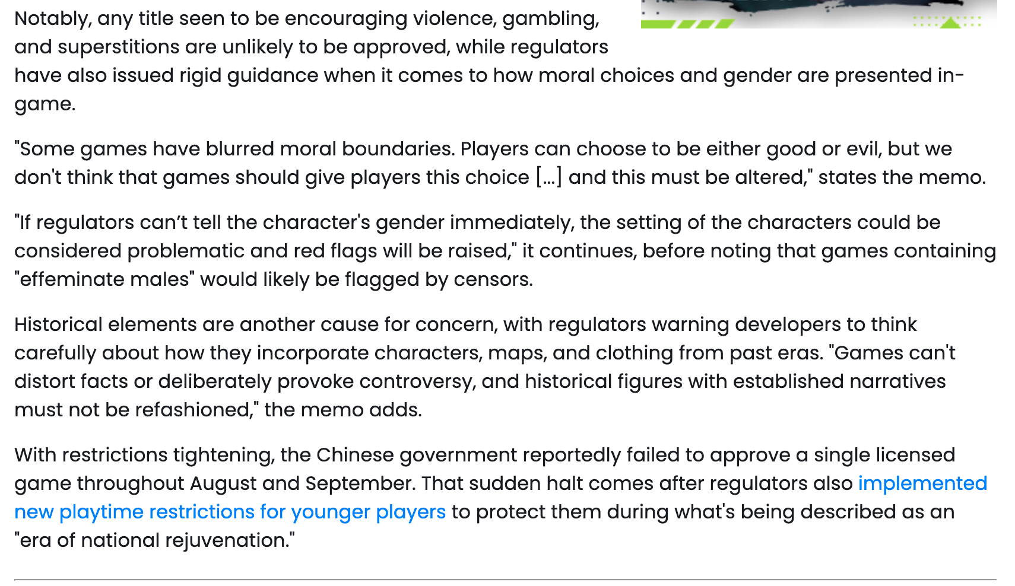

Slide 32
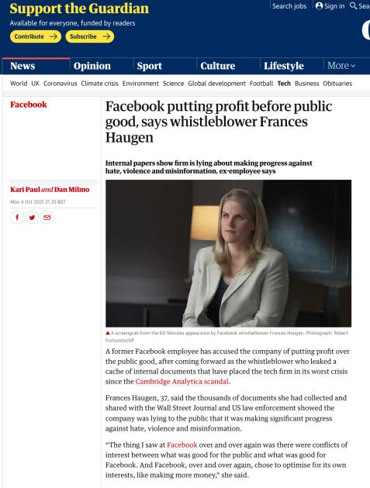


Are we “Zucked Up”?

Slide 33
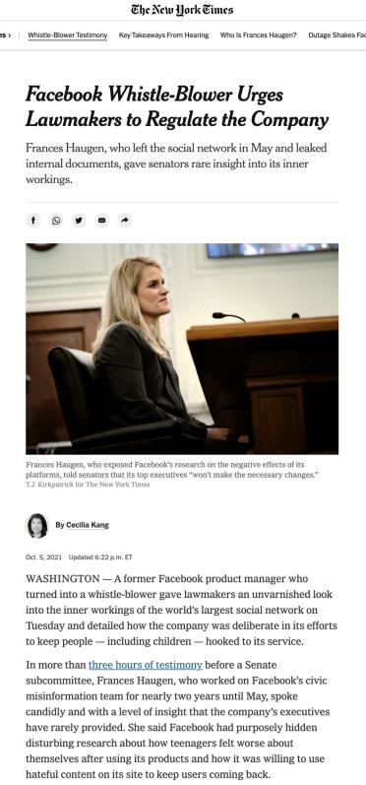

Slide 34
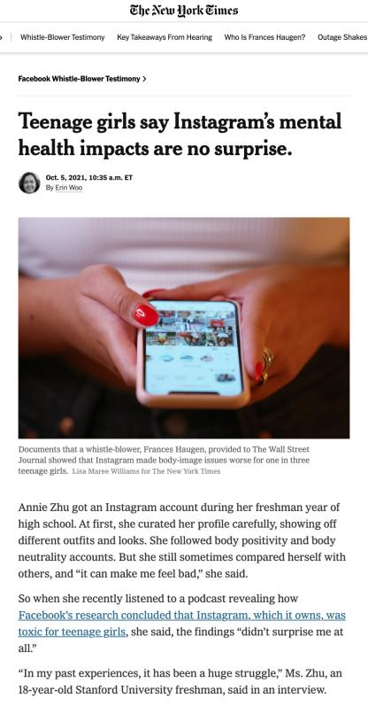

Slide 35
Two Years This Time

Slide 36
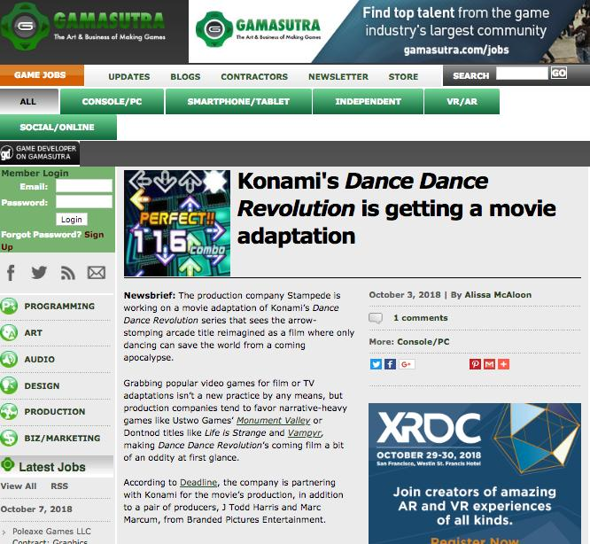
What? Why? How?

Slide 37
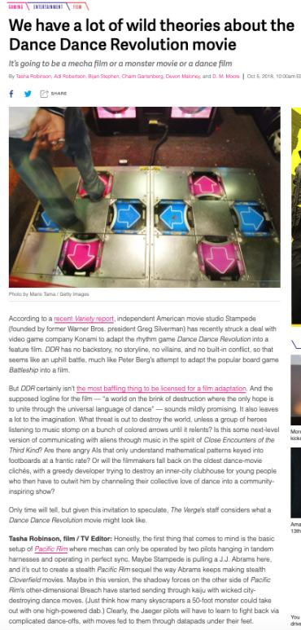

Slide 38
Yours?

Slide 39
Pause

Slide 40
QUESTIONS?
THOUGHTS?
DISCUSSION?

Slide 41
Loose Ends
From
Last Week

Slide 42
Notice any common denominators?
Creativity is never in issue in any of the cases
Copyright Law is only directly relevant in Microstar (& Galoob “Game Genie”) - no contractual nexus, so sole “copyright only” case.
“Fair Use” to create mods question avoided by:
Contract Law (Davidson, iRacing & MDY all decided on EULA, ToS or ToU terms & obligations).
Nothing creative in what Micro Star did – they did not create a mod – they usurped mod creators without permission
Conclusion: No current precedent that game mods are not “Fair Use” which is a copyright concept.

Slide 43

Right to Mod: The Original…
Lewis Galoob Toys v. Nintendo of America 1992 USCA: “Game Genie” device allowed gameplay features to be modified (e.g., # of lives) but did not change data in Nintendo cartridge. Court found “fair use”.

Slide 44
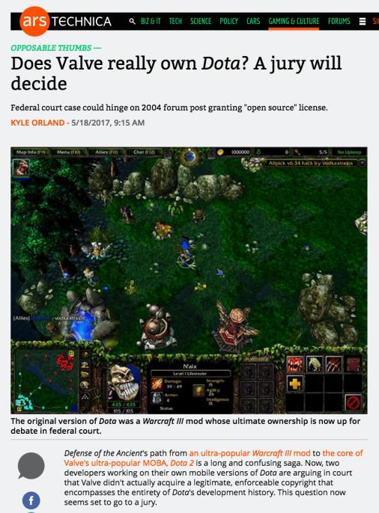
The Almost Case

Slide 45
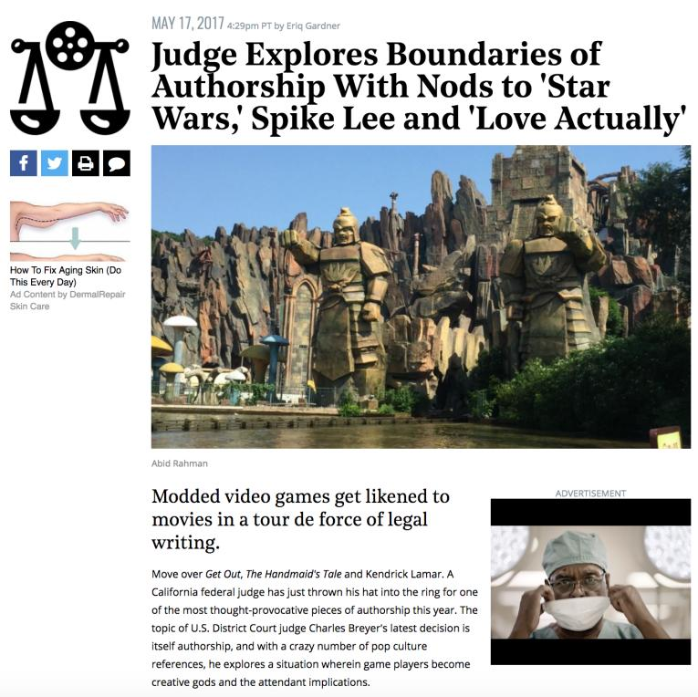

Slide 46
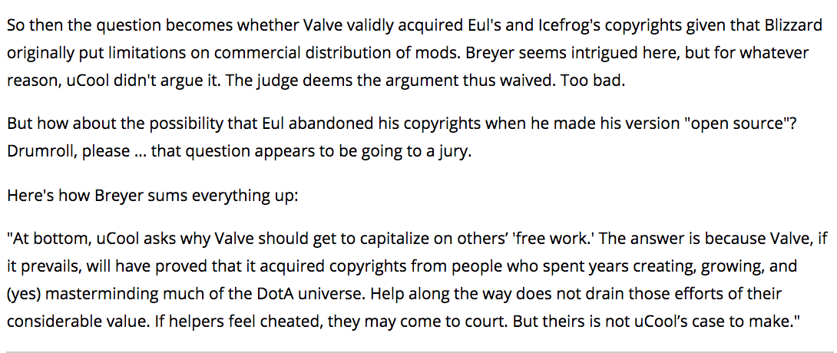

Slide 47
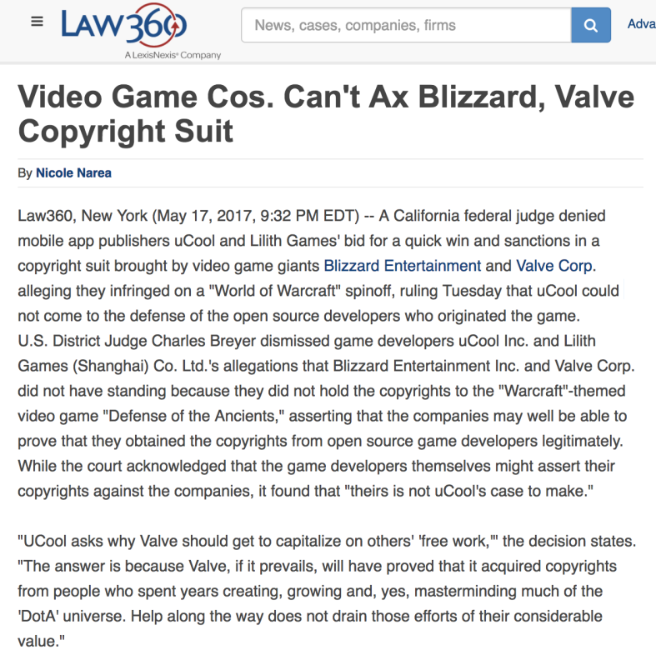

Slide 48
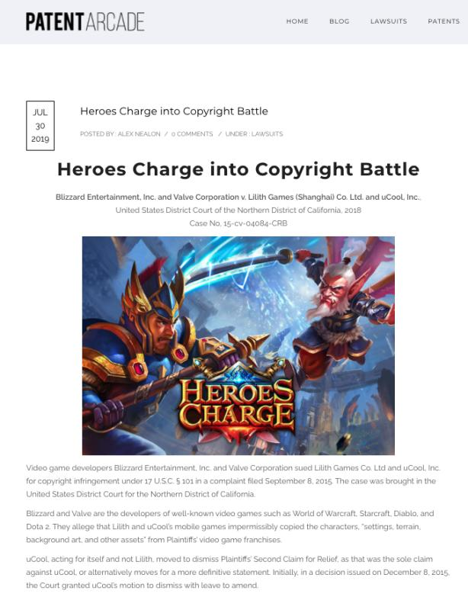

Slide 49
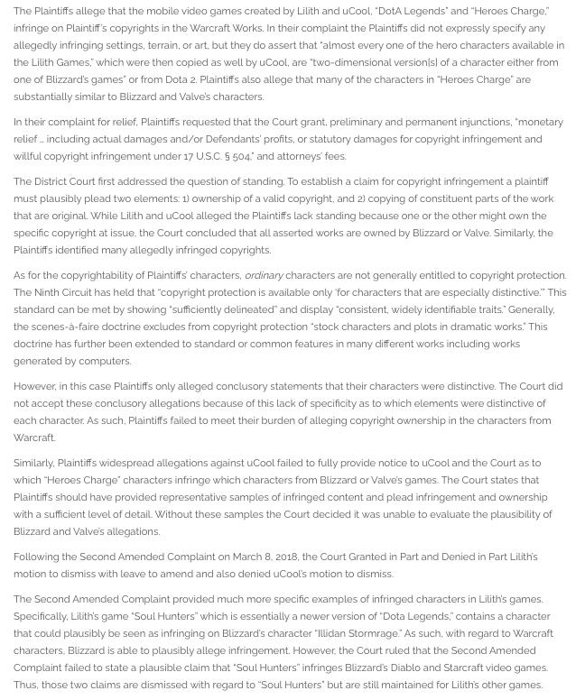

Slide 50
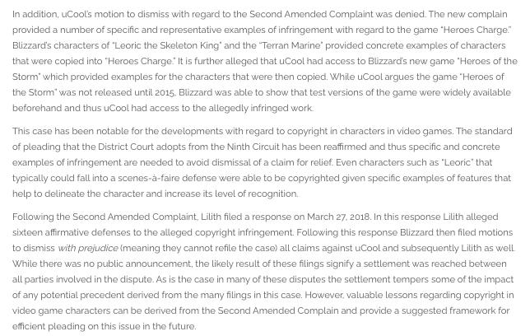
Probably Settled…

Slide 51
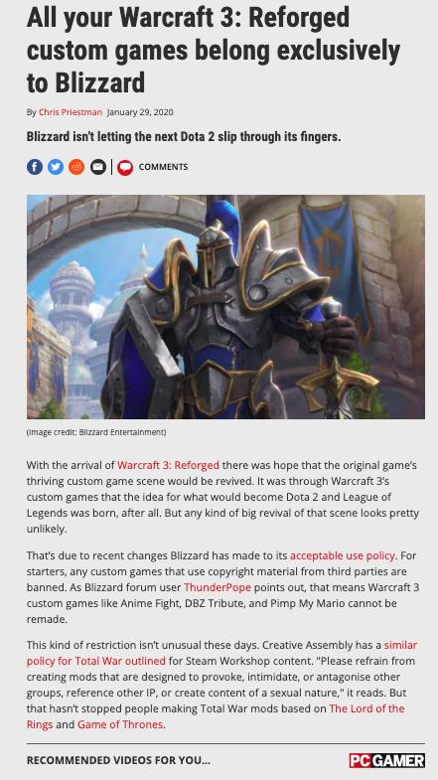

Slide 52
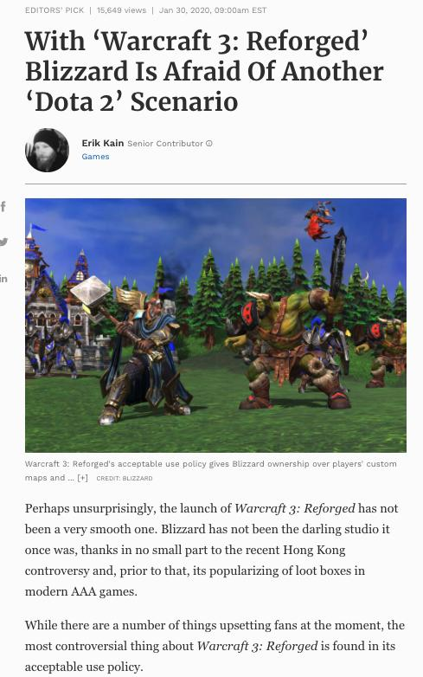

Slide 53

What’s at stake?
Mods
Machinima
Fan Fiction
Re-mix
Multi-source content
3D Printing
& (of course) Freedom to CREatE

Slide 54
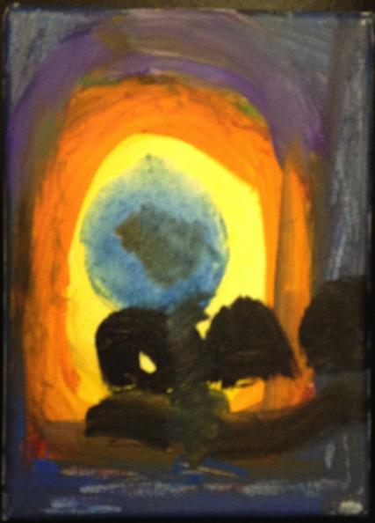
Right to Remix/Mod/CREAtE ?
“Right to CREAtE”
Not “Right in the
Creation”
Right to Remix-CREAtE-Mod as a creative/expressive right rather than an IP right/property protection.

Slide 55
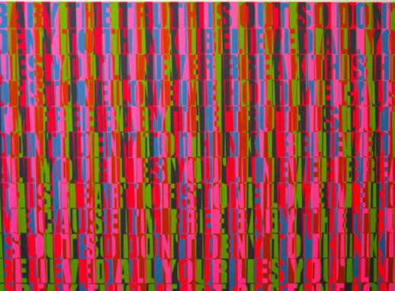
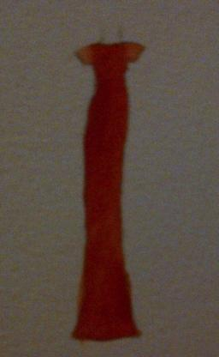
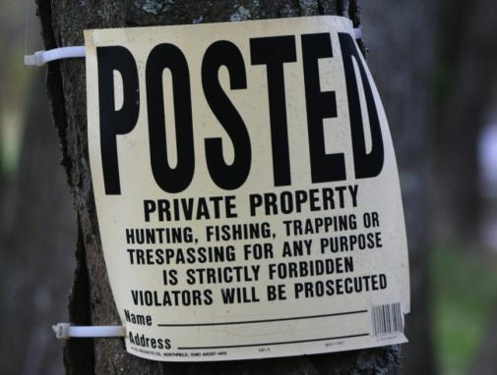
IS Creativity More
Important than Property?

Slide 56


Truth in ‘tone’…
USA 1st Amendment & creativity
Audio of the June 20, 2005 oral argument in 8th Circuit Court of Appeal in Blizzard v. BnetD (Davidson) @ 32:40 – 33:05: “This case does not involve new creation. There may be a case that does. This isn’t it…”
ABOUT MOD_MAKER AS CREATOR
Audio of the November 2, 2010 oral argument in the U.S. Supreme Court in Brown v. Entertainment Merchants Association @ 1:13 - 7:20 + 11:25 - 14:04: “What’s a deviant violent video game?...Some of the Grimm’s Fairy Tales are quite grim…”
ABOUT THE READER AS CREATOR

Slide 57
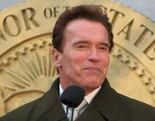
on the impact of ‘Interactivity’
“California claims that video games present special problems because they are “interactive,” in that the player participates in the violent action on screen and determines its outcome. The latter feature is nothing new: Since at least the publication of The Adventures of You: Sugarcane Island in 1969, young readers of choose-your-own-adventure stories have been able to make decisions that determine the plot by following instructions about which page to turn to. As for the argument that video games enable participation in the violent action, that seems to us more a matter of degree than of kind.” (Justice Scalia delivering the opinion of the Court)
Versus
“When all of the characteristics of video games are taken into account, there is certainly a reasonable basis for thinking that the experience of playing a video game may be quite different from the experience of reading a book, listening to a radio broadcast, or viewing a movie. And if this is so, then for at least some minors, the effects of playing violent video games may also be quite different. The Court acts prematurely in dismissing this possibility out of hand.” (Justice Alito, concurring in the result)

Slide 58
IS LAW “AGILE”(enough)?
POSSIBLE
WAYS
FORWARD

Slide 59

Fair Dealing in Canada:
Enter User Rights…
Recent SCC “User” paradigm shifts
USERS ARE CREATORS TOO
August 2012 “Copyright Pentalogy” & previous cases
Moving from fair dealing as an exception to copyright infringement towards proactive “User Rights”
Right to Link (Crookes v. Newton)
Right to longer iTunes previews
Tech Neutrality
Fair dealing is to be assessed from the point of view of the purchaser/user
“Research” need not be associated with traditional intellectual pursuits

Slide 60

SCC Penatalogy...words
Abella J. for the majority in Alberta (Education) v. Canadian Copyright Licensing Agency (Access Copyright) 2012 SCC 37
“…fair dealing is a “user’s right”, and the relevant perspective when considering whether the dealing is for an allowable purpose…is that of the user…”
Abella J. for the Court in Society of Composers, Authors and Music Publishers of Canada v. Bell Canada 2012 SCC 36
“Further, given the ease and magnitude with which digital works are disseminated over the Internet, focusing on the “aggregate” amount of the dealing in cases involving digital works could well lead to disproportionate findings of unfairness when compared with non-digital works.”

Slide 61

Non-commercial user-generated content
(Copyright Act, Canada)
29.21 (1) It is not an infringement of copyright for an individual to use an
existing work or other subject-matter or copy of one, which has been
published or otherwise made available to the public, in the creation of a
new work or other subject-matter in which copyright subsists and for the
individual — or, with the individual’s authorization, a member of their
household — to use the new work or other subject-matter or to authorize an
intermediary to disseminate it, if
(a) the use of, or the authorization to disseminate, the new work or other
subject-matter is done solely for non-commercial purposes;
(b) the source — and, if given in the source, the name of the author, performer,
maker or broadcaster — of the existing work or other subject-matter or copy of
it are mentioned, if it is reasonable in the circumstances to do so;
(c) the individual had reasonable grounds to believe that the existing work or
other subject-matter or copy of it, as the case may be, was not infringing
copyright; and
(d) the use of, or the authorization to disseminate, the new work or other
subject-matter does not have a substantial adverse effect, financial or
otherwise, on the exploitation or potential exploitation of the existing work or
other subject-matter — or copy of it — or on an existing or potential market for
it, including that the new work or other subject-matter is not a substitute for the
existing one.

Slide 62

POSSIBLE WAYS FORWARD
Double Standard Test yields answer?
ETHICAL SOLUTION?: Embedding a “Do Unto Others” algorithm rule-set which permits us to use the digital bits of others if we share ours to the same standard.
Barter not infringement.

Slide 63

Can I Mod
Yet?

Slide 64
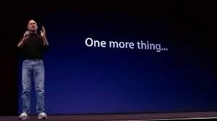

Slide 65
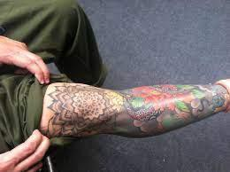

Tattoo's

Slide 66
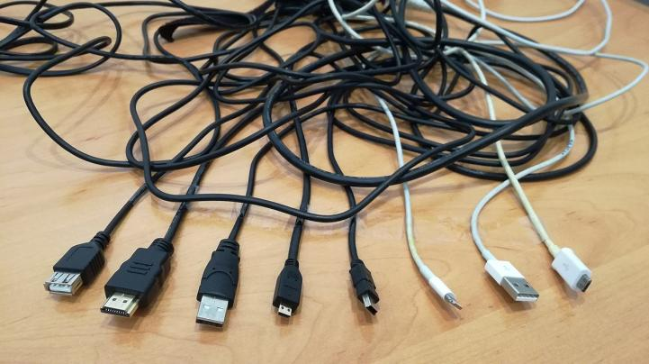
TODAY: beginning of Part B
“Connecting”
(Part C. “Controlling”)

Slide 67
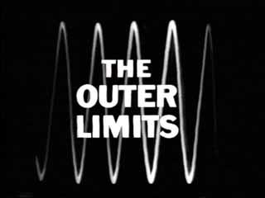
Today…We voyage to the…
Outer limits of the Digital World

Slide 68
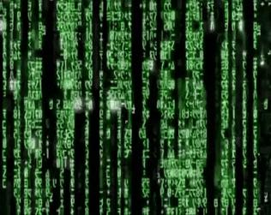
Connecting Ourselves: Gamer Vulnerability in Virtual Realities

Slide 69
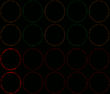
SECTION 1

Slide 70
Virtual Reality 3.0

Slide 71
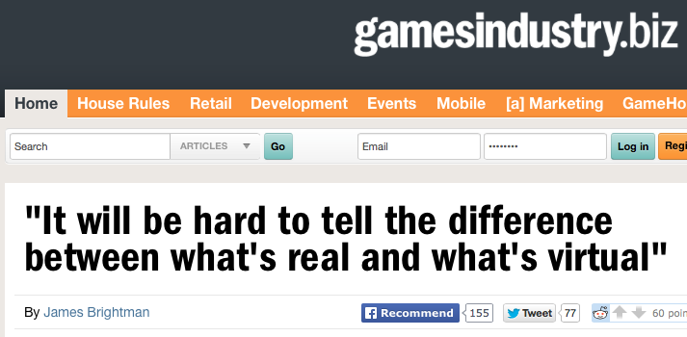
http://www.gamesindustry.biz/articles/2014-12-03-it-will-be-hard-to-tell-the-difference-between-whats-real-and-whats-virtual

Slide 72
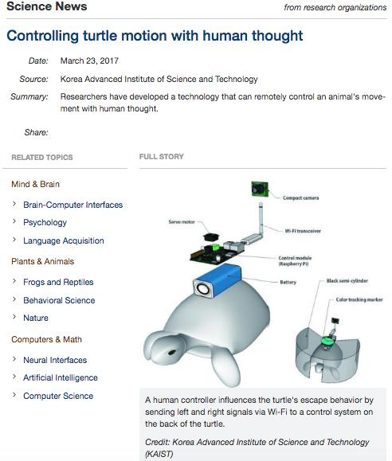

Slide 73
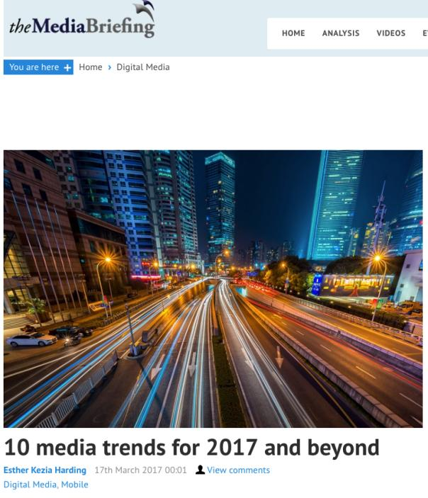
“What the new realities
represent is an entirely new
way to think about advertising.
We always assumed the
screens were the canvas, and
there’s a frame around what
we are doing. But AR and VR
transform all that.”
Tom Goodwin.
EVP Zenith USA

Slide 74
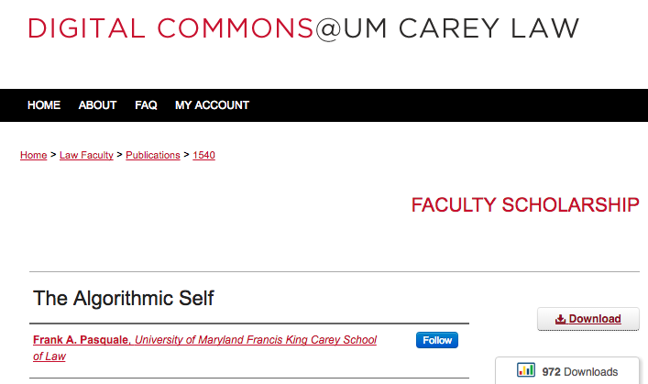
“…there is a delicate balance between appropriating new technologies and being appropriated by them.”

Slide 75

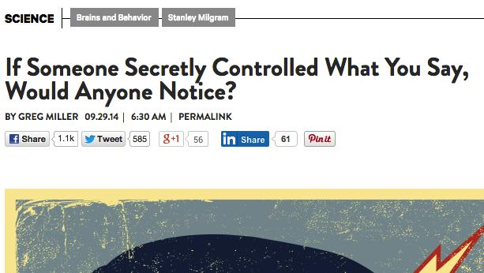
http://www.wired.com/2014/09/cyranoid-experiment/

Slide 76
The Problem: Info-gathering
The Problem: Effecting & Affecting Behaviours
Humans are particularly susceptible to VR
VR & Post-Structuralism
The Law
When should law intervene? At what point do we lose our human agency in Virtual Reality/Alternate Reality?

Slide 77
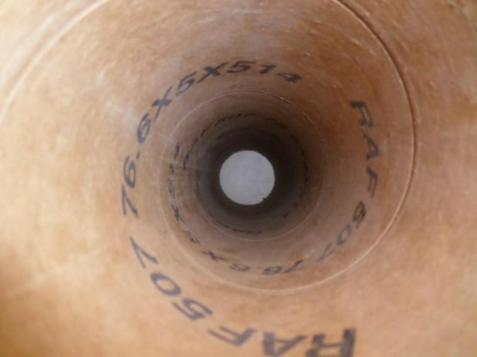
A. THE PROBLEM:
INFO-GATHERING
THERE IS NO ONE WAY TUBE

Slide 78

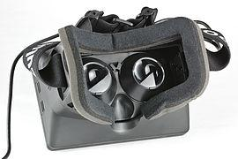


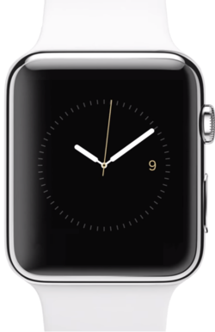
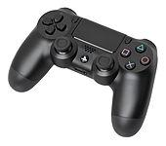
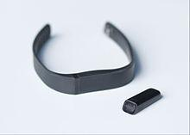
Devices read you.

Slide 79
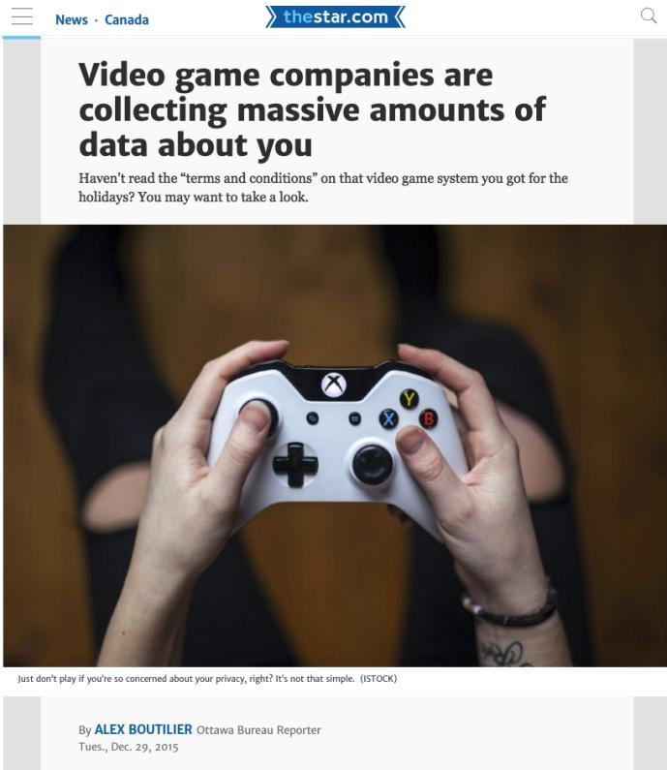

Slide 80

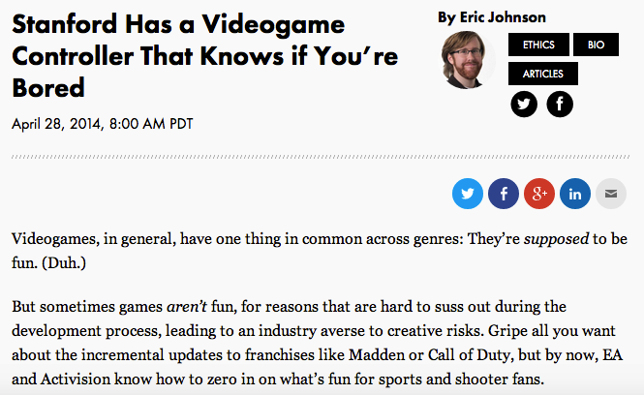
http://recode.net/2014/04/28/stanford-has-a-videogame-controller-that-knows-if-youre-bored/

Slide 81


Slide 82


Slide 83


https://www.newscientist.com/article/mg22730392-700-face-analysis-can-tell-what-youll-buy-after-watching-ads-2/

Slide 84


Slide 85


Slide 86


Slide 87
Trigger warning for slightly gross picture

Slide 88


Slide 89

B. THE PROBLEM: EFFECTING & AFFECTING BEHAVIOURS
Brain-games are becoming ever more pervasive.

Slide 90

Because BIG DATA

Slide 91
Because Artificial Intelligence (A.I.)

Slide 92
Because Machine Learning

Slide 93


Slide 94


Slide 95


Slide 96



Slide 97


Slide 98


Slide 99


Slide 100


Slide 101


http://www.theverge.com/2013/8/27/4664722/researchers-control-a-subjects-body-with-another-persons-brain

Slide 102




Slide 103

http://youtu.be/z8iEogscUl8

Slide 104

http://newsoffice.mit.edu/2013/neuroscientists-plant-false-memories-in-the-brain-0725

Slide 105


Slide 106

& sometimes there are no words other than “sick & evil”…

Slide 107


Slide 108

LOSS OF HUMAN AGENCY

Slide 109

C. Establishing humans are particularly susceptible to VR

Slide 110

1. Humans are the only animals that believe
in things that exist only in our imagination
(e.g. religion, nation-states, money)
http://youtu.be/YZa4sdIwV04

Slide 111

2. Is reality already “Virtual”?
“All the World is a Game”

Slide 112

3. A Really Strange Question
Is this a video game?

Slide 113
“…the process of creating a model of the world using multiple feedback loops in various parameters (e.g., in temperature, space, time, and in relation to others), in order to accomplish a goal (e.g., find mates, food, shelter).”

Slide 114

NO, IT IS YOU
“Consciousness is the process of creating a model of the world using multiple feedback loops in various parameters (e.g., in temperature, space, time, and in relation to others), in order to accomplish a goal (e.g., find mates, food, shelter).”

Slide 115

D. Post-Structuralism & Virtual Reality

Slide 116

Breathe

Slide 117

Post-Structuralism encourages/reinforces/represents the value of human agency, choice & creativity.
Rene Magritte
“Not to be
Reproduced”
1937

Slide 118







Creative freedoms/human agency may have an inverse relationship to the degree of technology (?).
8000 BC
3500 BC
1440 AD
1876 AD
1894 AD
1927 AD
1943 AD

Slide 119


1958
1989

Slide 120

In contrast to…

Slide 121

Technology is (very) Structuralist

Slide 122

Illusion of choice is structure

Slide 123

More Technology →
Less Individual Creative Agency.

Slide 124

Reluctant post-structuralist conclusion…
Overall we lose personal agency
in the virtual world, not gain it.

Slide 125

Virtual Reality is Structuralist (For now? – For always?)

Slide 126

The law should intervene when we substantially lose our
human agency?

Slide 127

Objection

Slide 128

But what about?…

Slide 129

Answer?:
Probably immersion.
Not so much human agency.

Slide 130

E. The Law

Slide 131

Subliminal Advertising

Slide 132
IS PRIVACY A ROBUST ENOUGH LEGAL CONCEPT FOR THESE DEVELOPMENTS?

Slide 133

Two Uncertainties
Defining what a reasonable expectation of privacy is in a Virtual Reality/Alternative Reality situations?
Complications arising because of differences between American & Continental understandings of the purpose of privacy law.

Slide 134

Could VR be considered a drug?
Do we really want to go there?

Slide 135

EC position

Slide 136

Consumer Protection Regulation

Slide 137


Slide 138

Duties of contractual good faith and honest performance

Slide 139
Related legal question:
Might a Platform be a Trustee of certain of your (brain) data with commensurate fiduciary responsibilities given the implied terms of the contract and various assurances given?

Slide 140
Would not selling or abusing your brain data meet this test?
A contractual term could be implied where the “officious bystander test” is met. The “officious bystander test” originates in U.K. law and is formulated as follows:
  “…that which in any contract is left to be implied and need not be expressed is something so obvious that it goes without saying. Thus, if while the parties were making their bargain, an officious bystander were to suggest some express provision for it in their agreement, they would testily suppress him with a common: ‘Oh, of course’.”

Slide 141

“Information Fiduciaries”

Slide 142
Constructive Trust?
Might a court determine that the Platform is a Constructive Trustee of your sensitive data with commensurate fiduciary responsibilities towards you?

Slide 143
Fits???
“A constructive trust is an equitable remedy resembling a trust (implied trust) imposed by a court to benefit a party that has been wrongfully deprived of its rights due to either a person obtaining or holding a legal property right which they should not possess due to unjust enrichment or interference.”

Slide 144

Requires…
Relationship of dependency & reliance.

Slide 145
Objection

Slide 146

Trust must be of…
Property

Slide 147

Is Privacy a “Property Right”?
In the USA it’s very close.

Slide 148
Do Personality Rights constitute a “Property Right”?

Slide 149
Enter “Freedom of Thought” as an interpretive aid
The Canadian Charter of Rights and Freedoms guarantees…
Everyone has the following fundamental freedoms:
(a) freedom of conscience and religion;
(b) freedom of thought, belief, opinion and expression, including freedom of the press and other media of communication;…
7. Everyone has the right to life, liberty and security of the person and the right not to be deprived thereof except in accordance with the principles of fundamental justice.

Slide 150
Universal Declaration of Human Rights
Article 3.
Everyone has the right to life, liberty and security of person.
Article 18.
Everyone has the right to freedom of thought, conscience and religion; this right includes freedom to change his religion or belief, and freedom, either alone or in community with others and in public or private, to manifest his religion or belief in teaching, practice, worship and observance.

Slide 151

Mandatory right to be forgotten for brain data?

Slide 152

F. When do we lose our human agency in Virtual Reality/Alternate Reality?
When is the player controlled, not in control?

Slide 153

Is Criminal Law mens rea the appropriate standard for non-criminal cases?

Slide 154
Human Agency as Freedom of Thought
The law should intervene where data was obtained from an individual without fully informed consent, and that individual’s freedom of thought is impacted causing a substantial risk of harm.
Freedom of thought to be defined in terms of personal autonomy and human dignity, not just to make choices, but to make creative choices on ones own terms creating one’s own meanings [very post-structural].

Slide 155

Cliffhanger to the future…

Slide 156
QUESTIONS?
THOUGHTS?
DISCUSSION?

Slide 157


A MATTER OF PERSPECTIVE

Slide 158


Slide 159
In learning you will teach
And in teaching you will learn
Phil Collins' Son of Man (1999)

Slide 160

Always include a cat picture

Slide 161
Our Academic Partners

