Slide 1
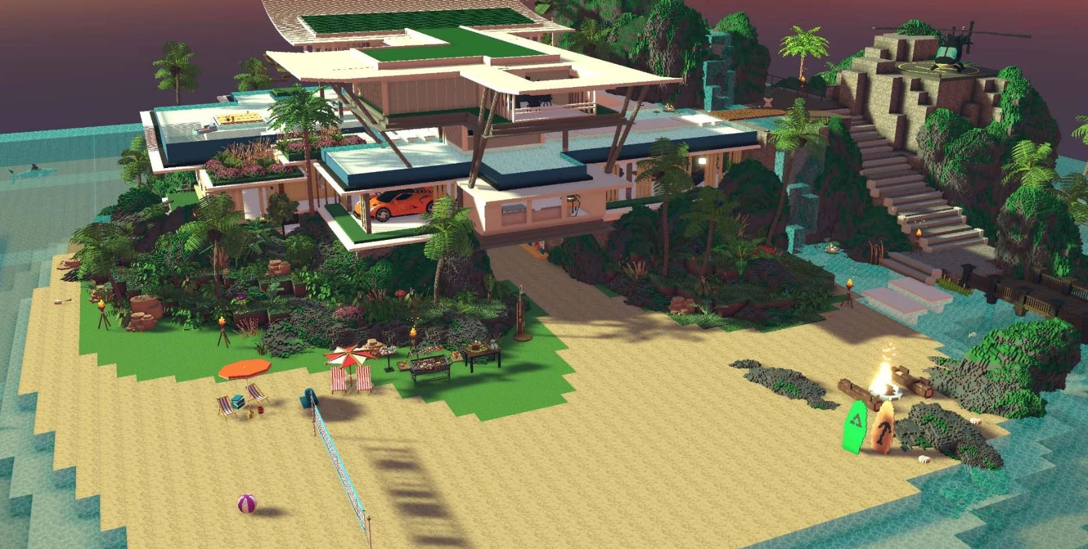
The Metaverse Real Estate Phenomenon: Sifting through Future Regulatory Sandbox

Slide 2
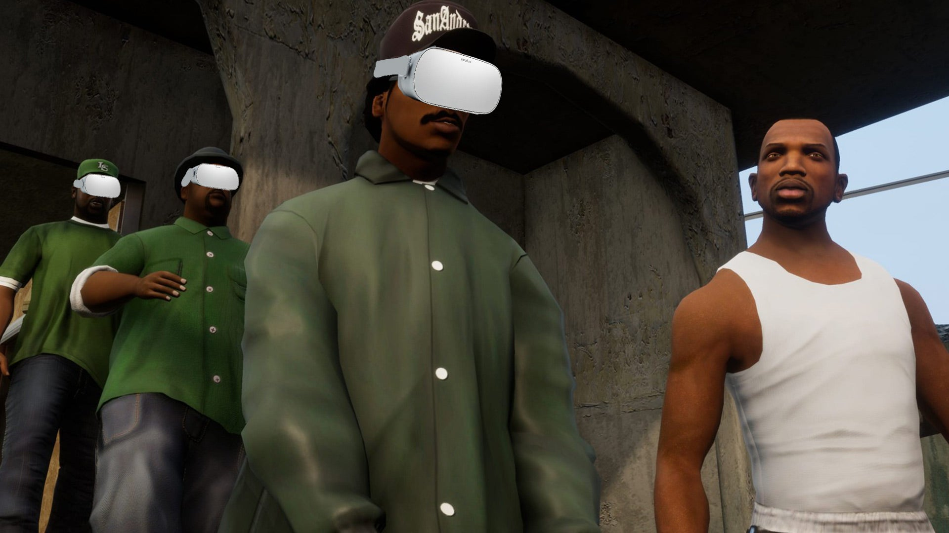

Slide 3
IN A SENSE WE HAVE BEEN HERE BEFORE
In truth, Grand Theft Auto has been metaverse-adjacent for some time now. The game has its own currency, which players compete to earn and then spend on things like virtual properties and cars. While those two things also have their own gameplay implications, the game intends for players to simply live in those spaces as well. Bottles of wine and liquor line shelves, waiting to get player avatars drunk, and there’s always a bong, packed and at the ready to deliver a virtual high.
The world of Grand Theft Auto Online has always been one meant for players to inhabit. While so much of the game’s different facets are centered around gameplay mechanics, others are just for show, for players to say they have as they occupy a space in virtual Los Santos.

Slide 4
Questions regarding Regulation
Should we Regulate?
What areas should we Regulate?
3. How do we go about Regulation?

Slide 5
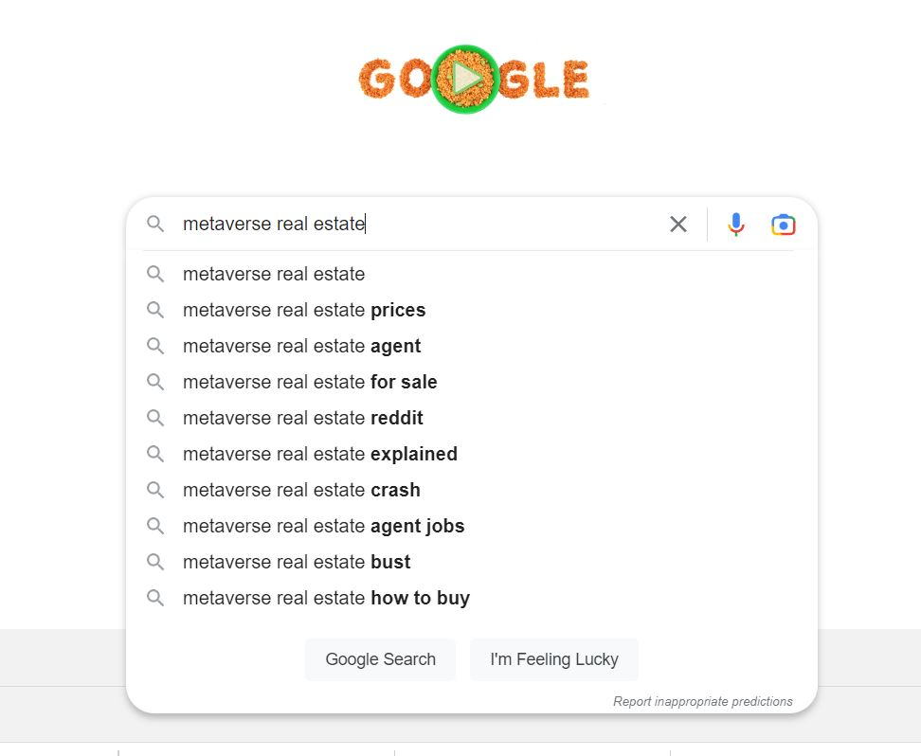

Slide 7
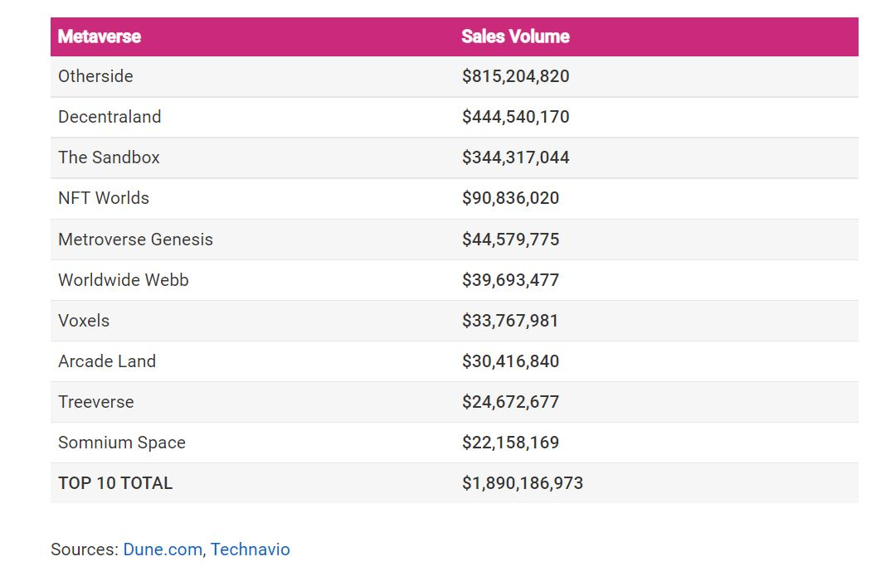

Slide 8
What is the Point?

Slide 11
Personal Conclusion: Slightly Rubbish? Disclaimer: I could be wrong Hence the Presentation..

Slide 13
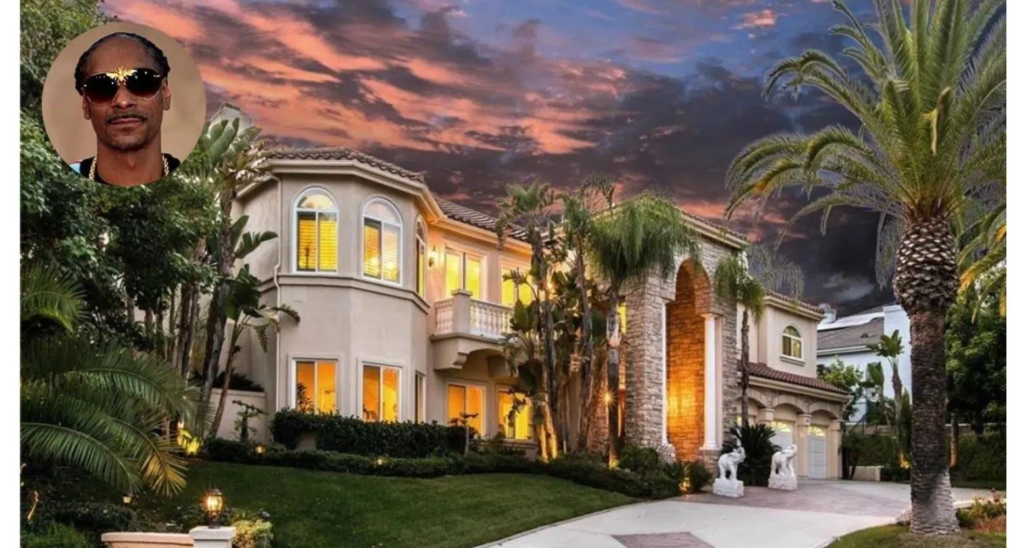

Slide 14
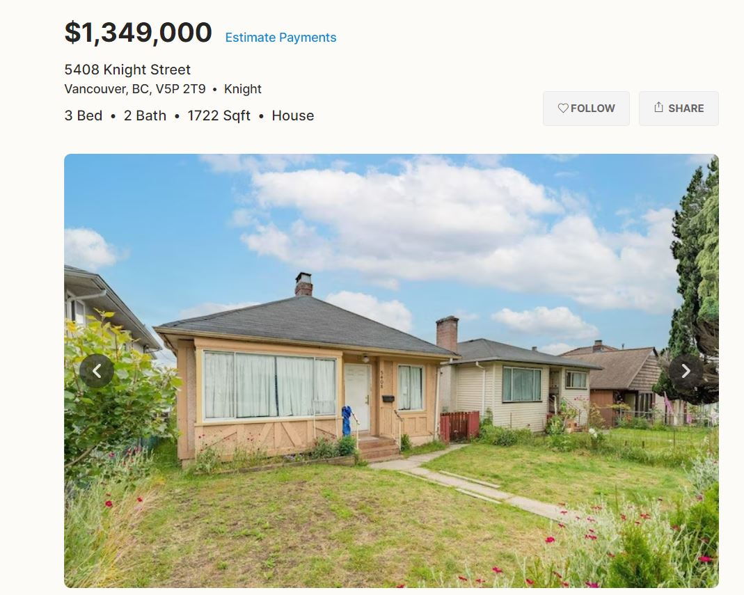

Slide 15
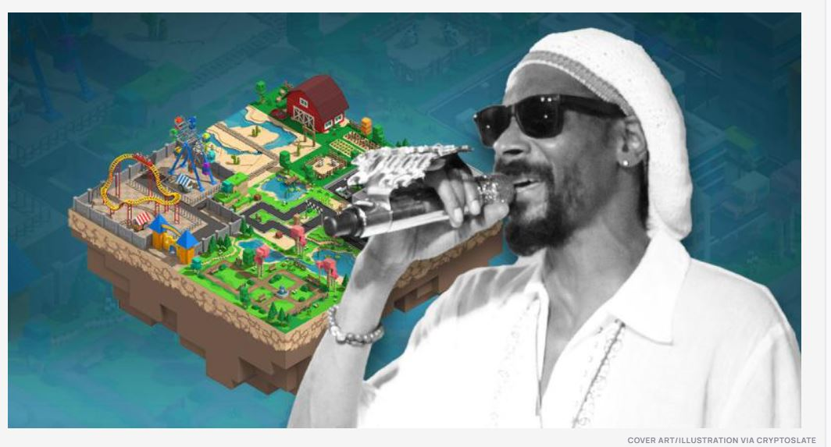

Slide 16
 | Traditional Real Estate | Metaverse Real Estate
Proof of Ownership | Land Title Office | Digital Ledger of NFT stored in crypto wallet
Identifying Property | Land Survey | NFT Coordinates
Owner Property Rights | Buy, sell (in whole or in part) or rent | Buy, sell (in whole or in part) or rent
Platform for Commerce | Multiple Listing Service (MLS) | Primary and Secondary marketplaces (e.g. OpenSea or Rarible)
Method of Purchase | Cash or Mortgage | Cryptocurrency or metaverse mortgage
Total Listings | 11,134 (Canada) | 622,000 parcels of land (top 10 largest virtual worlds)
Price Determinants
Key Legislation | Land Property Act (BC) | None – Platforms themselves

Slide 17
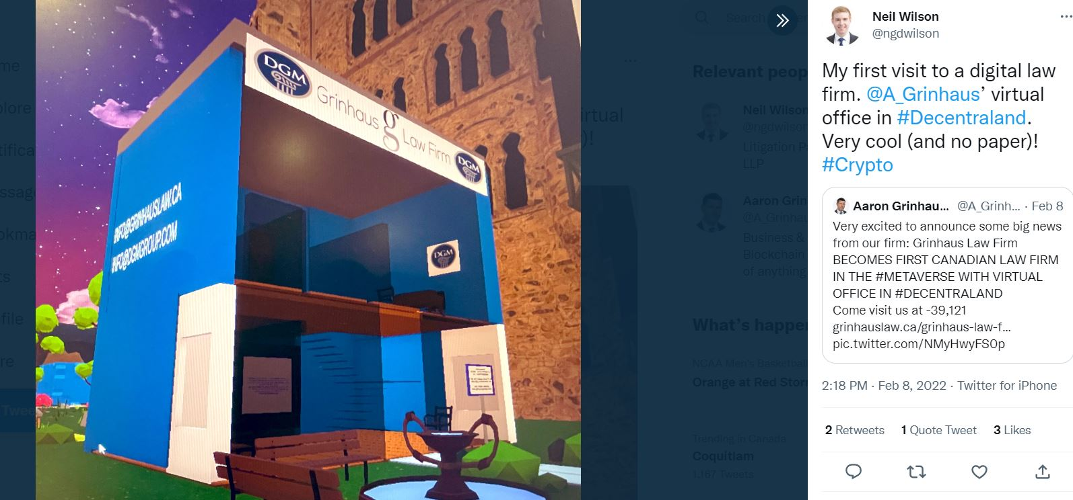
First Canadian Law firm in the Metaverse

Slide 18
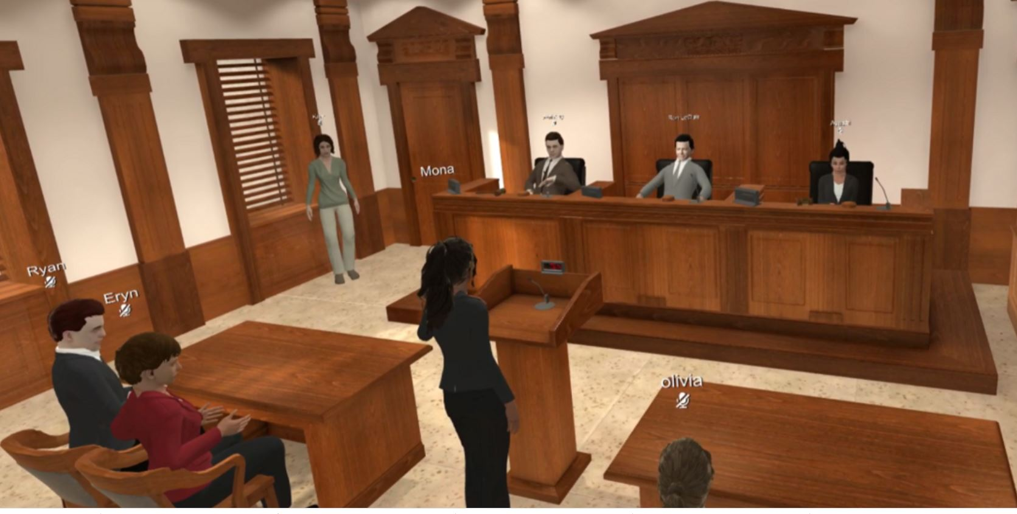
Discussions of Future Courthouses

Slide 19
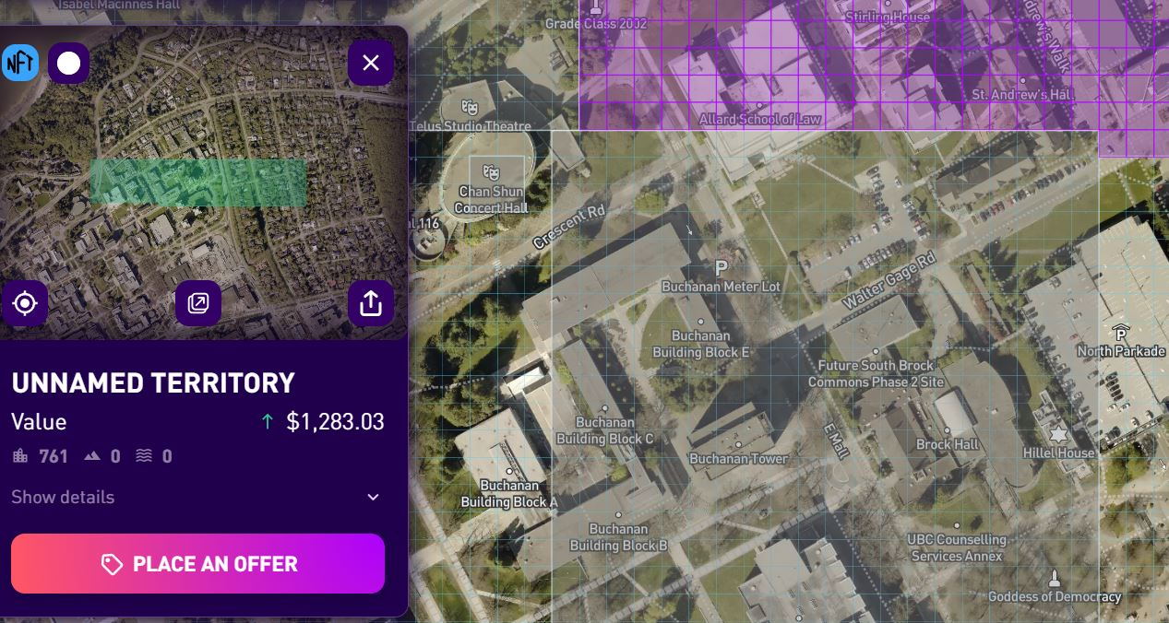
Purchase of “replica” Properties

Slide 20
Possible Regulatory Issues:
1. Can the developer legally dilute the value of my land by creating additional land making my property less scarce and therefore less valuable?
2. Can some just steal your property, your house and everything in it? 3. Can someone sell you a fake house (contracts)? 4. Can someone copy another person's house and infringe copyright law? (IP law)? 5. Can you discriminate against someone coming onto your property (human rights law)? 6. Can you evict a tenant because someone is willing to pay more rent (LTA law)? 7. Who can sell real estate? 8. Can it be taxed? 9. Will it be subject to bylaws, municipal taxes and so forth..?

Slide 21
Potential Lawyer Issues
Issues on Jurisdiction
Decentralize Autonomous Organizations
Determining Identity
Jurisdiction of controlling minds in Organization?
issue of interoperability of different servers/metaverses which may engage multiple end user agreements
3. Ethical Issues on Practice: Competence, Confidentiality and Trust Funds
4. IP Law v. EULA

Slide 22
Over to you..
Thoughts on regulation?
Any specific area of regulation you find particularly pressing?
Do you think metaverse and subsequent purchase of real estate in the space will be a bust?
Would you start a law firm in the metaverse? Pros and Cons?

